Slide 1
0
9
The Cell Cycle

Slide 2
Overview: The Key Roles of Cell Division
The ability of organisms to produce more of their own kind best distinguishes living things from nonliving matter
The continuity of life is based on the reproduction of cells, or cell division
Notes:
2

Slide 3
In unicellular organisms, division of one cell reproduces the entire organism
Cell division enables multicellular eukaryotes to develop from a single cell and, once fully grown, to renew, repair, or replace cells as needed
Cell division is an integral part of the cell cycle, the life of a cell from its formation to its own division
Notes:
3

Slide 4
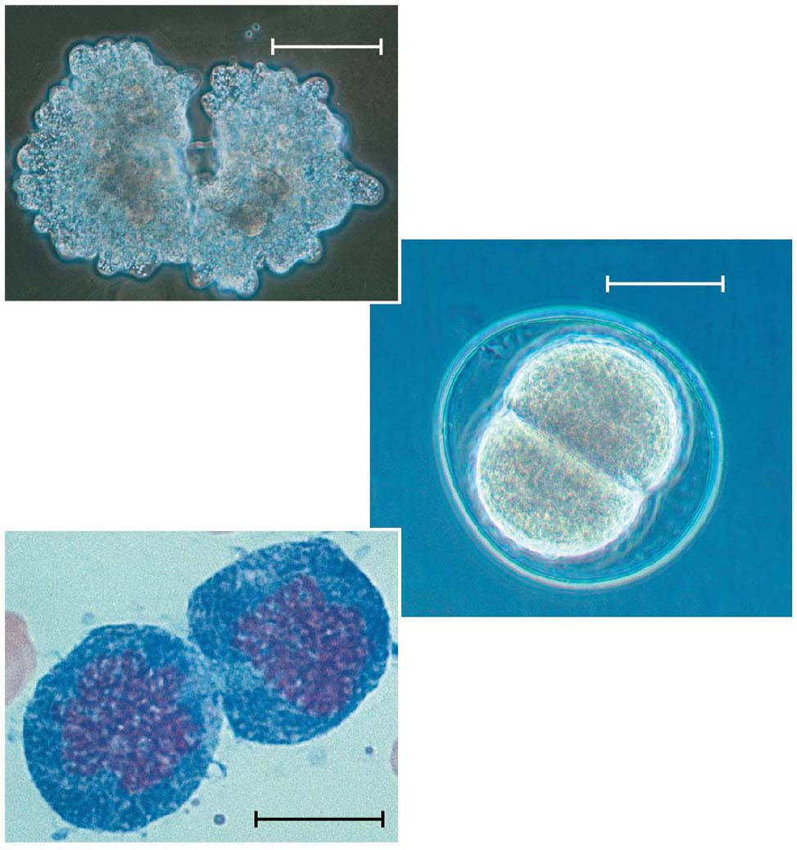
Figure 9.2
100 μm
(a) Reproduction
50 μm
(b) Growth and development
20 μm
(c) Tissue renewal
Notes:
Figure 9.2 The functions of cell division

Slide 5
Concept 9.1: Most cell division results in genetically identical daughter cells
Most cell division results in the distribution of identical genetic material—DNA—to two daughter cells
DNA is passed from one generation of cells to the next with remarkable fidelity
Notes:
5

Slide 6
Cellular Organization of the Genetic Material
All the DNA in a cell constitutes the cell’s genome
A genome can consist of a single DNA molecule (common in prokaryotic cells) or a number of DNA molecules (common in eukaryotic cells)
DNA molecules in a cell are packaged into chromosomes
Notes:
6

Slide 7
Eukaryotic chromosomes consist of chromatin, a complex of DNA and protein
Every eukaryotic species has a characteristic number of chromosomes in each cell nucleus
Somatic cells (nonreproductive cells) have two sets of chromosomes
Gametes (reproductive cells: sperm and eggs) have one set of chromosomes
Notes:
7

Slide 8
Distribution of Chromosomes During Eukaryotic Cell Division
In preparation for cell division, DNA is replicated and the chromosomes condense
Each duplicated chromosome has two sister chromatids, joined identical copies of the original chromosome
The centromere is where the two chromatids are most closely attached
Notes:
8

Slide 9
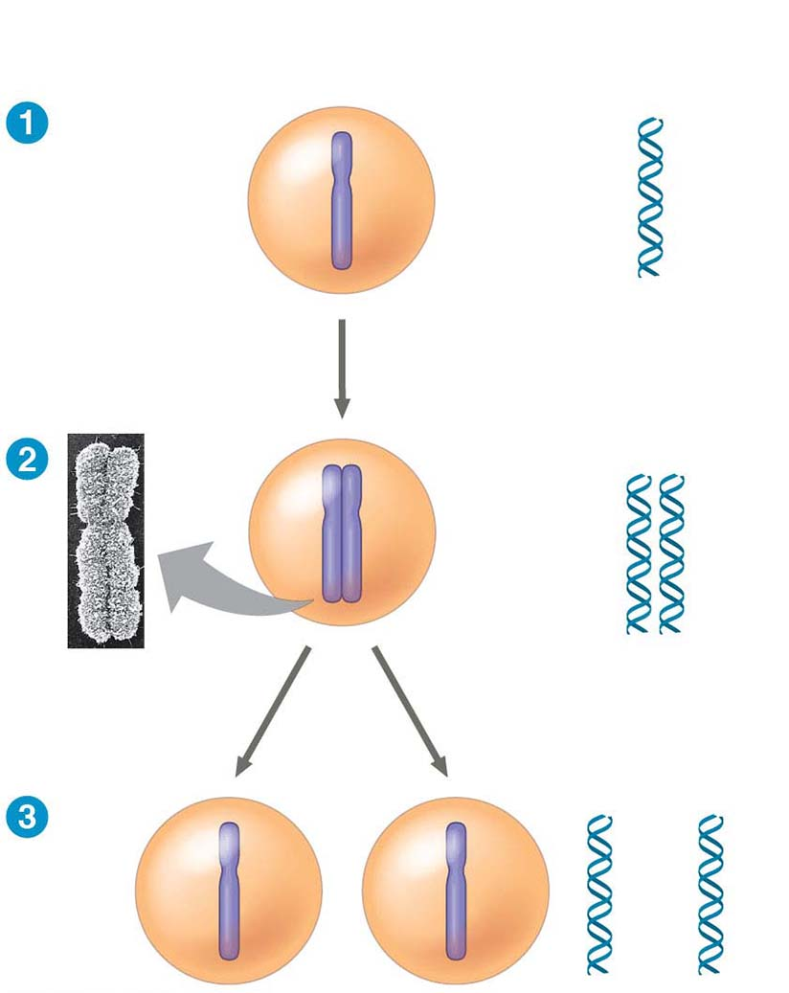
Figure 9.5-s3
Chromosomal
Chromosomes
DNA molecules
Centromere
Chromosome
arm
Chromosome duplication
Sister
chromatids
Separation of sister
chromatids
Notes:
Figure 9.5-s3 Chromosome duplication and distribution during cell division (step 3)

Slide 10
Eukaryotic cell division consists of
Mitosis, the division of the genetic material in the nucleus
Cytokinesis, the division of the cytoplasm
Gametes are produced by a variation of cell division called meiosis
Meiosis yields nonidentical daughter cells that have only one set of chromosomes, half as many as the parent cell
Notes:
10

Slide 11
Concept 9.2: The mitotic phase alternates with interphase in the cell cycle
In 1882, the German anatomist Walther Flemming developed dyes to observe chromosomes during mitosis and cytokinesis
Notes:
11

Slide 12
Phases of the Cell Cycle
The cell cycle consists of
Mitotic (M) phase, including mitosis and cytokinesis
Interphase, including cell growth and copying of chromosomes in preparation for cell division
Notes:
12

Slide 13
Interphase (about 90% of the cell cycle) can be divided into subphases
G₁ phase (“first gap”)
S phase (“synthesis”)
G₂ phase (“second gap”)
The cell grows during all three phases, but chromosomes are duplicated only during the S phase
Notes:
13

Slide 14
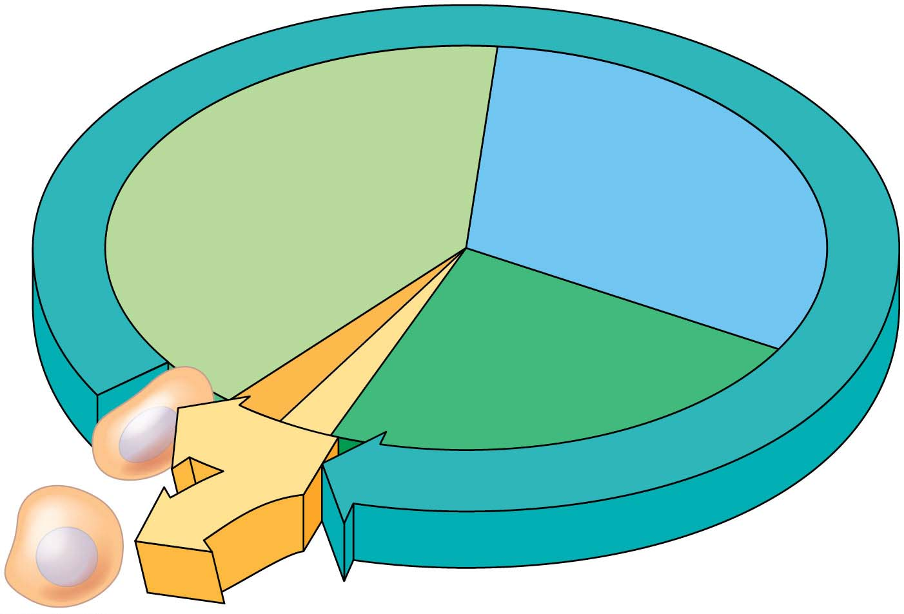
Figure 9.6
I
N
T
E
R
PHASE
S
G₁
(DNA synthesis)
Cytokinesis
G₂
Mitosis
MIT
(M)
OTIC
PHA
SE
Notes:
Figure 9.6 The cell cycle

Slide 15
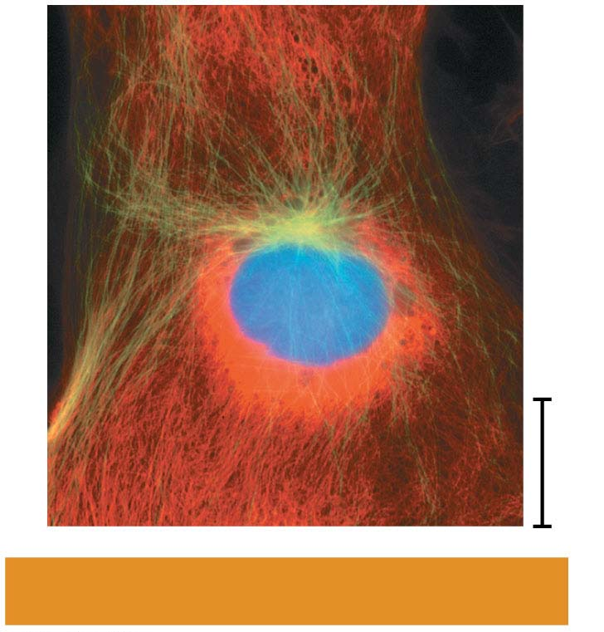
Figure 9.7-6
10 μm
G₂ of Interphase
Notes:
Figure 9.7-6 Exploring mitosis in an animal cell (part 6: G₂ of interphase micrograph)

Slide 16
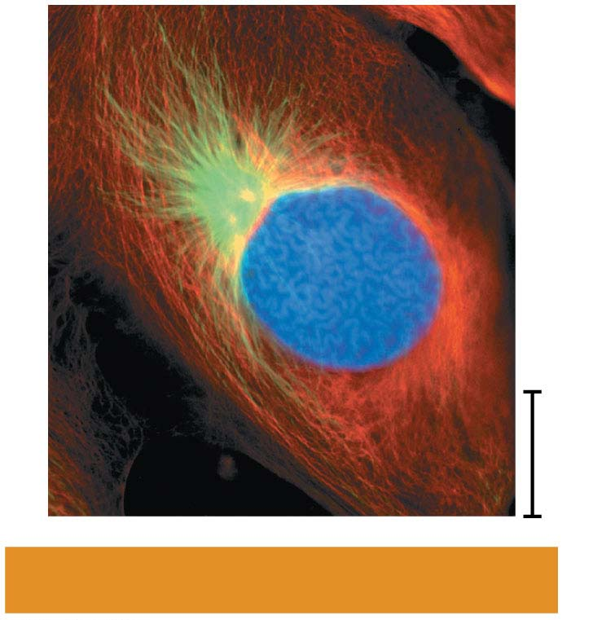
Figure 9.7-7
10 μm
Prophase
Notes:
Figure 9.7-7 Exploring mitosis in an animal cell (part 7: prophase micrograph)

Slide 17
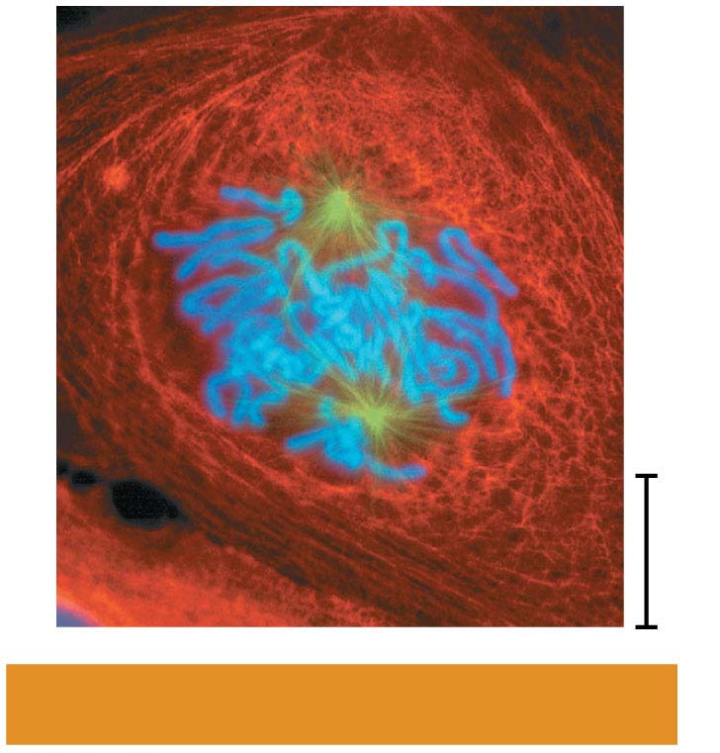
Figure 9.7-8
10 μm
Prometaphase
Notes:
Figure 9.7-8 Exploring mitosis in an animal cell (part 8: prometaphase micrograph)

Slide 18
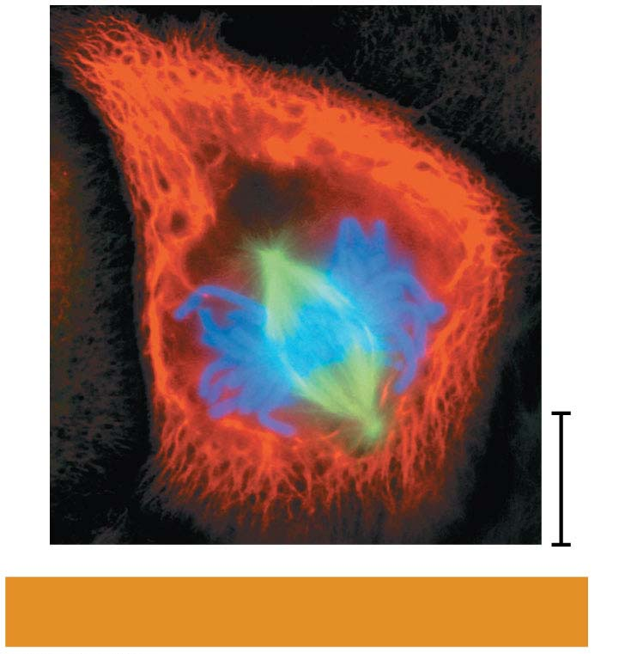
Figure 9.7-9
10 μm
Metaphase
Notes:
Figure 9.7-9 Exploring mitosis in an animal cell (part 9: metaphase micrograph)

Slide 19
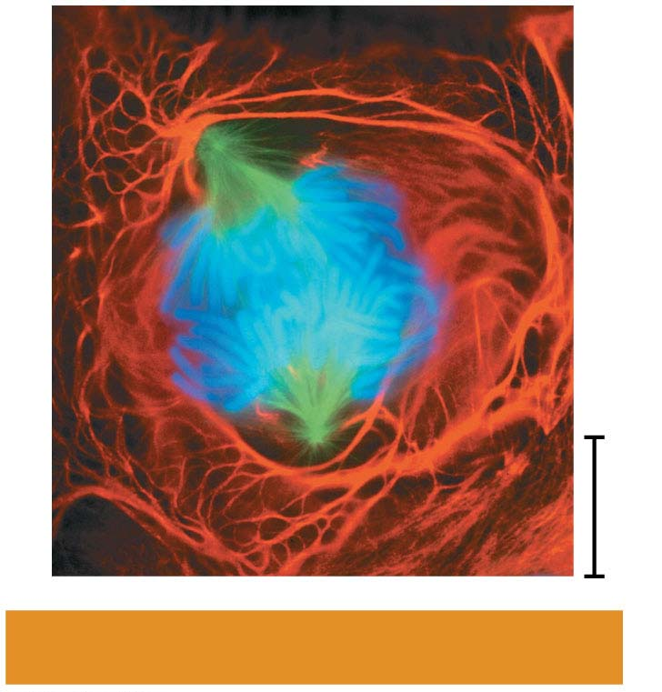
Figure 9.7-10
10 μm
Anaphase
Notes:
Figure 9.7-10 Exploring mitosis in an animal cell (part 10: anaphase micrograph)

Slide 20
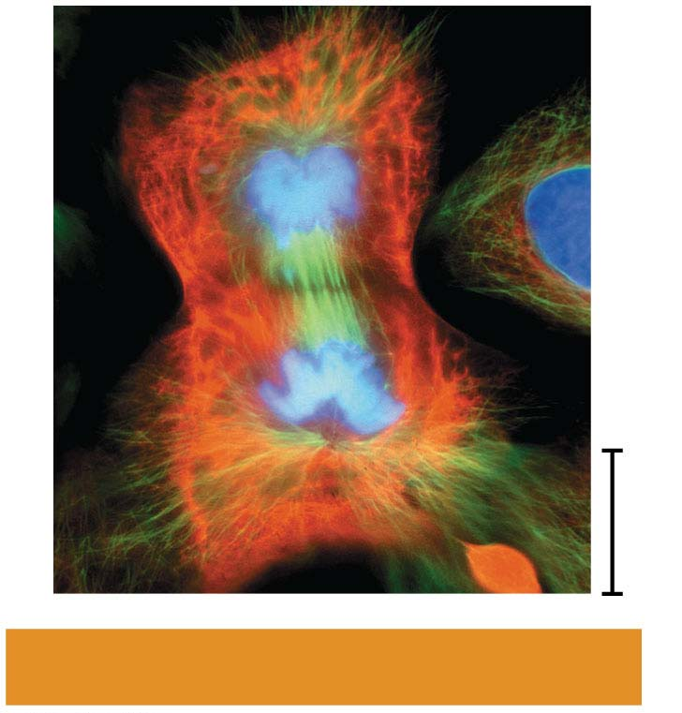
Figure 9.7-11
10 μm
Telophase and Cytokinesis
Notes:
Figure 9.7-11 Exploring mitosis in an animal cell (part 11: telophase and cytokinesis micrograph)

Slide 21
The Mitotic Spindle: A Closer Look
The mitotic spindle is a structure made of microtubules and associated proteins
It controls chromosome movement during mitosis
In animal cells, assembly of spindle microtubules begins in the centrosome, a type of microtubule organizing center
Notes:
21

Slide 22
The centrosome replicates during interphase, forming two centrosomes that migrate to opposite ends of the cell during prophase and prometaphase
An aster (radial array of short microtubules) extends from each centrosome
The spindle includes the centrosomes, the spindle microtubules, and the asters
Notes:
22

Slide 23
During prometaphase, some spindle microtubules attach to the kinetochores of chromosomes and begin to move the chromosomes
Kinetochores are protein complexes that assemble on sections of DNA at centromeres
At metaphase, the centromeres of all the chromosomes are at the metaphase plate, an imaginary structure at the midway point between the spindle’s two poles
Notes:
23

Slide 24
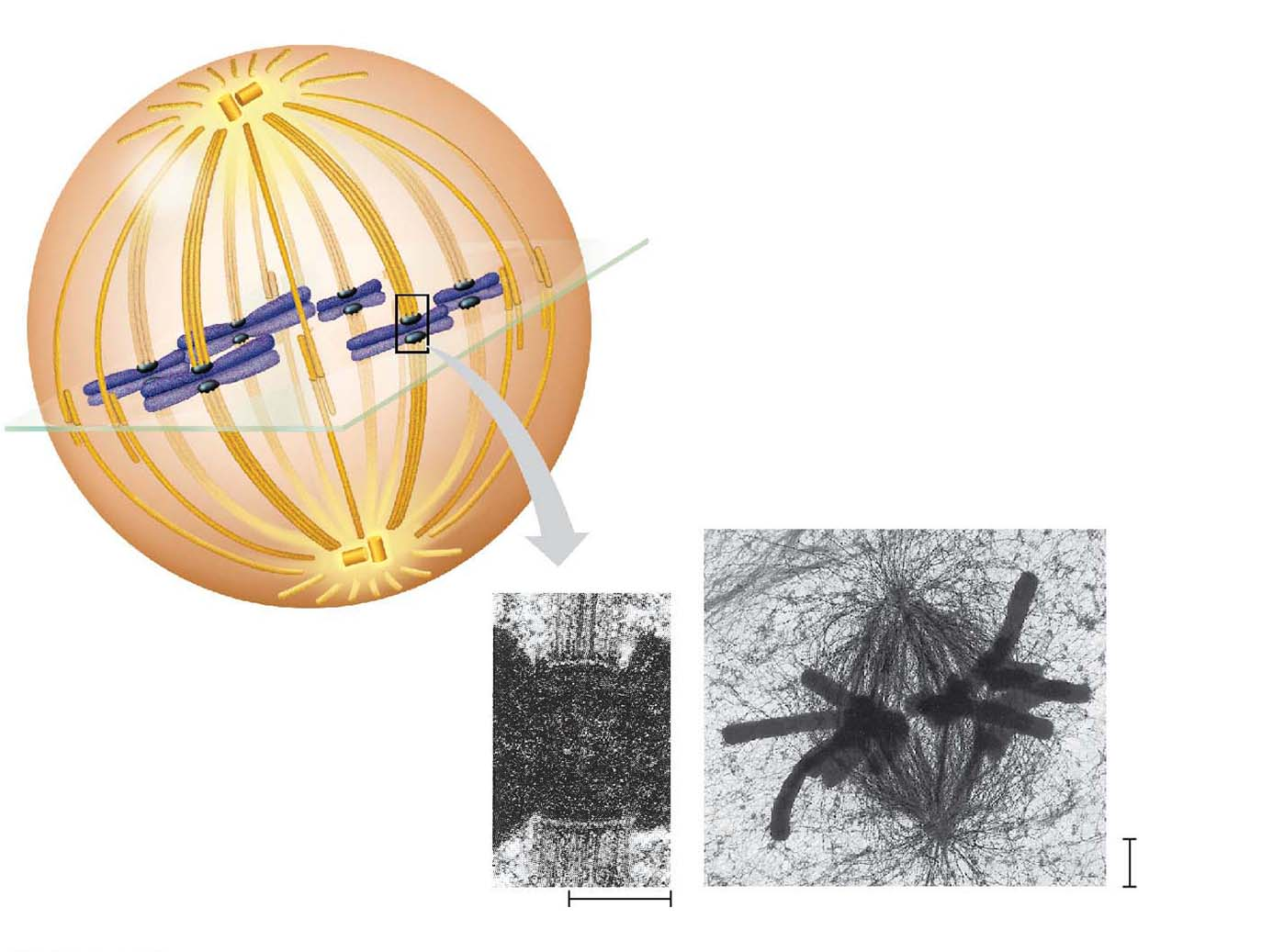
Figure 9.8
Aster
Sister
chromatids
Centrosome
Metaphase plate
(imaginary)
Kineto-
chores
Microtubules
Chromosomes
Overlapping
nonkinetochore
microtubules
Kinetochore
microtubules
1 μm
0.5 μm
Centrosome
Notes:
Figure 9.8 The mitotic spindle at metaphase

Slide 25
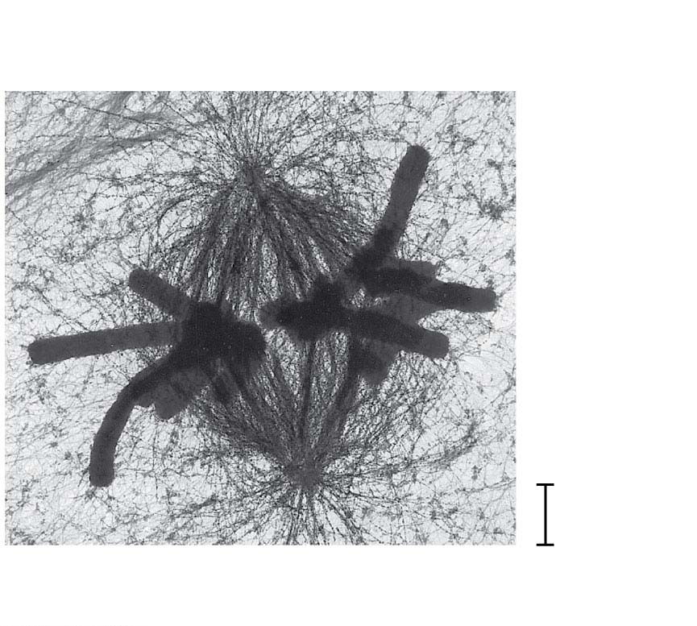
Figure 9.8-1
Microtubules
Chromosomes
1 μm
Centrosome
Notes:
Figure 9.8-1 The mitotic spindle at metaphase (part 1: TEM)

Slide 26
Figure 9.8-2
Kinetochores
Kinetochore
microtubules
0.5 μm
Notes:
Figure 9.8-2 The mitotic spindle at metaphase (part 2: kinetochore TEM)

Slide 27
In anaphase, sister chromatids separate and move along the kinetochore microtubules toward opposite ends of the cell
The microtubules shorten by depolymerizing at their kinetochore ends
Chromosomes are also “reeled in” by motor proteins at spindle poles, and microtubules depolymerize after they pass by the motor proteins
Notes:
27

Slide 28
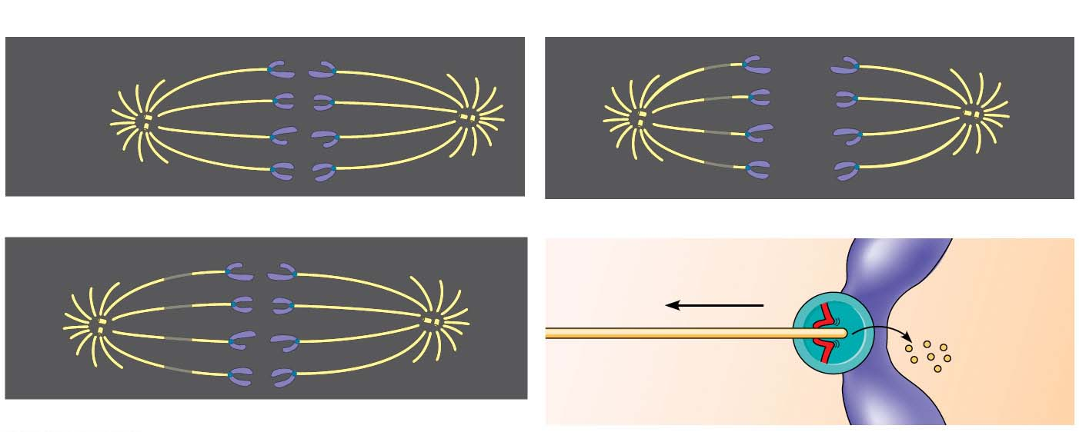
Figure 9.9
Experiment
Results
Kinetochore
Spindle
pole
Conclusion
Mark
Chromosome
movement
Kinetochore
Motor
protein
Tubulin
subunits
Microtubule
Chromosome
Notes:
Figure 9.9 Inquiry: At which end do kinetochore microtubules shorten during anaphase?

Slide 29
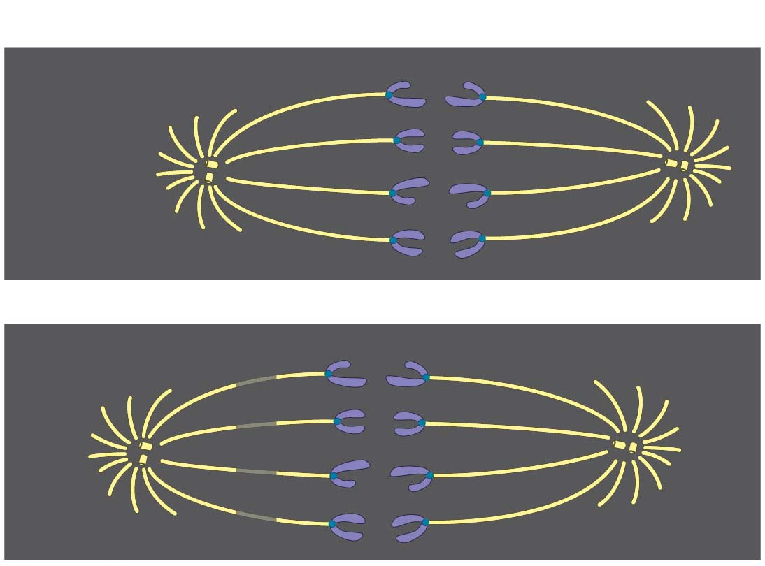
Figure 9.9-1
Experiment
Kinetochore
Spindle
pole
Mark
Notes:
Figure 9.9-1 Inquiry: At which end do kinetochore microtubules shorten during anaphase? (part 1: experiment)

Slide 30
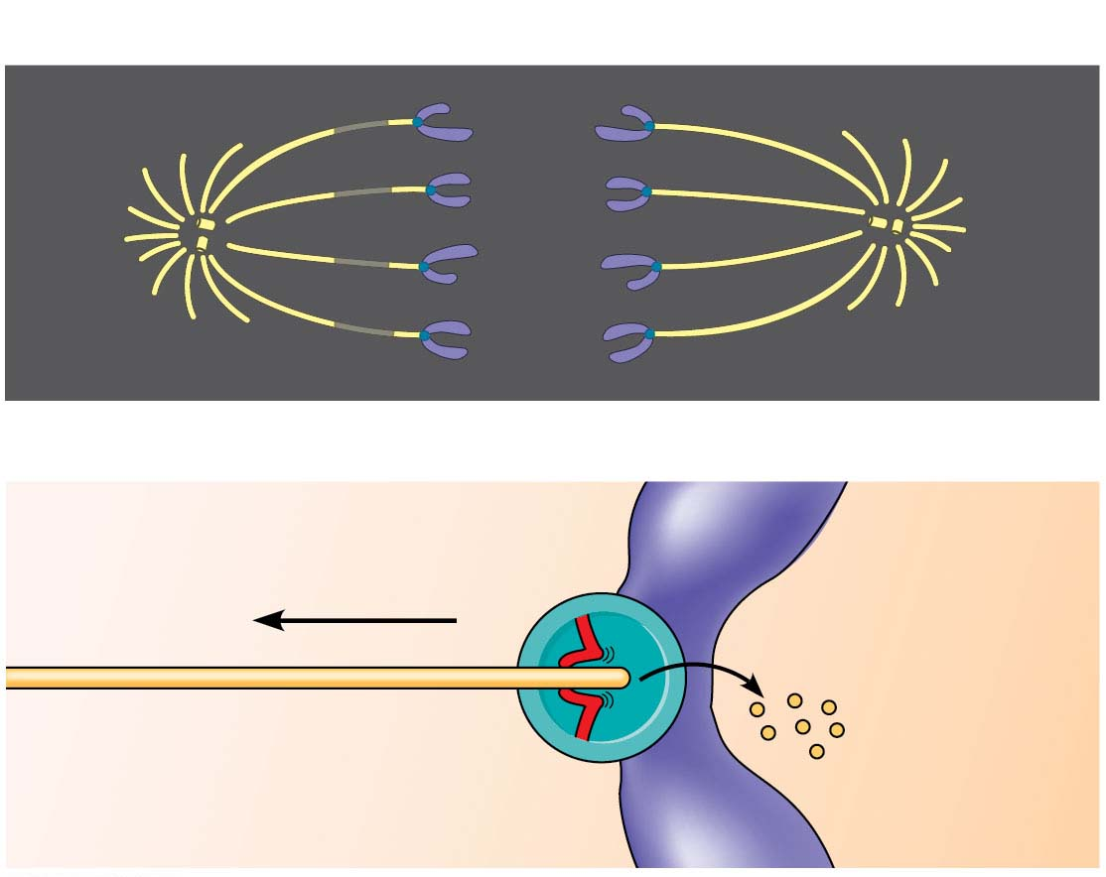
Figure 9.9-2
Results
Conclusion
Chromosome
movement
Kinetochore
Motor
protein
Tubulin
subunits
Microtubule
Chromosome
Notes:
Figure 9.9-2 Inquiry: At which end do kinetochore microtubules shorten during anaphase? (part 2: results and conclusion)

Slide 31
Nonkinetochore microtubules from opposite poles overlap and push against each other, elongating the cell
At the end of anaphase, duplicate groups of chromosomes have arrived at opposite ends of the elongated parent cell
Cytokinesis begins during anaphase or telophase, and the spindle eventually disassembles
Notes:
31

Slide 32
Binary Fission in Bacteria
Prokaryotes (bacteria and archaea) reproduce by a type of cell division called binary fission
In E. coli, the single chromosome replicates, beginning at the origin of replication
The two daughter chromosomes actively move apart while the cell elongates
The plasma membrane pinches inward, dividing the cell into two
Notes:
32

Slide 33
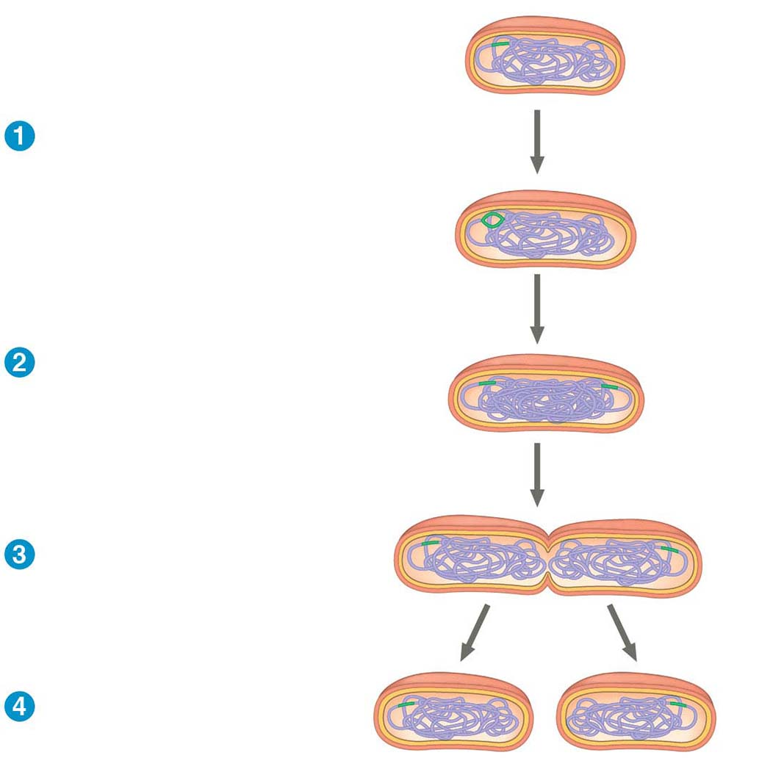
Figure 9.12-s4
Origin of
replication
Cell wall
Plasma
membrane
E. coli cell
Chromosome
replication begins.
Bacterial
chromosome
Two copies
of origin
One copy of the origin
is now at each end of
the cell.
Origin
Origin
Replication finishes.
Two daughter
cells result.
Notes:
Figure 9.12-s4 Bacterial cell division by binary fission (step 4)

Slide 34
The Evolution of Mitosis
Since prokaryotes evolved before eukaryotes, mitosis probably evolved from binary fission
Certain protists (dinoflagellates, diatoms, and some yeasts) exhibit types of cell division that seem intermediate between binary fission and mitosis
Notes:
34

Slide 35
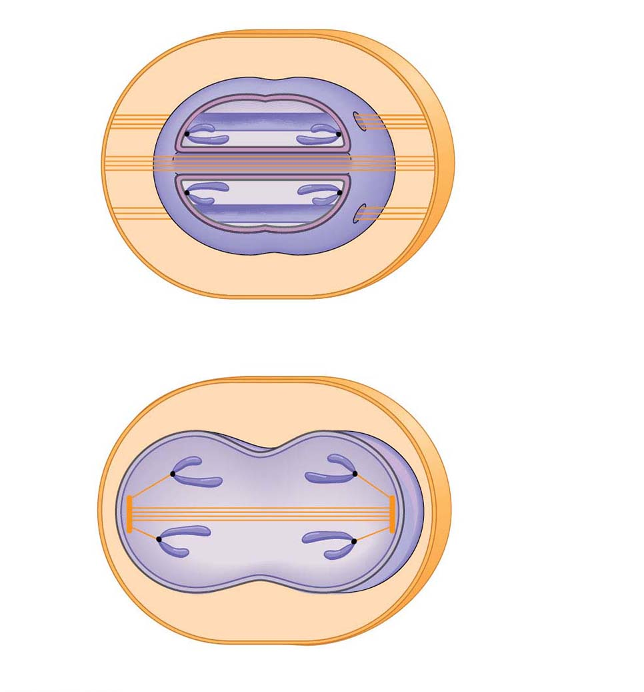
Figure 9.13
Chromosomes
Microtubules
Intact nuclear
envelope
(a) Dinoflagellates
Kinetochore
microtubule
Intact nuclear
envelope
(b) Diatoms and some yeasts
Notes:
Figure 9.13 Mechanisms of cell division

Slide 36
Concept 9.3: The eukaryotic cell cycle is regulated by a molecular control system
The frequency of cell division varies with the type of cell
These differences result from regulation at the molecular level
Cancer cells manage to escape the usual controls on the cell cycle
Notes:
36

Slide 37
Evidence for Cytoplasmic Signals
The cell cycle is driven by specific signaling molecules present in the cytoplasm
Some evidence for this hypothesis comes from experiments with cultured mammalian cells
Cells at different phases of the cell cycle were fused to form a single cell with two nuclei at different stages
Cytoplasmic signals from one of the cells could cause the nucleus from the second cell to enter the “wrong” stage of the cell cycle
Notes:
37

Slide 38
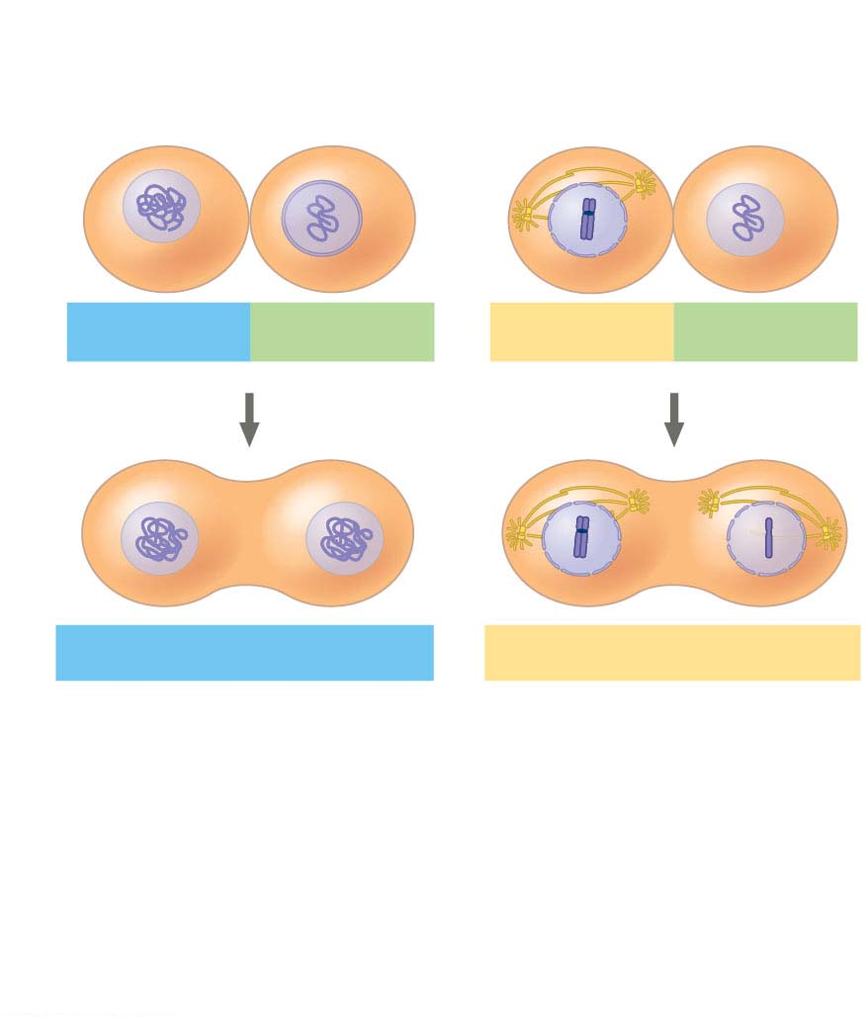
Figure 9.14
Experiment
Experiment 1
Experiment 2
S
G₁
M
G₁
Results
S
S
M
M
G₁ nucleus
immediately
entered S phase
and DNA was
synthesized.
G₁ nucleus began
mitosis without
chromosome
duplication.
Conclusion Molecules present in the cytoplasm
control the progression to S and M phases.
Notes:
Figure 9.14 Inquiry: Do molecular signals in the cytoplasm regulate the cell cycle?

Slide 39
Checkpoints of the Cell Cycle Control System
The sequential events of the cell cycle are directed by a distinct cell cycle control system, which is similar to a timing device of a washing machine
The cell cycle control system is regulated by both internal and external controls
The clock has specific checkpoints where the cell cycle stops until a go-ahead signal is received
Notes:
39

Slide 40
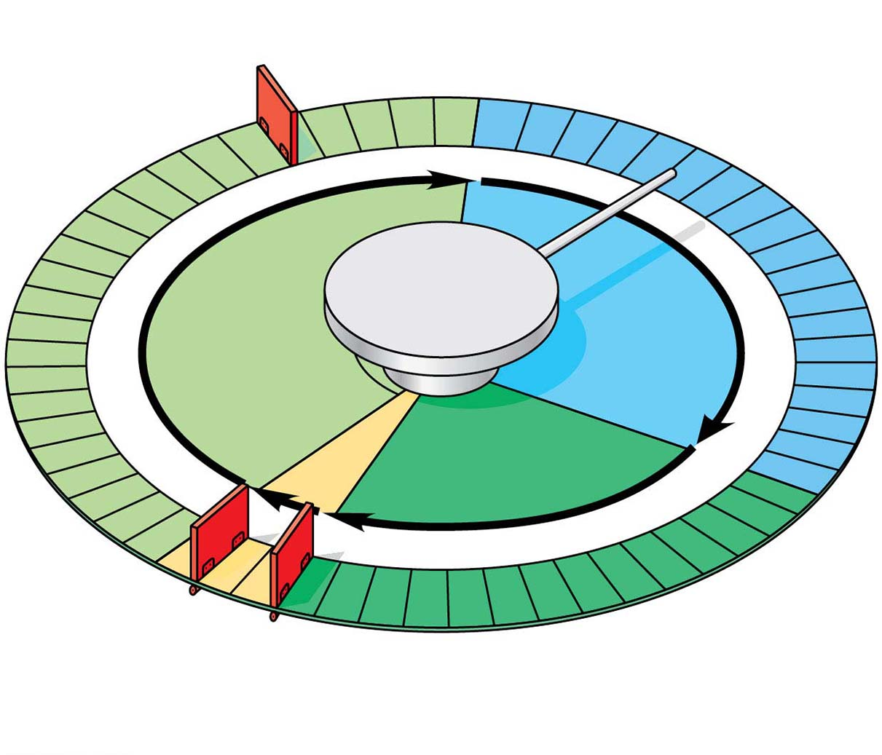
Figure 9.15
G₁ checkpoint
Control
system
S
G₁
M
G₂
M checkpoint
G₂ checkpoint
Notes:
Figure 9.15 Mechanical analogy for the cell cycle control system

Slide 41
For many cells, the G₁ checkpoint seems to be the most important
If a cell receives a go-ahead signal at the G₁ checkpoint, it will usually complete the S, G₂, and M phases and divide
If the cell does not receive the go-ahead signal, it will exit the cycle, switching into a nondividing state called the G₀ phase
Notes:
41

Slide 42
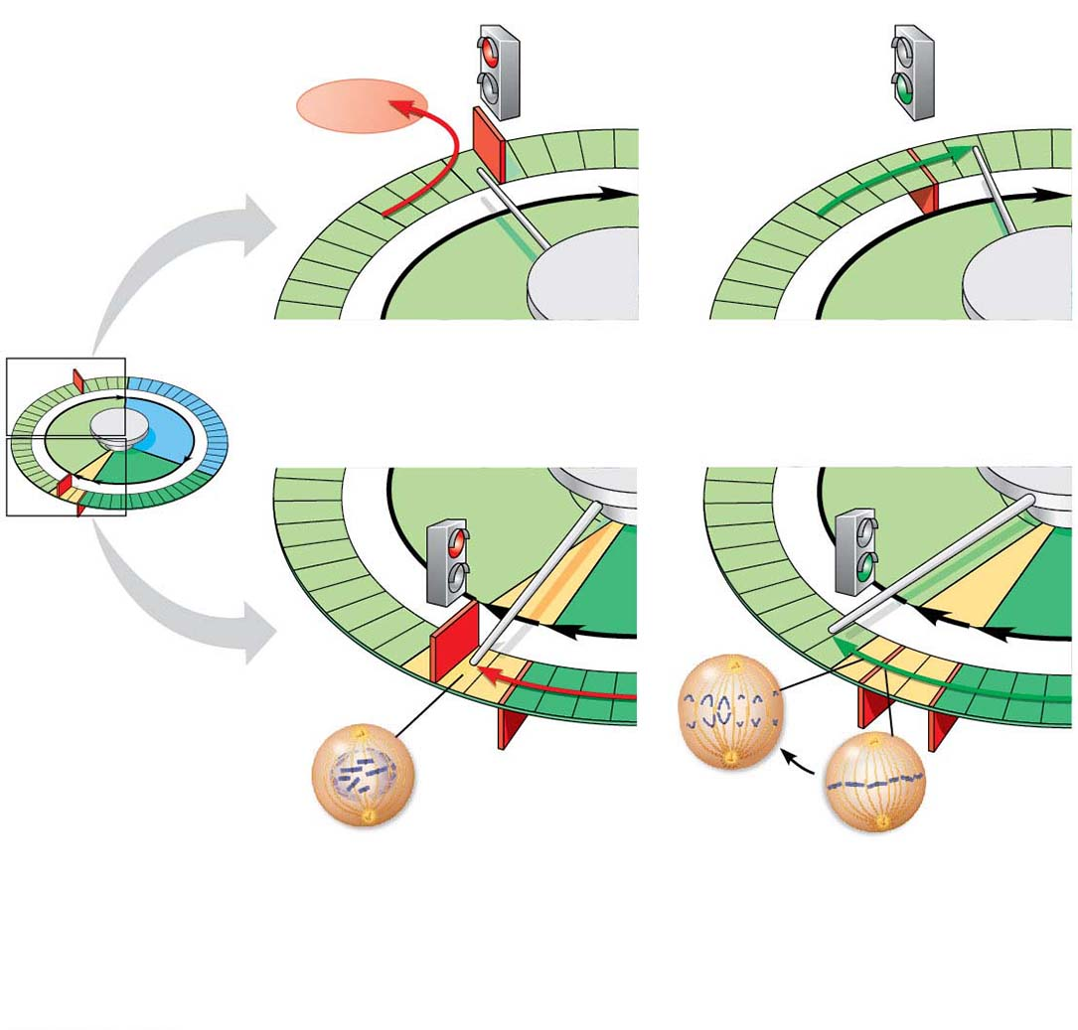
Figure 9.16
G₁ checkpoint
G₀
G₁
G₁
Without go-ahead signal, cell
enters G₀.
With go-ahead signal, cell
continues cell cycle.
G₁
S
(a) G₁ checkpoint
M
G₂
G₁
G₁
M
G₂
M
G₂
M
checkpoint
Anaphase
G₂
checkpoint
Prometaphase
Metaphase
Without full chromosome
attachment, stop signal is
received.
With full chromosome
attachment, go-ahead signal is
received.
(b) M checkpoint
Notes:
Figure 9.16 Two important checkpoints

Slide 43
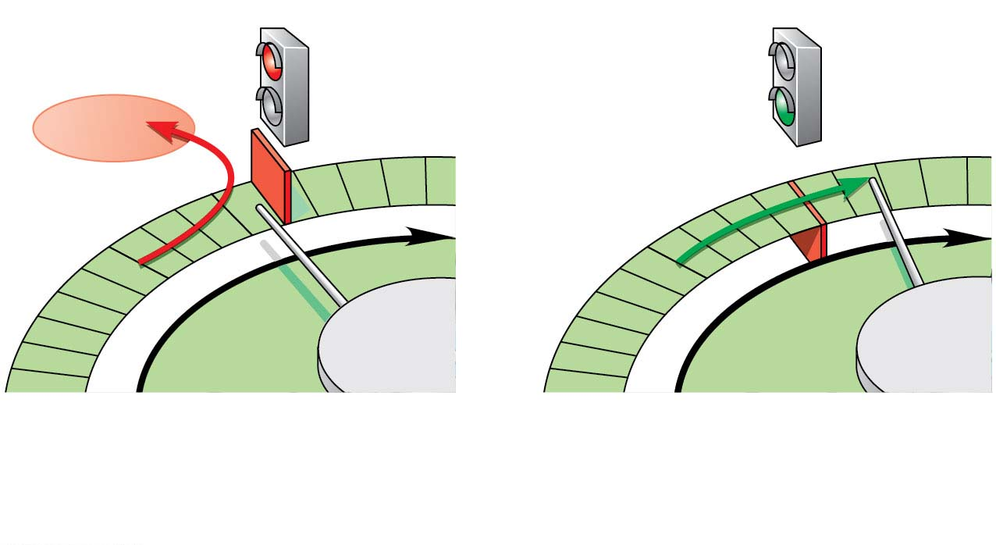
Figure 9.16-1
G₁ checkpoint
G₀
G₁
G₁
Without go-ahead signal, cell
enters G₀.
With go-ahead signal, cell
continues cell cycle.
(a) G₁ checkpoint
Notes:
Figure 9.16-1 Two important checkpoints (part 1: G₁ checkpoint)

Slide 44
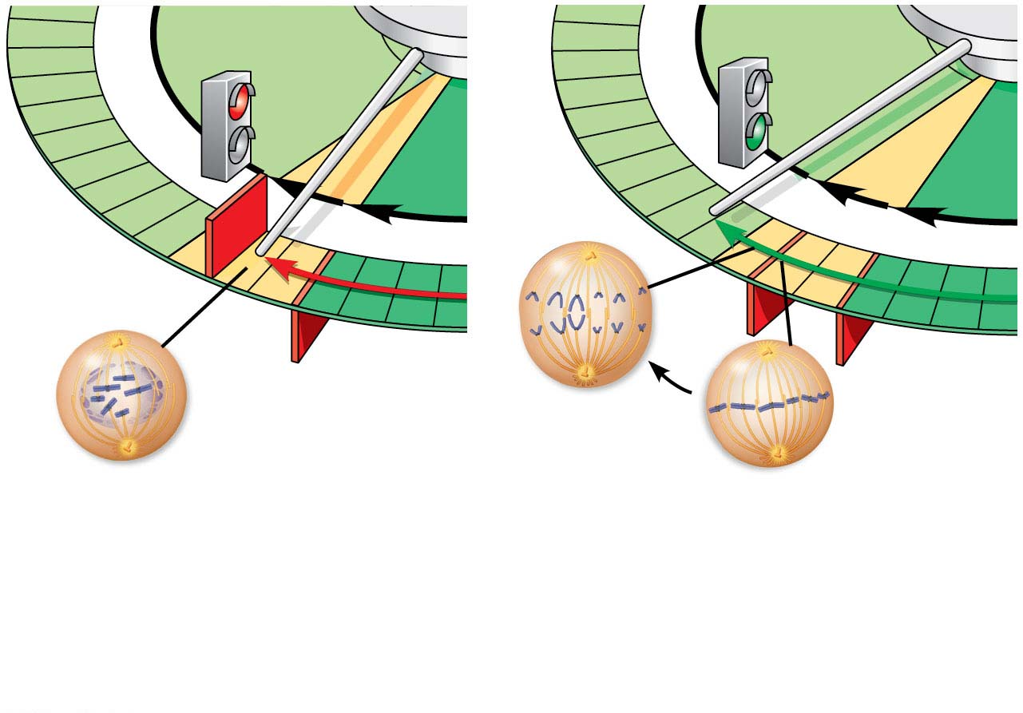
Figure 9.16-2
G₁
G₁
M
G₂
M
G₂
M
checkpoint
G₂
checkpoint
Anaphase
Prometaphase
Metaphase
Without full chromosome
attachment, stop signal is
received.
With full chromosome
attachment, go-ahead signal is
received.
(b) M checkpoint
Notes:
Figure 9.16-2 Two important checkpoints (part 2: M checkpoint)

Slide 45
The cell cycle is regulated by a set of regulatory proteins and protein complexes including kinases and proteins called cyclins
Notes:
45

Slide 46
An example of an internal signal occurs at the M phase checkpoint
In this case, anaphase does not begin if any kinetochores remain unattached to spindle microtubules
Attachment of all of the kinetochores activates a regulatory complex, which then activates the enzyme separase
Separase allows sister chromatids to separate, triggering the onset of anaphase
Notes:
46

Slide 47
Some external signals are growth factors, proteins released by certain cells that stimulate other cells to divide
For example, platelet-derived growth factor (PDGF) stimulates the division of human fibroblast cells in culture
Notes:
47

Slide 48
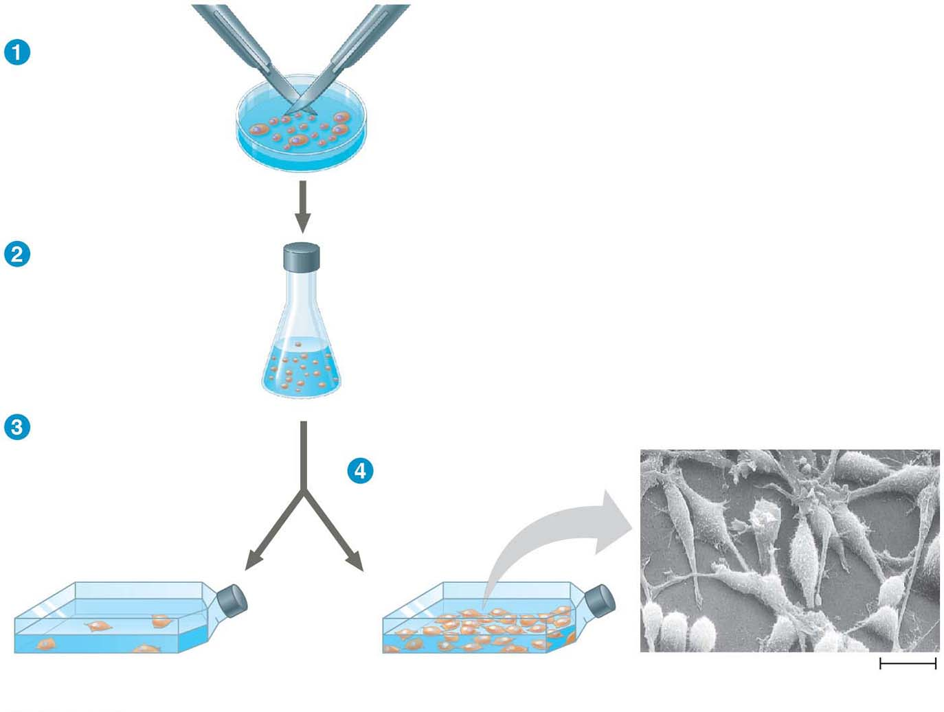
Figure 9.17-s4
Scalpels
A sample of
human connective
tissue is cut
up into small
pieces.
Petri
dish
Enzymes digest
the extracellular
matrix, resulting
in a suspension of
free fibroblasts.
Cells are transferred
to culture vessels.
PDGF is added to
half the vessels.
Without PDGF
With PDGF
Cultured fibroblasts
(SEM)
10 μm
Notes:
Figure 9.17-s4 The effect of platelet-derived growth factor (PDGF) on cell division (step 4)

Slide 49
Another example of external signals is density-dependent inhibition, in which crowded cells stop dividing
Most animal cells also exhibit anchorage dependence, in which they must be attached to a substratum in order to divide
Cancer cells exhibit neither density-dependent inhibition nor anchorage dependence
Notes:
49

Slide 50
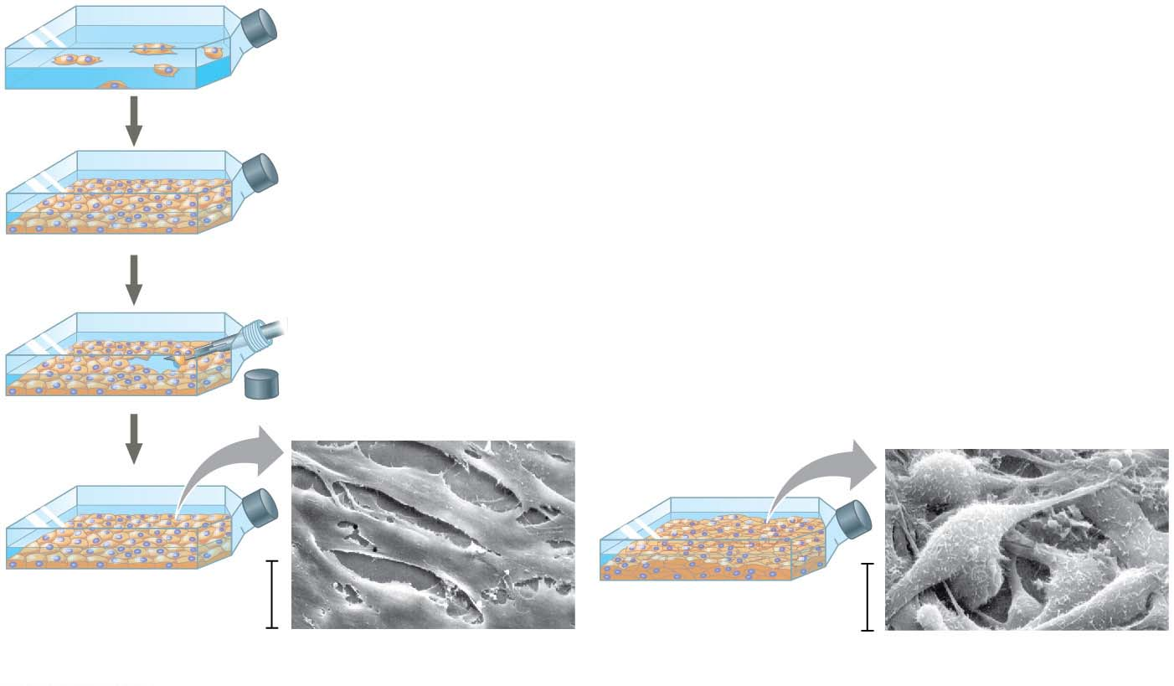
Figure 9.18
Anchorage dependence: cells
require a surface for division
Density-dependent inhibition:
cells form a single layer
Density-dependent inhibition:
cells divide to fill a gap and
then stop
20 μm
20 μm
(a) Normal mammalian cells
(b) Cancer cells
Notes:
Figure 9.18 Density-dependent inhibition and anchorage dependence of cell division

Slide 51
Loss of Cell Cycle Controls in Cancer Cells
Cancer cells do not respond to signals that normally regulate the cell cycle
Cancer cells do not need growth factors to grow and divide
They may make their own growth factor
They may convey a growth factor’s signal without the presence of the growth factor
They may have an abnormal cell cycle control system
Notes:
51

Slide 52
A normal cell is converted to a cancerous cell by a process called transformation
Cancer cells that are not eliminated by the immune system form tumors, masses of abnormal cells within otherwise normal tissue
If abnormal cells remain only at the original site, the lump is called a benign tumor
Malignant tumors invade surrounding tissues and undergo metastasis, exporting cancer cells to other parts of the body, where they may form additional tumors
Notes:
52

Slide 53
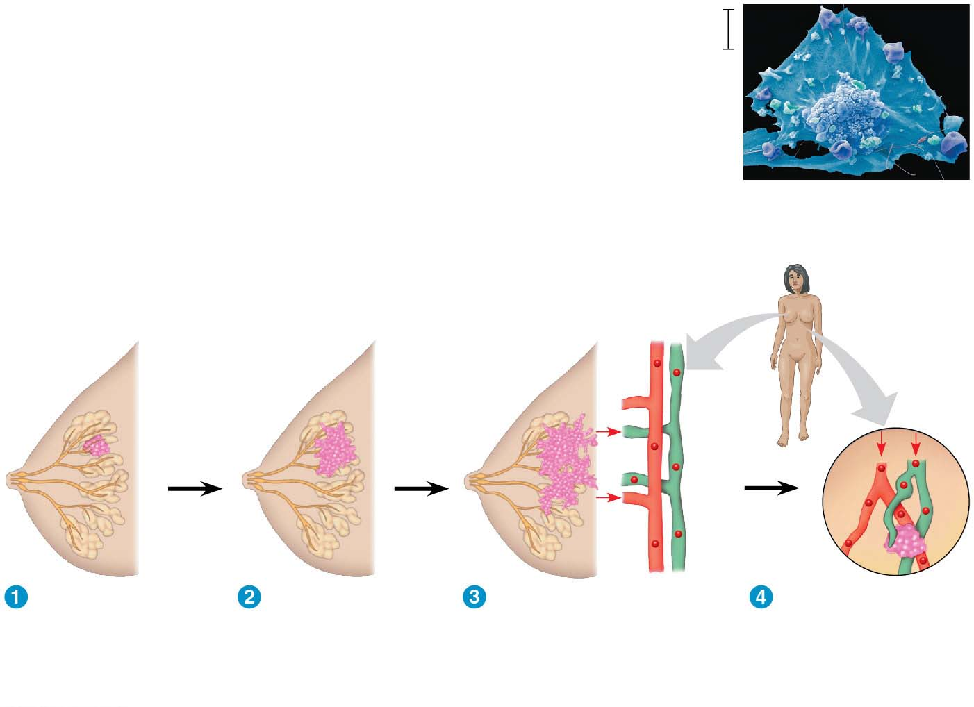
Figure 9.19
5 μm
Breast cancer cell
(colorized SEM)
Metastatic
tumor
Lymph
vessel
Tumor
Blood
vessel
Glandular
tissue
Cancer
cell
A tumor grows
from a single
cancer cell.
Cancer cells
invade
neighboring
tissue.
Cancer cells spread
through lymph and
blood vessels to
other parts of the
body.
A small percentage
of cancer cells may
metastasize to
another part of the
body.
Notes:
Figure 9.19 The growth and metastasis of a malignant breast tumor

Slide 54
Recent advances in understanding the cell cycle and cell cycle signaling have led to advances in cancer treatment
Medical treatments for cancer are becoming more “personalized” to an individual patient’s tumor
Notes:
54

Slide 55
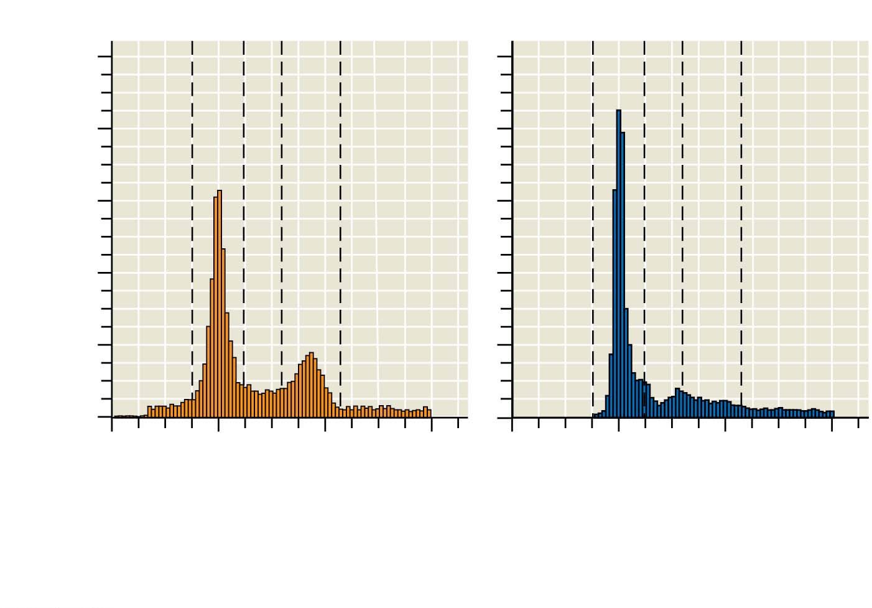
Figure 9.UN01-1
Control
Treated
200
A
B
C
A
B
C
160
Number of cells
120
80
40
0
0
200
400
600
0
200
400
600
Amount of fluorescence per cell (fluorescence units)
Data from K. K. Velpula et al., Regulation of glioblastoma progression by cord
blood stem cells is mediated by downregulation of cyclin D1, PLoS ONE 6(3):
e18017 (2011). doi:10.1371/journal.pone.0018017
Notes:
Figure 9.UN01-1 Skills exercise: interpreting histograms (part 1)

