Slide 1
The Energy of Life
The living cell is a miniature chemical factory where thousands of reactions occur
The cell extracts energy and applies energy to perform work
Some organisms even convert energy to light, as in bioluminescence
Notes:
1

Slide 2
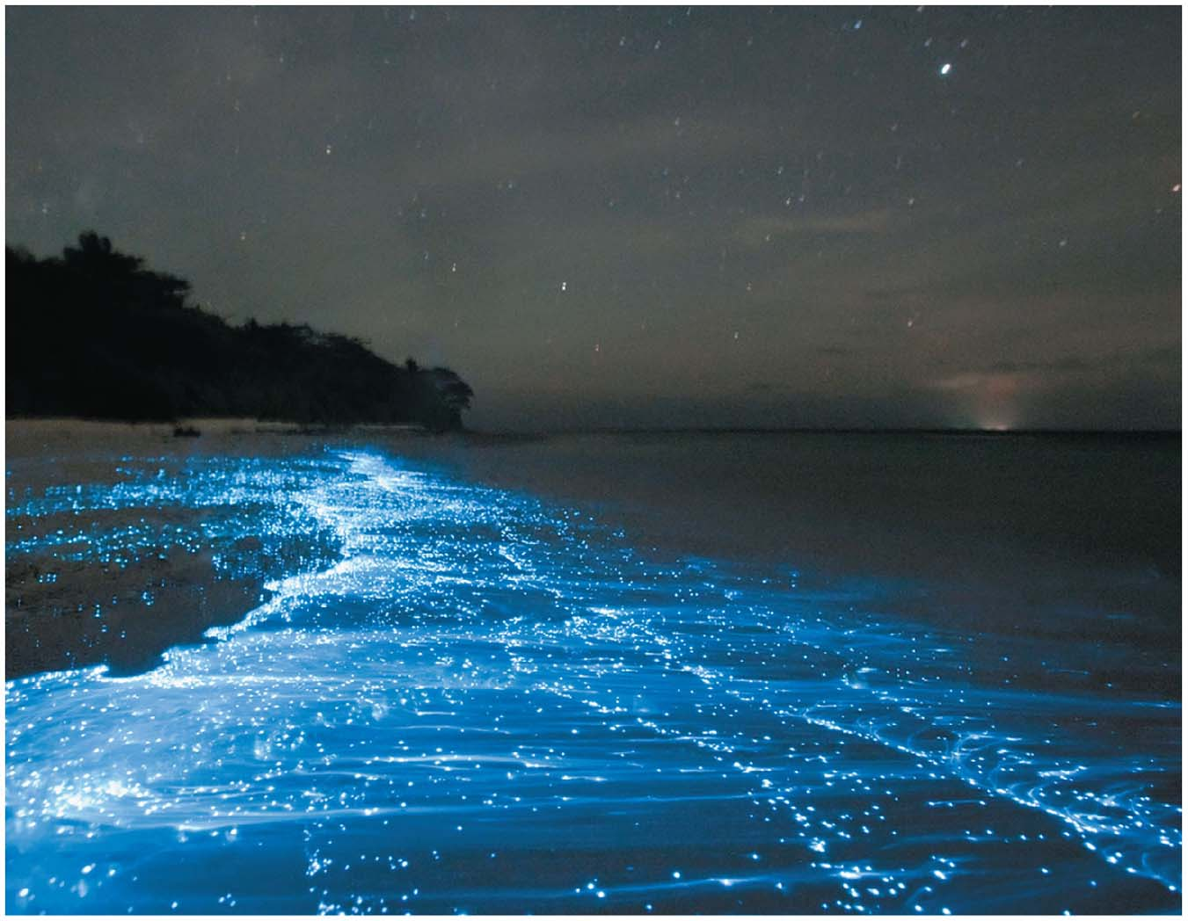
Figure 6.1
© 2016 Pearson Education, Inc.
Notes:
Figure 6.1 What causes these breaking waves to glow?

Slide 3
Concept 6.1: An organism’s metabolism transforms matter and energy
Metabolism is the totality of an organism’s chemical reactions
Metabolism is an emergent property of life that arises from interactions between molecules within the cell

Slide 4
Metabolic Pathways
A metabolic pathway begins with a specific molecule and ends with a product
Each step is catalyzed by a specific enzyme
Notes:
4

Slide 5
Figure 6.UN01
Enzyme 1
Enzyme 2
Enzyme 3
A
B
C
D
Reaction 1
Reaction 2
Reaction 3
Starting
molecule
Product
© 2016 Pearson Education, Inc.
Notes:
Figure 6.UN01 In-text figure, metabolic pathway, p. 122

Slide 6
Catabolic pathways release energy by breaking down complex molecules into simpler compounds
One example of catabolism is cellular respiration, the breakdown of glucose and other organic fuels to carbon dioxide and water
Notes:
6

Slide 7
Anabolic pathways consume energy to build complex molecules from simpler ones
The synthesis of proteins from amino acids is an example of anabolism
Bioenergetics is the study of how energy flows through living organisms
Notes:
7

Slide 8
The Laws of Energy Transformation
Thermodynamics is the study of energy transformations
In an open system, energy and matter can be transferred between the system and its surroundings
In an isolated system, exchange with the surroundings cannot occur
Organisms are open systems
Notes:
8

Slide 9
The First Law of Thermodynamics
According to the first law of thermodynamics, the energy of the universe is constant
Energy can be transferred and or transformed, but it cannot be created or destroyed
The first law is also called the principle of conservation of energy
Notes:
9

Slide 10
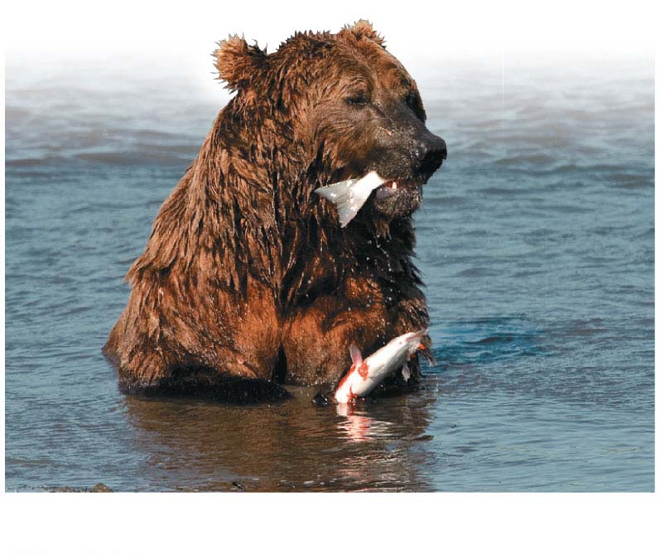
Figure 6.3-1
Chemical
energy
(a) First law of thermodynamics
© 2016 Pearson Education, Inc.
Notes:
Figure 6.3-1 The two laws of thermodynamics (part 1: conservation of energy)

Slide 11
The Second Law of Thermodynamics
During every energy transfer or transformation, some energy is lost as heat
According to the second law of thermodynamics
Every energy transfer or transformation increases the entropy of the universe
Entropy is a measure of disorder, or randomness
Notes:
11

Slide 12
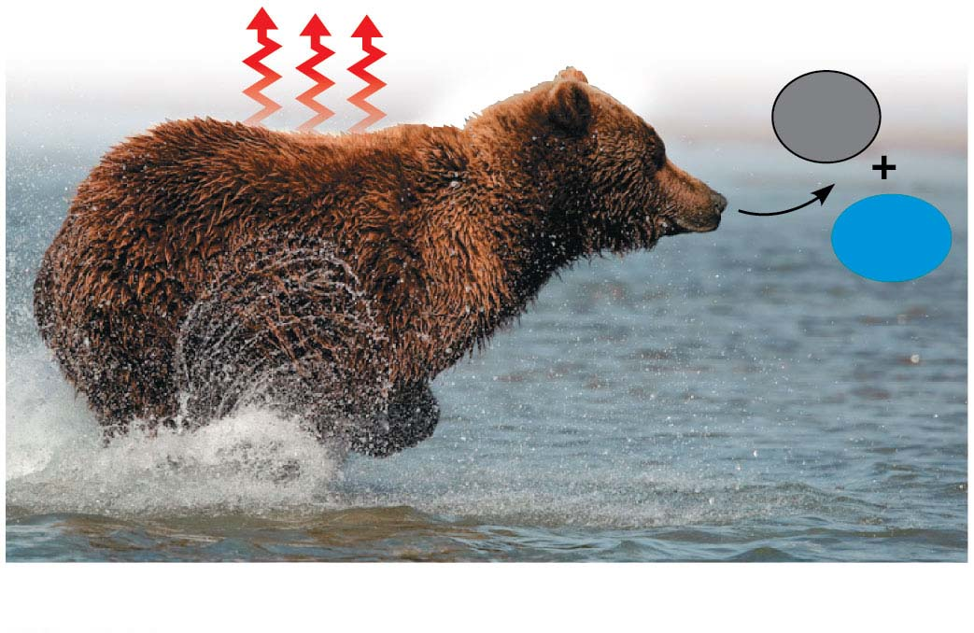
Figure 6.3-2
Heat
CO₂
H₂O
(b) Second law of thermodynamics
© 2016 Pearson Education, Inc.
Notes:
Figure 6.3-2 The two laws of thermodynamics (part 2: entropy)

Slide 13
Living cells unavoidably convert organized forms of energy to heat
Spontaneous processes occur without energy input; they can happen quickly or slowly
For a process to occur spontaneously, it must increase the entropy of the universe
Notes:
13

Slide 14
Free Energy and Metabolism
The concept of free energy can be applied to the chemistry of life’s processes
Notes:
14

Slide 15
Exergonic and Endergonic Reactions in Metabolism
An exergonic reaction proceeds with a net release of free energy and is spontaneous; ∆G is negative
The magnitude of ∆G represents the maximum amount of work the reaction can perform
Notes:
15

Slide 16
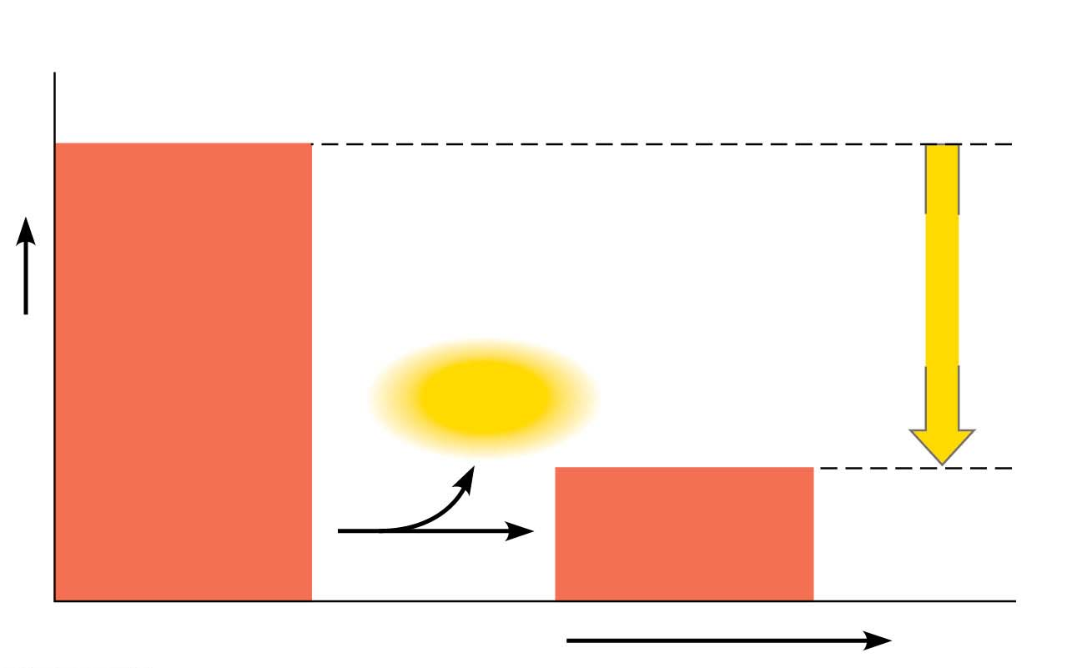
Figure 6.6-1
(a) Exergonic reaction: energy released, spontaneous
Reactants
Amount of
energy
released
(ΔG < 0)
Free energy
Energy
Products
Progress of the reaction
© 2016 Pearson Education, Inc.
Notes:
Figure 6.6-1 Free energy changes (∆G) in exergonic and endergonic reactions (part 1: exergonic)

Slide 17
An endergonic reaction absorbs free energy from its surroundings and is nonspontaneous; ∆G is positive
The magnitude of ∆G is the quantity of energy required to drive the reaction
Notes:
17

Slide 18
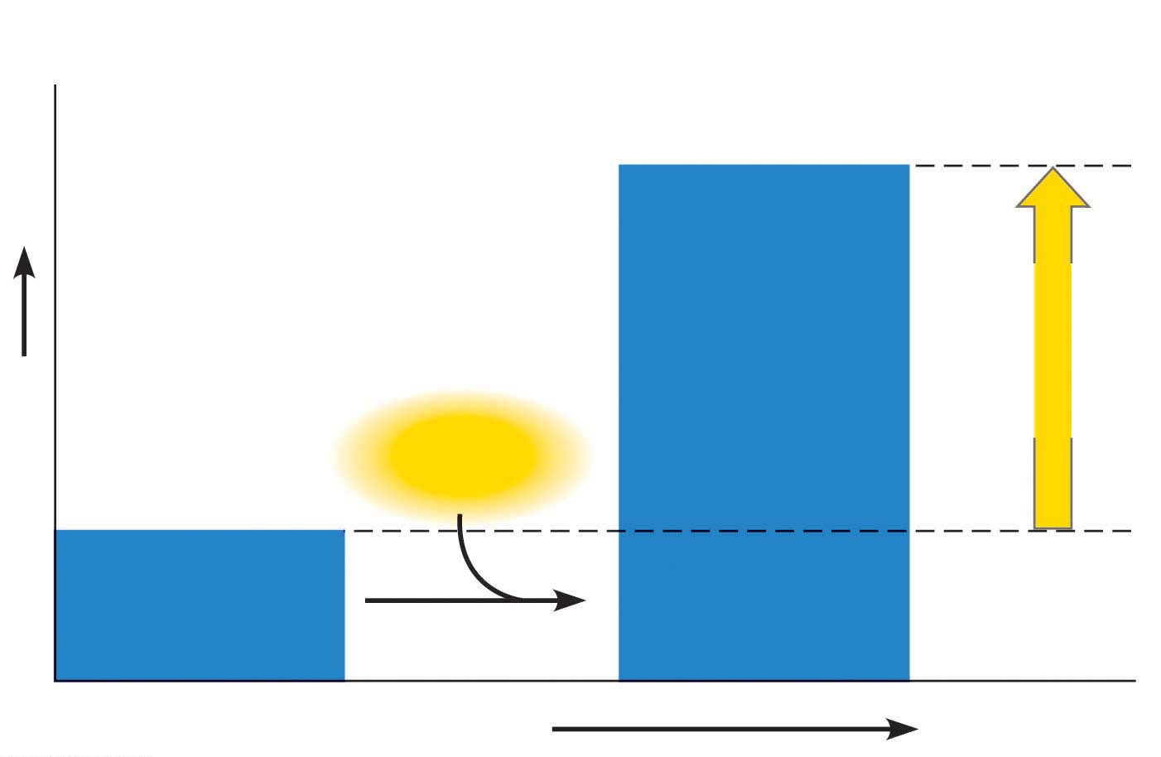
Figure 6.6-2
(b) Endergonic reaction: energy required, nonspontaneous
Products
Amount of
energy
required
(ΔG > 0)
Free energy
Energy
Reactants
Progress of the reaction
© 2016 Pearson Education, Inc.
Notes:
Figure 6.6-2 Free energy changes (∆G) in exergonic and endergonic reactions (part 2: endergonic)

Slide 19
Cells are not in equilibrium; they are open systems experiencing a constant flow of materials
Notes:
19

Slide 20
A catabolic pathway in a cell releases free energy in a series of reactions
The product of each reaction is the reactant for the next, preventing the system from reaching equilibrium
Notes:
20

Slide 21
Concept 6.3: ATP powers cellular work by coupling exergonic reactions to endergonic reactions
A cell does three main kinds of work
Chemical
Transport
Mechanical
Notes:
21

Slide 22
To do work, cells manage energy resources by energy coupling, the use of an exergonic process to drive an endergonic one
Most energy coupling in cells is mediated by ATP
Notes:
22

Slide 23
The Structure and Hydrolysis of ATP
ATP (adenosine triphosphate) is composed of ribose (a sugar), adenine (a nitrogenous base), and three phosphate groups
In addition to its role in energy coupling, ATP is also used to make RNA
Notes:
23

Slide 24
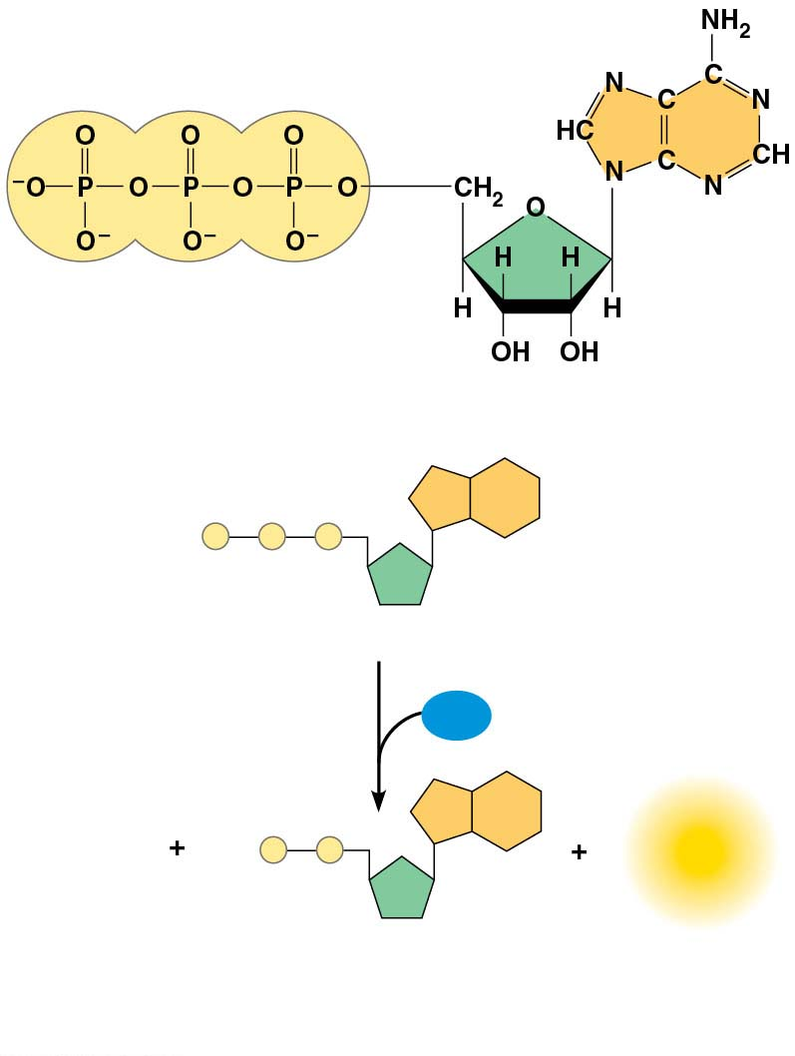
Figure 6.8
Adenine
Triphosphate group
(3 phosphate groups)
Ribose
(a) The structure of ATP
P
P
P
Adenosine triphosphate (ATP)
H₂O
P
_{i}
P
P
Energy
Inorganic
Adenosine diphosphate (ADP)
phosphate
© 2016 Pearson Education, Inc.
(b) The hydrolysis of ATP
Notes:
Figure 6.8 The structure and hydrolysis of adenosine triphosphate (ATP)

Slide 25
The bonds between the phosphate groups of ATP can be broken by hydrolysis
Energy is released from ATP when the terminal phosphate bond is broken
This release of energy comes from the chemical change to a state of lower free energy, not from the phosphate bonds themselves
Notes:
25

Slide 26
ATP hydrolysis releases a lot of energy due to the repulsive force of the three negatively charged phosphate groups
The triphosphate tail of ATP is the chemical equivalent of a compressed spring
Notes:
26

Slide 27
How the Hydrolysis of ATP Performs Work
The three types of cellular work (mechanical, transport, and chemical) are powered by the hydrolysis of ATP
In the cell, the energy from the exergonic reaction of ATP hydrolysis can be used to drive endergonic reactions
Notes:
27

Slide 28
ATP drives endergonic reactions by phosphorylation, transferring a phosphate group to some other molecule, such as a reactant
The recipient molecule is now called a phosphorylated intermediate
Overall, the coupled reactions are exergonic
Notes:
28

Slide 29
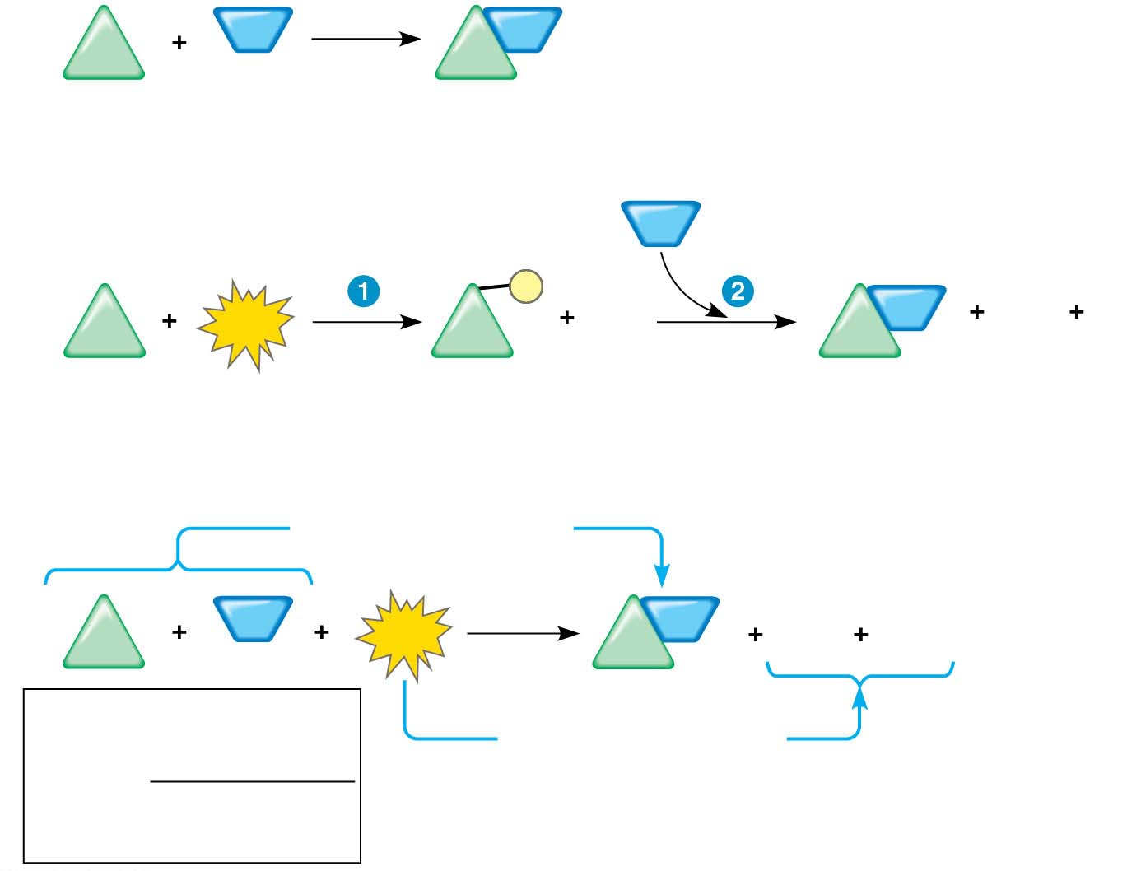
Figure 6.9
NH₃
NH₂
ΔG_{Glu} = +3.4 kcal/mol
Glu
Glu
Glutamic acid Ammonia
Glutamine
(a) Glutamic acid conversion to glutamine
NH₃
P
ADP
NH₂
ADP
P
Glu
ATP
Glu
Glu
i
Glutamic acid
Phosphorylated
intermediate
Glutamine
(b) Conversion reaction coupled with ATP hydrolysis
ΔG_{Glu} = +3.4 kcal/mol
NH₃
ATP
NH₂
ADP
P
Glu
Glu
i
ΔG_{Glu} = +3.4 kcal/mol
ΔG_{ATP} = −7.3 kcal/mol
+ ΔG_{ATP} = −7.3 kcal/mol
Net ΔG = −3.9 kcal/mol
(c) Free-energy change for coupled reaction
© 2016 Pearson Education, Inc.
Notes:
Figure 6.9 How ATP drives chemical work: energy coupling using ATP hydrolysis

Slide 30
Transport and mechanical work in the cell are powered by ATP hydrolysis
ATP hydrolysis leads to a change in a protein’s shape and often its ability to bind to another molecule
Notes:
30

Slide 31
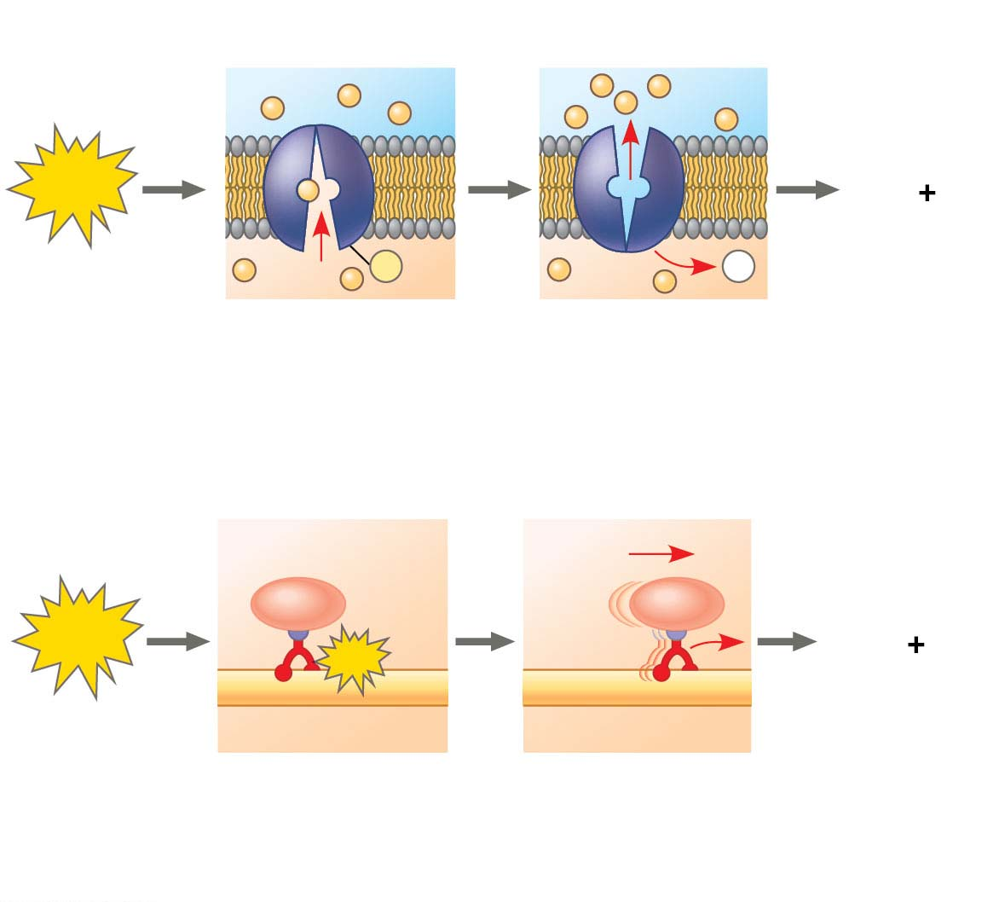
Figure 6.10
Transport protein
Solute
ATP
ADP
P
i
P
P
i
Solute transported
(a) Transport work: ATP phosphorylates transport proteins.
Vesicle
Cytoskeletal track
ATP
ADP
P
ATP
i
Motor protein
Protein and vesicle moved
(b) Mechanical work: ATP binds noncovalently to motor proteins and then is hydrolyzed.
© 2016 Pearson Education, Inc.
Notes:
Figure 6.10 How ATP drives transport and mechanical work

Slide 32
The Regeneration of ATP
ATP is a renewable resource that is regenerated by addition of a phosphate group to adenosine diphosphate (ADP)
The energy to phosphorylate ADP comes from catabolic reactions in the cell
The ATP cycle is a revolving door through which energy passes during its transfer from catabolic to anabolic pathways
Notes:
32

Slide 33
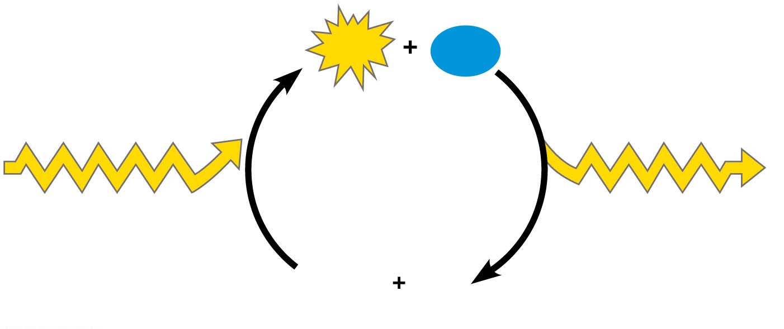
Figure 6.11
ATP
H₂O
Energy from
catabolism (exergonic,
energy-releasing
processes)
Energy for cellular
work (endergonic,
energy-consuming
processes)
ADP
P
i
© 2016 Pearson Education, Inc.
Notes:
Figure 6.11 The ATP cycle

Slide 34
Concept 6.4: Enzymes speed up metabolic reactions by lowering energy barriers
A catalyst is a chemical agent that speeds up a reaction without being consumed by the reaction
An enzyme is a catalytic protein
Hydrolysis of sucrose by the enzyme sucrase is an example of an enzyme-catalyzed reaction
Notes:
34

Slide 35
The Activation Energy Barrier
Every chemical reaction between molecules involves bond breaking and bond forming
The initial energy needed to start a chemical reaction is called the free energy of activation, or activation energy (E_{A})
Activation energy often occurs in the form of heat that reactant molecules absorb from the surroundings
Notes:
35

Slide 36
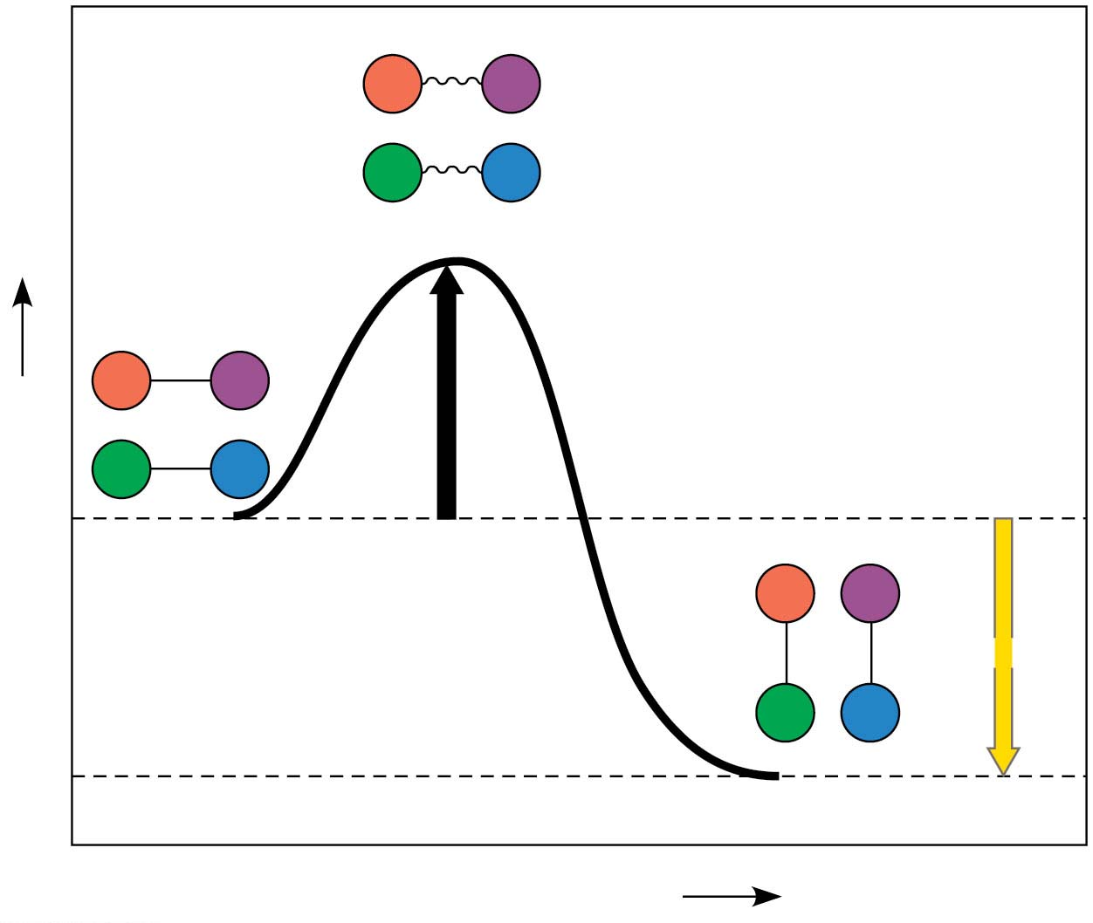
Figure 6.12
A
B
C
D
Transition state
A
B
E
Free energy
A
C
D
Reactants
A
B
ΔG < 0
C
D
Products
Progress of the reaction
© 2016 Pearson Education, Inc.
Notes:
Figure 6.12 Energy profile of an exergonic reaction

Slide 37
How Enzymes Speed Up Reactions
Instead of relying on heat, organisms carry out catalysis to speed up reactions
A catalyst (for example, an enzyme) can speed up a reaction by lowering the E_{A} barrier without itself being consumed
Enzymes do not affect the change in free energy (∆G); instead, they hasten reactions that would occur eventually
Notes:
37

Slide 38
Animation: How Enzymes Work

Slide 39
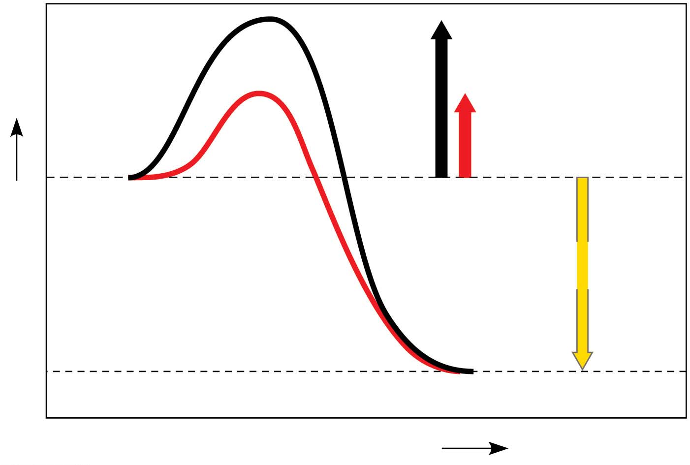
Figure 6.13
Course of
reaction
without
enzyme
E_{A}
without
enzyme
E_{A} with
enzyme
is lower
Reactants
Free energy
Course of
reaction
with enzyme
ΔG is unaffected
by enzyme
Products
Progress of the reaction
© 2016 Pearson Education, Inc.
Notes:
Figure 6.13 The effect of an enzyme on activation energy

Slide 40
Substrate Specificity of Enzymes
Enzymes are very specific for the reactions they catalyze
The reactant that an enzyme acts on is called the enzyme’s substrate
The enzyme binds to its substrate, forming an enzyme-substrate complex
The active site is the region on the enzyme where the substrate binds
Notes:
40

Slide 41
Enzyme specificity results from the complementary fit between the shape of the enzyme’s active site and the shape of the substrate
Enzymes change shape due to chemical interactions with the substrate
This induced fit of the enzyme to the substrate brings chemical groups of the active site together
Notes:
41

Slide 42
Video: Enzyme Induced Fit

Slide 43
Catalysis in the Enzyme’s Active Site
In an enzymatic reaction, the substrate binds to the active site of the enzyme
The active site can lower an E_{A} barrier by
Orienting substrates correctly
Straining substrate bonds
Providing a favorable microenvironment
Covalently bonding to the substrate
Notes:
43

Slide 44
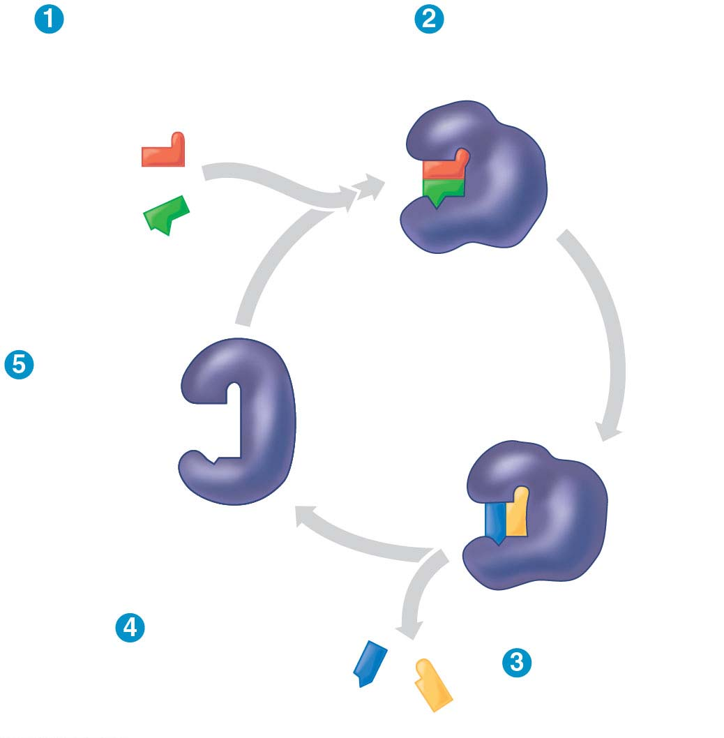
Figure 6.15-s4
Substrates enter
active site.
Substrates are
held in active site by
weak interactions.
Substrates
Enzyme-substrate
complex
Active site
is available
for new
substrates.
Enzyme
Products are
released.
Substrates are
converted to
products.
Products
© 2016 Pearson Education, Inc.
Notes:
Figure 6.15-s4 The active site and catalytic cycle of an enzyme (step 4)

Slide 45
The rate of enzyme catalysis can usually be sped up by increasing the substrate concentration in a solution
When all enzyme molecules in a solution are bonded with substrate, the enzyme is saturated
At enzyme saturation, reaction speed can only be increased by adding more enzyme
Notes:
45

Slide 46
Effects of Local Conditions on Enzyme Activity
An enzyme’s activity can be affected by
General environmental factors, such as temperature and pH
Chemicals that specifically influence the enzyme
Notes:
46

Slide 47
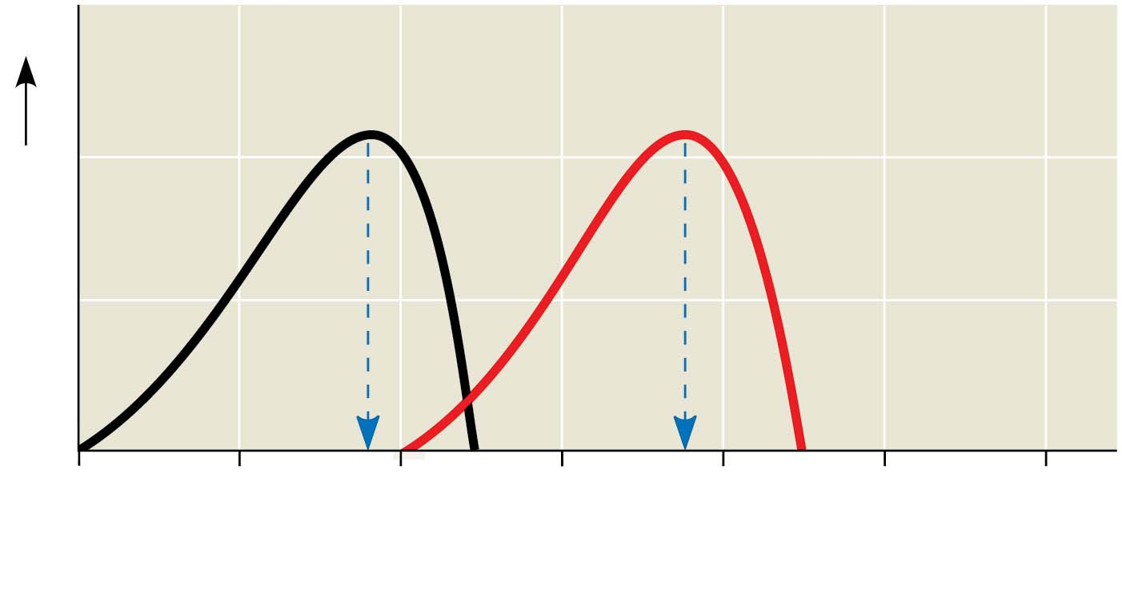
Figure 6.16-1
Optimal temperature for
typical human enzyme (37°C)
Optimal temperature for
enzyme of thermophilic
(heat-loving)
bacteria (75°C)
Rate of reaction
0
20
40
60
80
100
120
Temperature (°C)
(a) Optimal temperature for two enzymes
© 2016 Pearson Education, Inc.
Notes:
Figure 6.16-1 Environmental factors affecting enzyme activity (part 1: temperature)

Slide 48
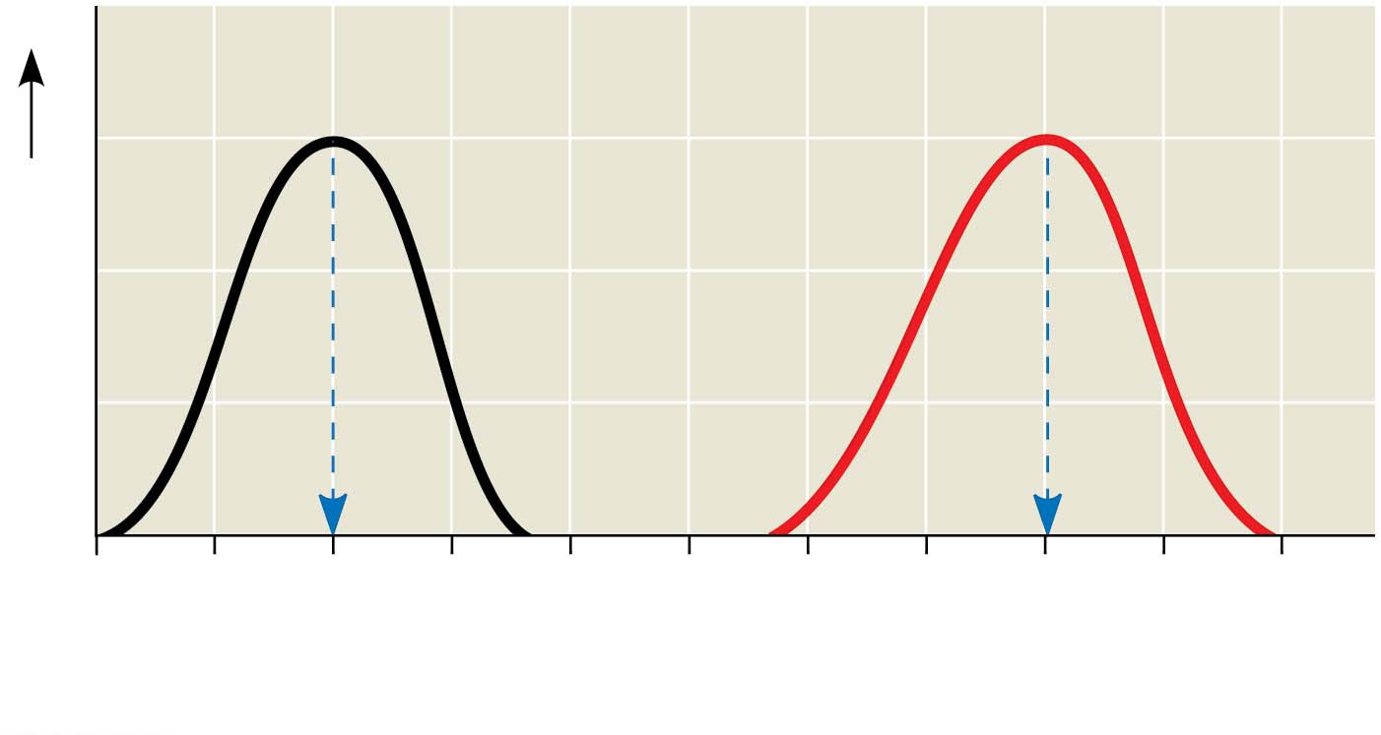
Figure 6.16-2
Optimal pH for pepsin
(stomach
enzyme)
Optimal pH for trypsin
(intestinal
enzyme)
Rate of reaction
0
1
2
3
4
5
6
7
8
9
10
pH
(b) Optimal pH for two enzymes
© 2016 Pearson Education, Inc.
Notes:
Figure 6.16-2 Environmental factors affecting enzyme activity (part 2: pH)

Slide 49
Cofactors
Cofactors are nonprotein enzyme helpers
Cofactors may be inorganic (such as a metal in ionic form) or organic
An organic cofactor is called a coenzyme
Most vitamins act as coenzymes or as the raw materials from which coenzymes are made
Notes:
49

Slide 50
Enzyme Inhibitors
Competitive inhibitors bind to the active site of an enzyme, competing with the substrate
Noncompetitive inhibitors bind to another part of an enzyme, causing the enzyme to change shape and making the active site less effective
Examples of inhibitors include toxins, poisons, pesticides, and antibiotics
Notes:
50

Slide 51
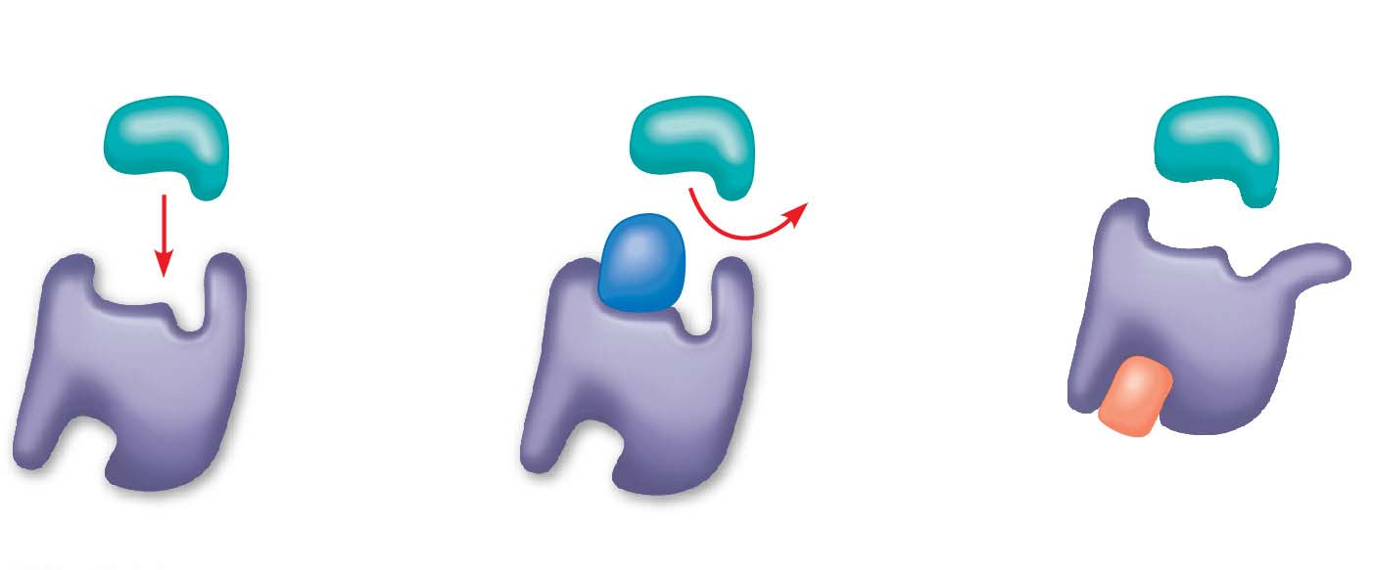
Figure 6.17
(a) Normal binding
(b) Competitive inhibition
(c) Noncompetitive inhibition
Substrate
Active site
Competitive
inhibitor
Enzyme
Noncompetitive
inhibitor
© 2016 Pearson Education, Inc.
Notes:
Figure 6.17 Inhibition of enzyme activity

Slide 52
The Evolution of Enzymes
Most enzymes are proteins encoded by genes
Changes (mutations) in genes lead to changes in amino acid composition of an enzyme
Altered amino acids in enzymes may alter their activity or substrate specificity
Under new environmental conditions a novel form of an enzyme might be favored
Notes:
52

Slide 53
Concept 6.5: Regulation of enzyme activity helps control metabolism
Chemical chaos would result if a cell’s metabolic pathways were not tightly regulated
A cell does this by switching on or off the genes that encode specific enzymes or by regulating the activity of enzymes
Notes:
53

Slide 54
Allosteric Regulation of Enzymes
Allosteric regulation may either inhibit or stimulate an enzyme’s activity
Allosteric regulation occurs when a regulatory molecule binds to a protein at one site and affects the protein’s function at another site
Notes:
54

Slide 55
Allosteric Activation and Inhibition
Most allosterically regulated enzymes are made from polypeptide subunits
Each enzyme has active and inactive forms
The binding of an activator stabilizes the active form of the enzyme
The binding of an inhibitor stabilizes the inactive form of the enzyme
Notes:
55

Slide 56
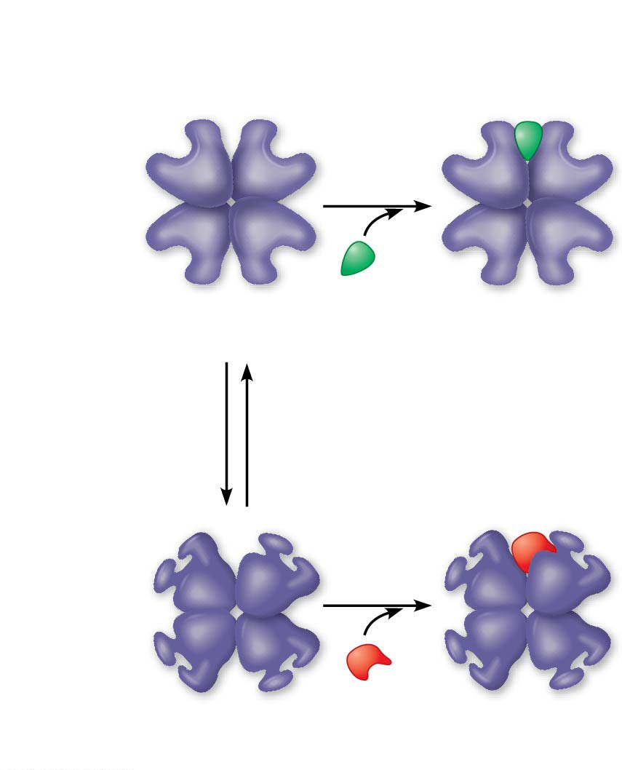
Figure 6.18-1
(a) Allosteric activators and inhibitors
Allosteric enzyme
with four subunits
Active site
(one of four)
Regulatory
site (one
of four)
Activator
Active form
Stabilized
active form
Oscillation
Non-
functional
active site
Inhibitor
Inactive form
Stabilized
inactive form
© 2016 Pearson Education, Inc.
Notes:
Figure 6.18-1 Allosteric regulation of enzyme activity (part 1: activation and inhibition)

Slide 57
Cooperativity is a form of allosteric regulation that can amplify enzyme activity
One substrate molecule primes an enzyme to act on additional substrate molecules more readily
Cooperativity is allosteric because binding by a substrate to one active site affects catalysis in a different active site
Notes:
57

Slide 58
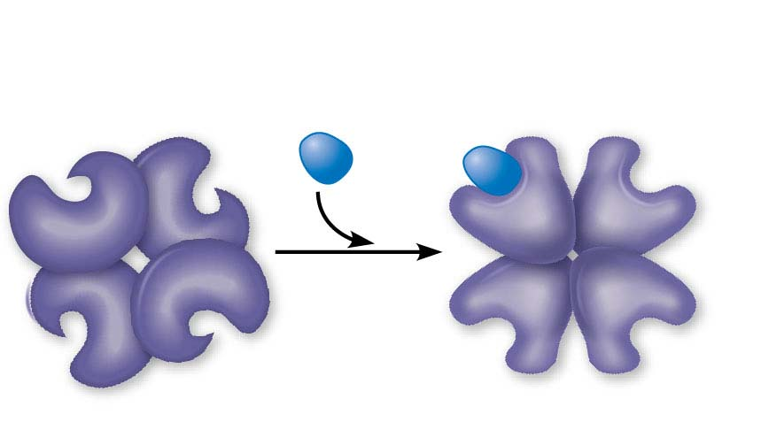
Figure 6.18-2
(b) Cooperativity: another type of allosteric activation
Substrate
Inactive form
Stabilized active form
© 2016 Pearson Education, Inc.
Notes:
Figure 6.18-2 Allosteric regulation of enzyme activity (part 2: cooperativity)

Slide 59
Feedback Inhibition
In feedback inhibition, the end product of a metabolic pathway shuts down the pathway
Feedback inhibition prevents a cell from wasting chemical resources by synthesizing more product than is needed
Notes:
59

Slide 60
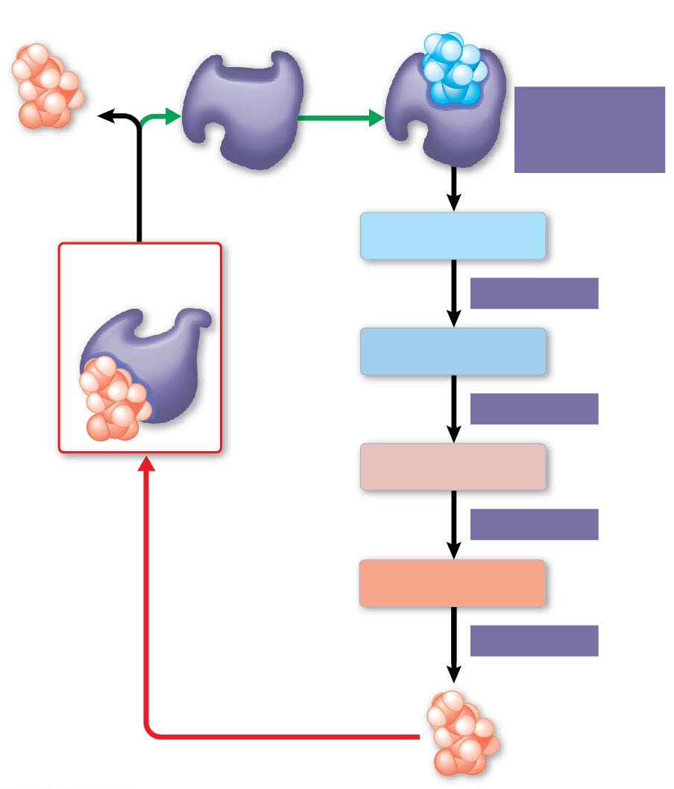
Figure 6.19
Active site available
Threonine
in active site
Enzyme 1
(threonine
deaminase)
Isoleucine
used up by
cell
Intermediate A
Feedback
inhibition
Enzyme 2
Intermediate B
Enzyme 3
Isoleucine
binds to
allosteric
site.
Intermediate C
Enzyme 4
Intermediate D
Enzyme 5
End product
(isoleucine)
© 2016 Pearson Education, Inc.
Notes:
Figure 6.19 Feedback inhibition in isoleucine synthesis

