Slide 1
Overview: The Fundamental Units of Life
All organisms are made of cells
The cell is the simplest collection of matter that can be alive
All cells are related by their descent from earlier cells
Though cells can differ substantially from one another, they share common features
Notes:
1

Slide 2
Cell Fractionation
Cell fractionation breaks up cells and separates the components, using centrifugation
Cell components separate based on their relative size
Cell fractionation enables scientists to determine the functions of organelles
Biochemistry and cytology help correlate cell function with structure
Notes:
2

Slide 3
Concept 4.2: Eukaryotic cells have internal membranes that compartmentalize their functions
The basic structural and functional unit of every organism is one of two types of cells: prokaryotic or eukaryotic
Organisms of the domains Bacteria and Archaea consist of prokaryotic cells
Protists, fungi, animals, and plants all consist of eukaryotic cells
Notes:
3

Slide 4
Comparing Prokaryotic and Eukaryotic Cells
Basic features of all cells
Plasma membrane
Semifluid substance called cytosol
Chromosomes (carry genes)
Ribosomes (make proteins)
Notes:
4

Slide 5
In a eukaryotic cell most of the DNA is in the nucleus, an organelle that is bounded by a double membrane
Prokaryotic cells are characterized by having
No nucleus
DNA in an unbound region called the nucleoid
No membrane-bound organelles
Both types of cells contain cytoplasm bound by the plasma membrane
Notes:
5

Slide 6
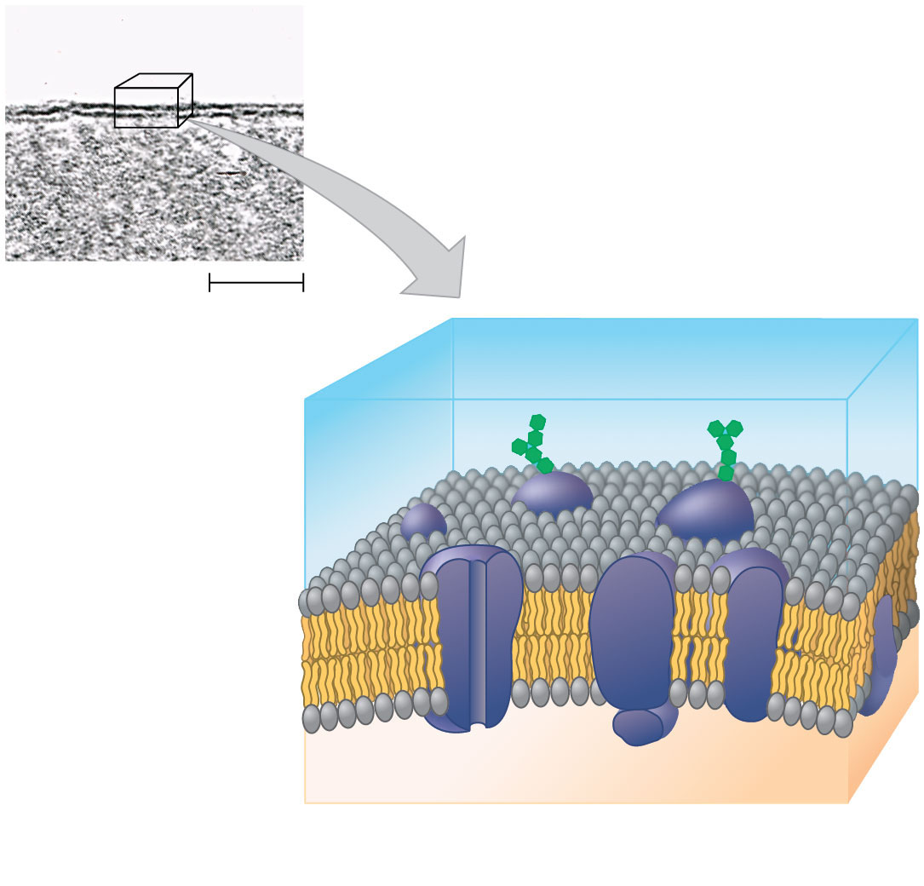
Figure 4.5
Outside of cell
(a) TEM of a plasma membrane
Inside of cell
0.1 μm
Carbohydrate side chains
Hydrophilic
region
Hydrophobic
region
Hydrophilic
region
Phospholipid
Proteins
(b) Structure of the plasma membrane
© 2016 Pearson Education, Inc.
Notes:
Figure 4.5 The plasma membrane

Slide 7
Metabolic requirements set upper limits on the size of cells
The ratio of surface area to volume of a cell is critical
As the surface area increases by a factor of n², the volume increases by a factor of n³
Small cells have a greater surface area relative to volume
Notes:
7

Slide 8
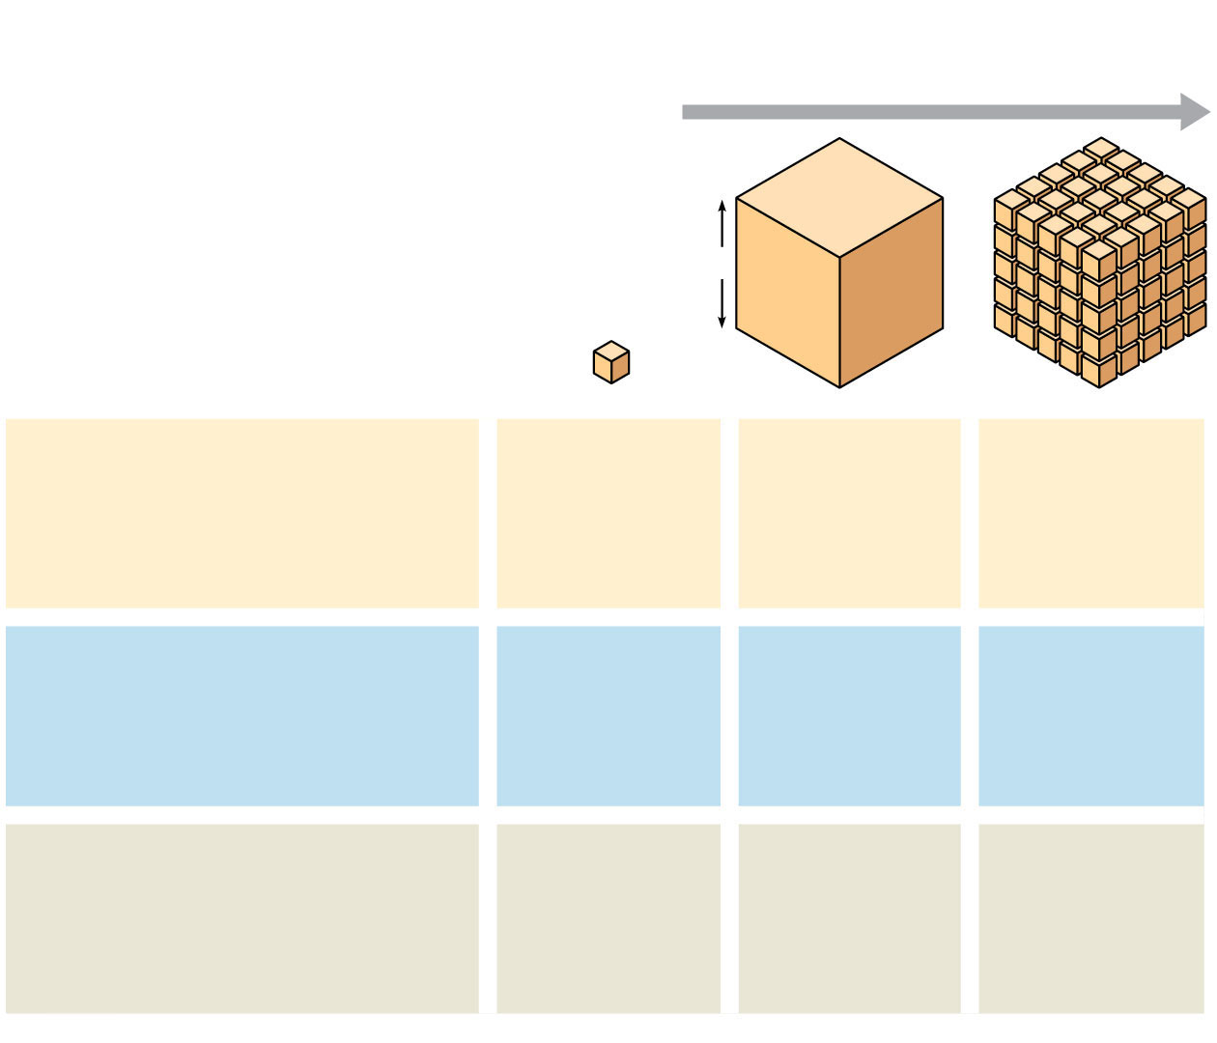
Figure 4.6
Surface area increases while
total volume remains constant
5
1
1
Total surface area
[sum of the surface areas
(height ✕ width) of all box
sides ✕ number of boxes]
6
150
750
Total volume
[height ✕ width ✕ length
✕ number of boxes]
1
125
125
Surface-to-volume
(S-to-V) ratio
[surface area $\text{÷}$
volume]
6
1.2
6
© 2016 Pearson Education, Inc.
Notes:
Figure 4.6 Geometric relationships between surface area and volume

Slide 9
Concept 4.3: The eukaryotic cell’s genetic instructions are housed in the nucleus and carried out by the ribosomes
The nucleus contains most of the DNA in a eukaryotic cell
Ribosomes use the information from the DNA to make proteins
Notes:
9

Slide 10
The Nucleus: Information Central
The nucleus contains most of the cell’s genes and is usually the most conspicuous organelle
The nuclear envelope encloses the nucleus, separating it from the cytoplasm
The nuclear membrane is a double membrane; each membrane consists of a lipid bilayer
Notes:
10

Slide 11
Nuclear pores regulate the entry and exit of molecules
The shape of the nucleus is maintained by the nuclear lamina, which is composed of protein
Notes:
11

Slide 12
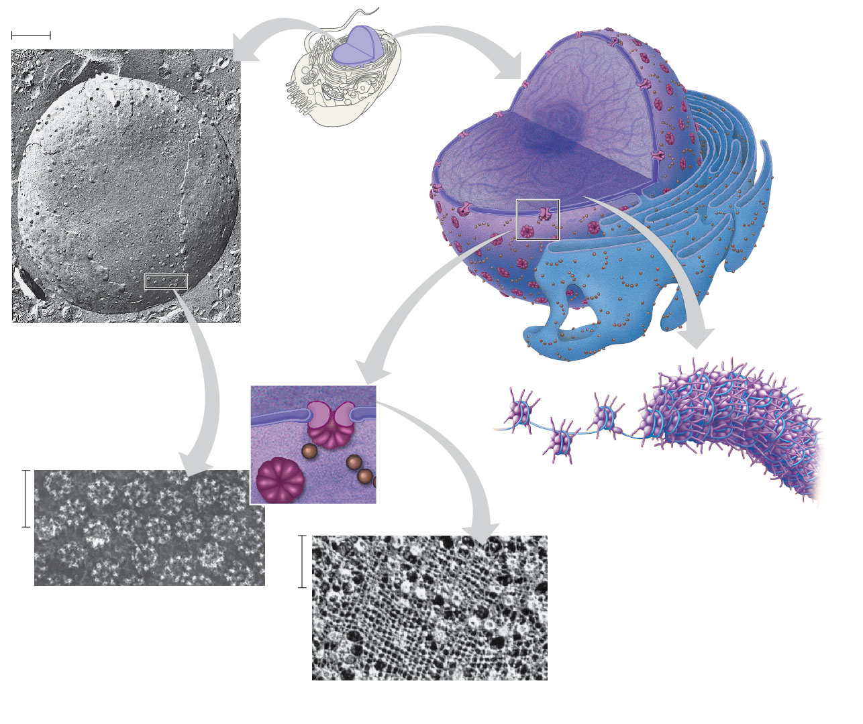
Figure 4.8
1 μm
Nucleus
Nucleus
Nucleolus
Chromatin
Nuclear envelope:
Inner membrane
Outer membrane
Nuclear pore
Rough ER
Surface of nuclear
envelope (TEM)
Pore
complex
Ribosome
Close-up
of nuclear
envelope
Chromatin
0.25 μm
0.5 μm
Pore complexes (TEM)
Nuclear lamina (TEM)
© 2016 Pearson Education, Inc.
Notes:
Figure 4.8 The nucleus and its envelope

Slide 13
In the nucleus, DNA is organized into discrete units called chromosomes
Each chromosome is one long DNA molecule associated with proteins
The DNA and proteins of chromosomes together are called chromatin
Chromatin condenses to form discrete chromosomes as a cell prepares to divide
The nucleolus is located within the nucleus and is the site of ribosomal RNA (rRNA) synthesis
Notes:
13

Slide 14
Ribosomes: Protein Factories
Ribosomes are complexes of ribosomal RNA and protein
Ribosomes carry out protein synthesis in two locations
In the cytosol (free ribosomes)
On the outside of the endoplasmic reticulum or the nuclear envelope (bound ribosomes)
Notes:
14

Slide 15
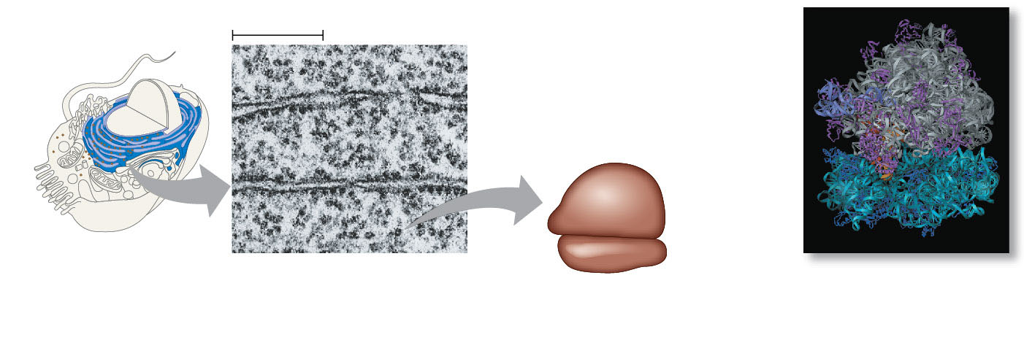
Figure 4.9
0.25 μm
Free ribosomes
in cytosol
Ribosomes
ER
Endoplasmic
reticulum (ER)
Ribosomes bound
to ER
Large
subunit
Small
subunit
TEM showing ER and
ribosomes
Diagram of a ribosome
Computer model
of a ribosome
© 2016 Pearson Education, Inc.
Notes:
Figure 4.9 Ribosomes

Slide 16
Concept 4.4: The endomembrane system regulates protein traffic and performs metabolic functions in the cell
Components of the endomembrane system
Nuclear envelope
Endoplasmic reticulum
Golgi apparatus
Lysosomes
Vacuoles
Plasma membrane
These components are either continuous or connected through transfer by vesicles
Notes:
16

Slide 17
The Endoplasmic Reticulum: Biosynthetic Factory
The endoplasmic reticulum (ER) accounts for more than half of the total membrane in many eukaryotic cells
The ER membrane is continuous with the nuclear envelope
There are two distinct regions of ER
Smooth ER: lacks ribosomes
Rough ER: surface is studded with ribosomes
Notes:
17

Slide 18
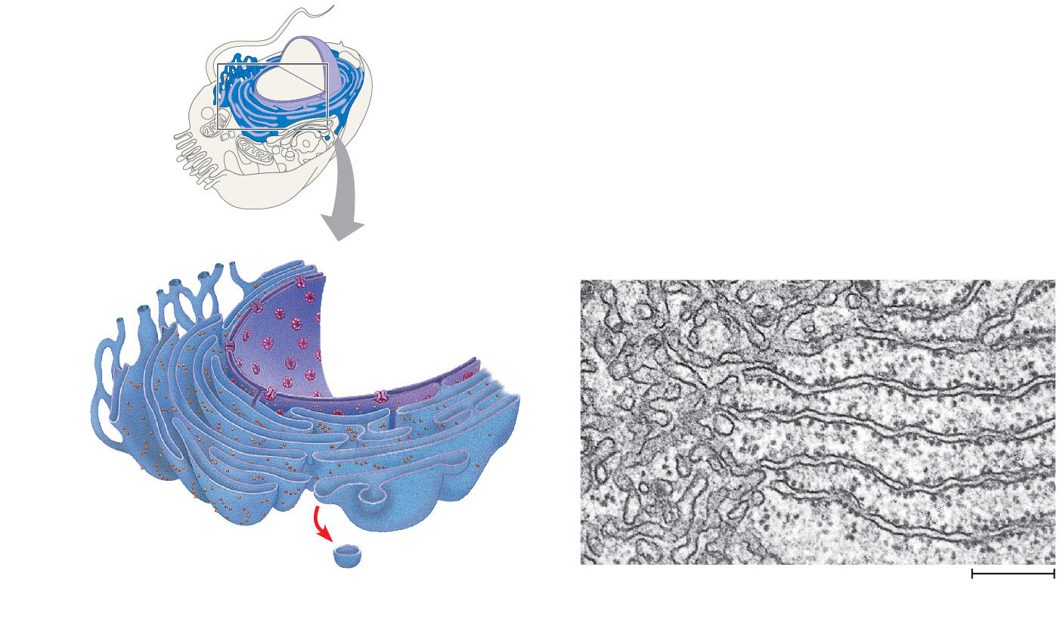
Figure 4.10
Smooth ER
Rough ER
Nuclear
envelope
Smooth ER
Rough ER
ER lumen
Cisternae
Ribosomes
Transitional
ER
Transport vesicle
0.2 μm
© 2016 Pearson Education, Inc.
Notes:
Figure 4.10 Endoplasmic reticulum (ER)

Slide 19
Functions of Smooth ER
The smooth ER
Synthesizes lipids
Metabolizes carbohydrates
Detoxifies drugs and poisons
Stores calcium ions
Notes:
19

Slide 20
Functions of Rough ER
The rough ER
Has bound ribosomes, which secrete glycoproteins (proteins covalently bonded to carbohydrates)
Distributes transport vesicles, proteins surrounded by membranes
Is a membrane factory for the cell
Notes:
20

Slide 21
The Golgi Apparatus: Shipping and Receiving Center
The Golgi apparatus consists of flattened membranous sacs called cisternae
Functions of the Golgi apparatus
Modifies products of the ER
Manufactures certain macromolecules
Sorts and packages materials into transport vesicles
Notes:
21

Slide 22
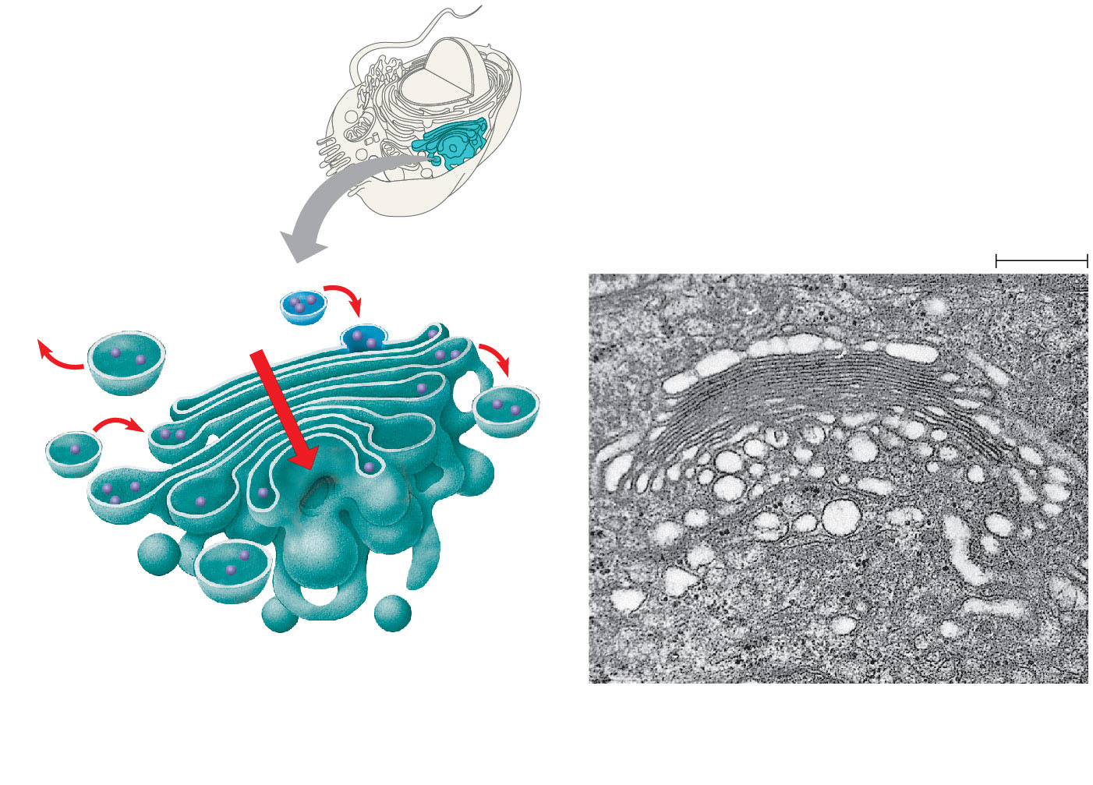
Figure 4.11
Golgi
apparatus
cis face
(“receiving” side of
Golgi apparatus)
0.1 μm
Cisternae
trans face
(“shipping” side of
Golgi apparatus)
TEM of Golgi apparatus
© 2016 Pearson Education, Inc.
Notes:
Figure 4.11 The Golgi apparatus

Slide 23
Lysosomes: Digestive Compartments
A lysosome is a membranous sac of hydrolytic enzymes that can digest macromolecules
Lysosomal enzymes work best in the acidic environment inside the lysosome
The three-dimensional shape of lysosomal proteins protects them from digestion by lysosomal enzymes
Notes:
23

Slide 24
Some types of cell can engulf another cell by phagocytosis; this forms a food vacuole
A lysosome fuses with the food vacuole and digests the molecules
Lysosomes also use enzymes to recycle the cell’s own organelles and macromolecules, a process called autophagy
Notes:
24

Slide 25
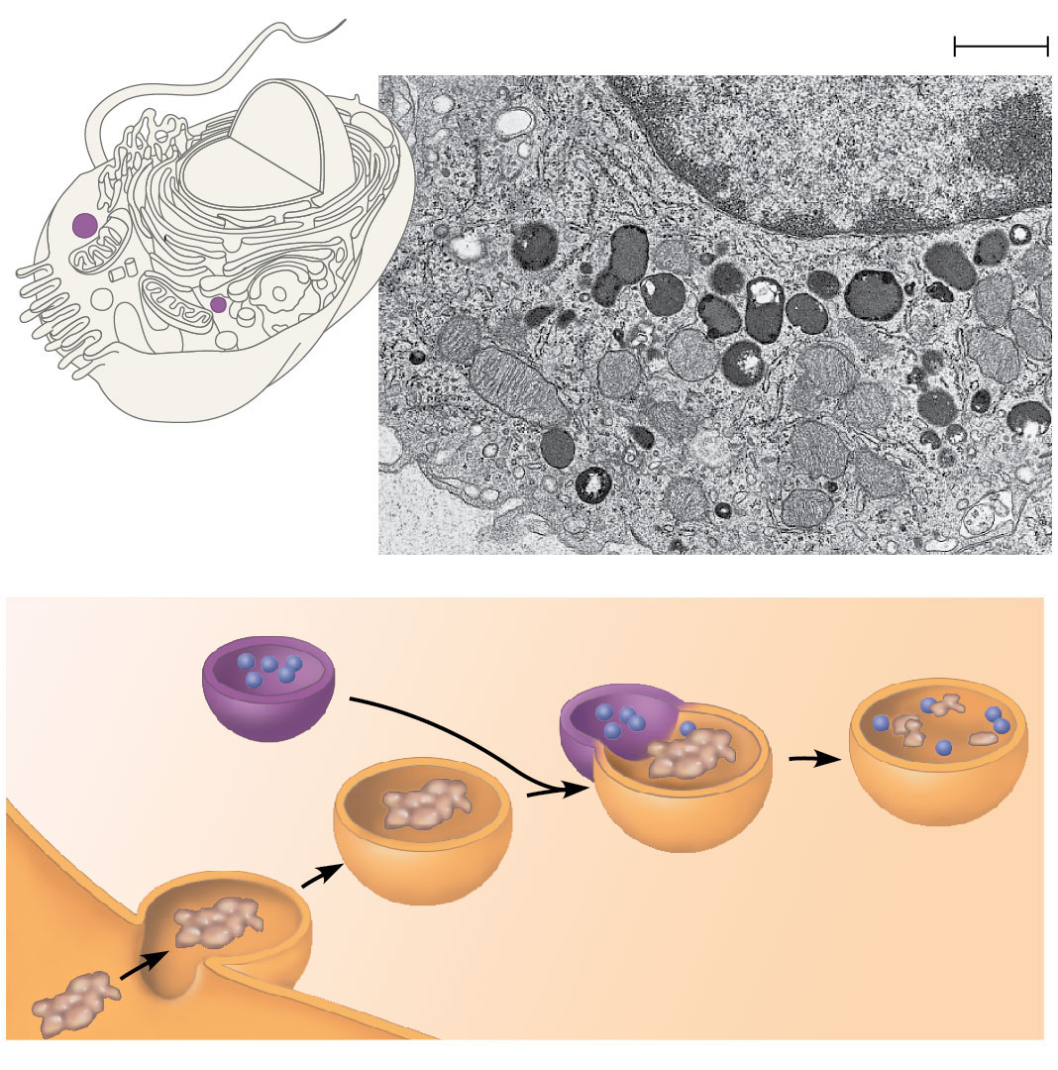
Figure 4.12
Nucleus
1 μm
Lysosome
Digestive
enzymes
Lysosome
Plasma
membrane
Digestion
Food
vacuole
© 2016 Pearson Education, Inc.
Notes:
Figure 4.12 Lysosomes: phagocytosis

Slide 26
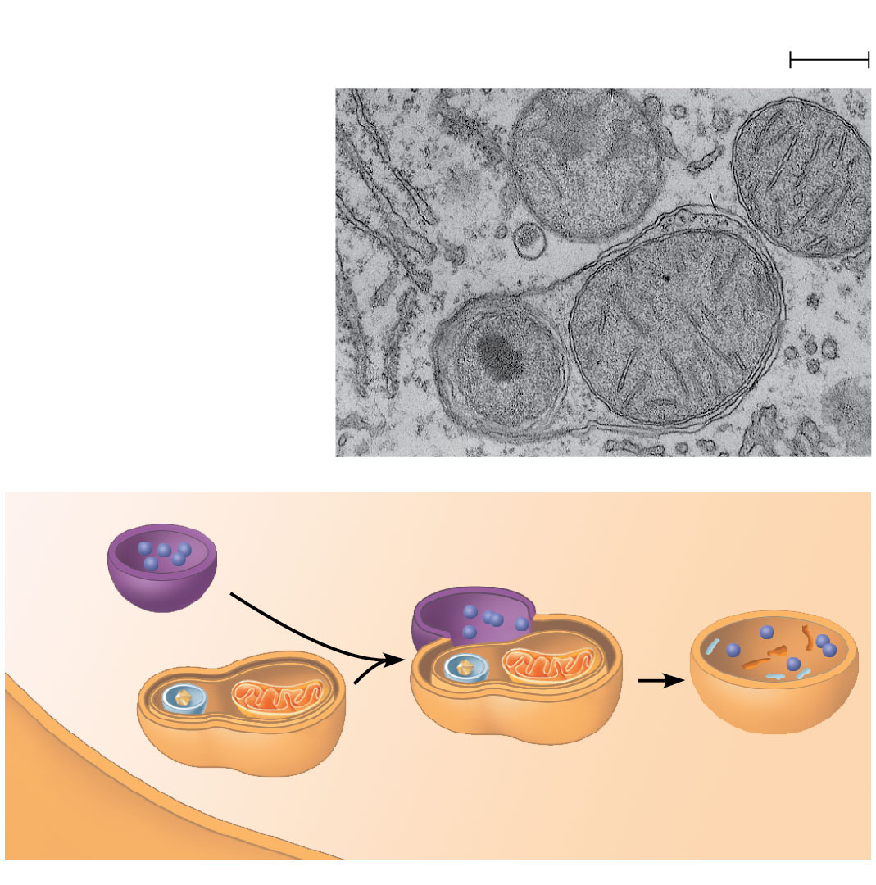
Figure 4.13
Vesicle containing
two damaged organelles
1 μm
Mitochondrion
fragment
Peroxisome
fragment
Lysosome
Peroxisome
Mitochondrion
Digestion
Vesicle
© 2016 Pearson Education, Inc.
Notes:
Figure 4.13 Lysosomes: autophagy

Slide 27
Vacuoles: Diverse Maintenance Compartments
Vacuoles are large vesicles derived from the endoplasmic reticulum and Golgi apparatus
The solution inside a vacuole differs in composition from the cytosol
Notes:
27

Slide 28
Food vacuoles are formed by phagocytosis
Contractile vacuoles, found in many freshwater protists, pump excess water out of cells
Central vacuoles, found in many mature plant cells, hold organic compounds and water
Certain vacuoles in plants and fungi carry out enzymatic hydrolysis like lysosomes
Notes:
28

Slide 29
The Endomembrane System: A Review
The endomembrane system is a complex and dynamic player in the cell’s compartmental organization
Notes:
29

Slide 30
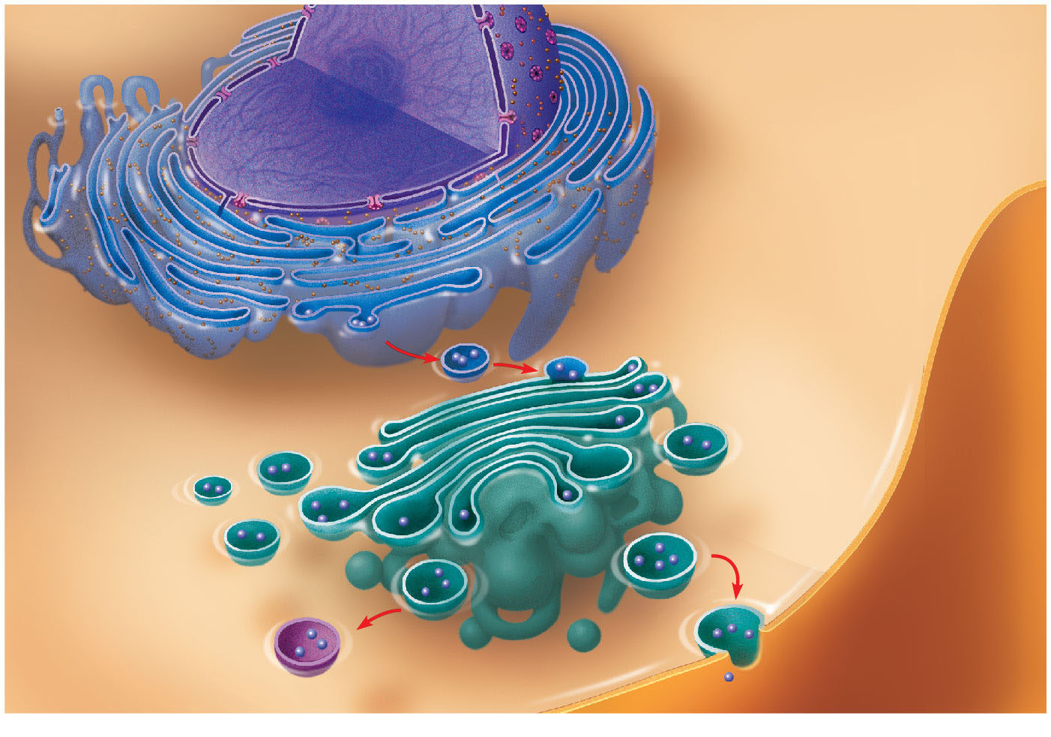
Figure 4.15
Nucleus
Rough ER
Smooth ER
cis Golgi
Plasma
membrane
trans Golgi
© 2016 Pearson Education, Inc.
Notes:
Figure 4.15 Review: relationships among organelles of the endomembrane system

Slide 31
Concept 4.5: Mitochondria and chloroplasts change energy from one form to another
Mitochondria are the sites of cellular respiration, a metabolic process that uses oxygen to generate ATP
Chloroplasts, found in plants and algae, are the sites of photosynthesis
Peroxisomes are oxidative organelles
Notes:
31

Slide 32
The Evolutionary Origins of Mitochondria and Chloroplasts
Mitochondria and chloroplasts display similarities with bacteria
Enveloped by a double membrane
Contain ribosomes and multiple circular DNA molecules
Grow and reproduce somewhat independently in cells
Notes:
32

Slide 33
The endosymbiont theory
An early ancestor of eukaryotic cells engulfed a nonphotosynthetic prokaryotic cell, which formed an endosymbiont relationship with its host
The host cell and endosymbiont merged into a single organism, a eukaryotic cell with a mitochondrion
At least one of these cells may have taken up a photosynthetic prokaryote, becoming the ancestor of cells that contain chloroplasts
Notes:
33

Slide 34
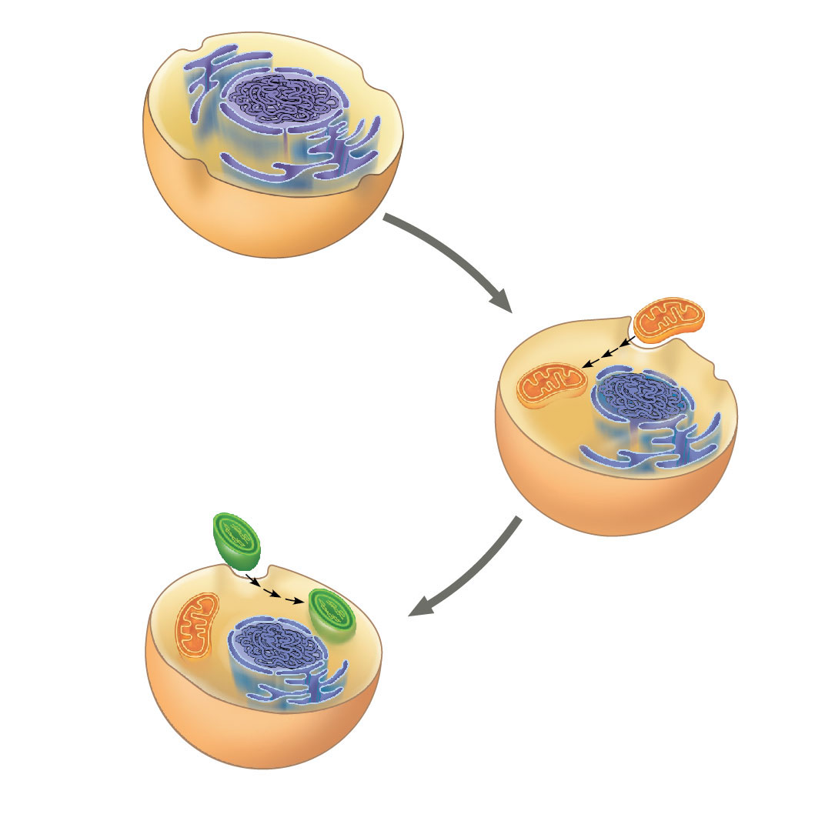
Figure 4.16
Endoplasmic
reticulum
Nucleus
Nuclear
envelope
Engulfing of oxygen-
using nonphotosynthetic
prokaryote, which,
becomes a mitochondrion
Ancestor of
eukaryotic cells (host cell)
Mitochondrion
Engulfing of
photosynthetic
prokaryote
Chloroplast
At least
one cell
Mitochondrion
Nonphotosynthetic
eukaryote
Photosynthetic eukaryote
© 2016 Pearson Education, Inc.
Notes:
Figure 4.16 The endosymbiont theory of the origins of mitochondria and chloroplasts in eukaryotic cells

Slide 35
Mitochondria: Chemical Energy Conversion
Mitochondria are in nearly all eukaryotic cells
They have a smooth outer membrane and an inner membrane folded into cristae
The inner membrane creates two compartments: intermembrane space and mitochondrial matrix
Some metabolic steps of cellular respiration are catalyzed in the mitochondrial matrix
Cristae present a large surface area for enzymes that synthesize ATP
Notes:
35

Slide 36
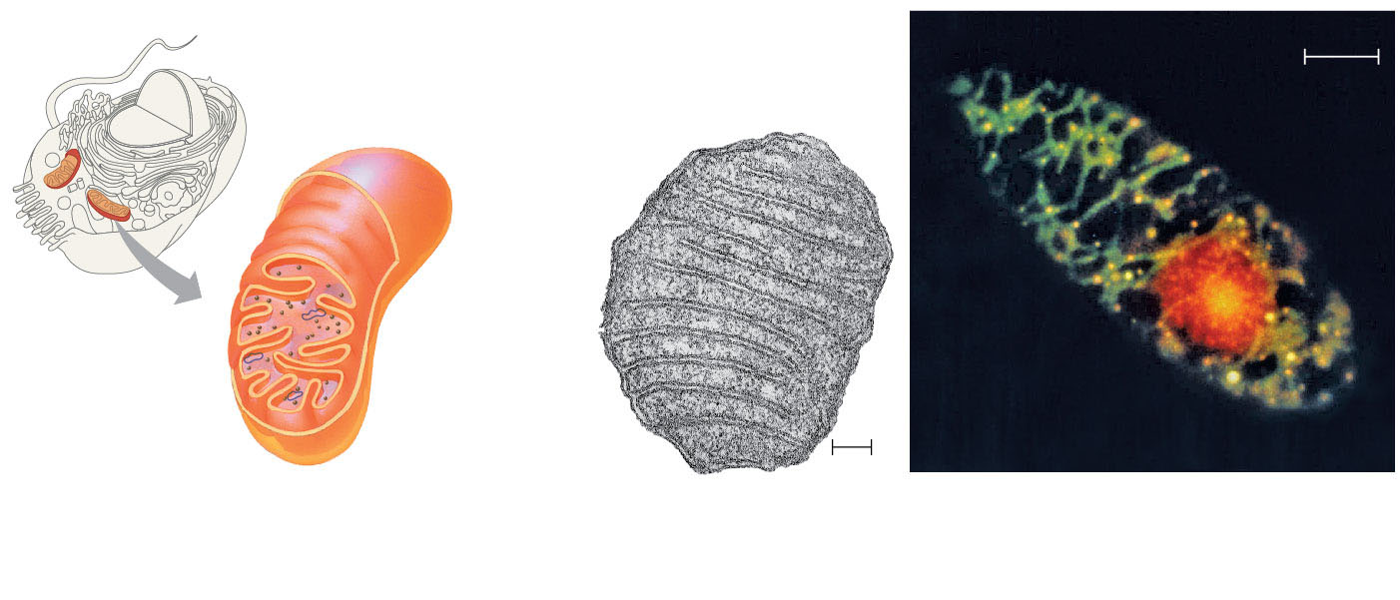
Figure 4.17
Mitochondrion
10 μm
Intermembrane space
Outer
membrane
Mitochondria
DNA
Inner
membrane
Mitochondrial
DNA
Free
ribosomes
in the
mitochondrial
matrix
Cristae
Matrix
Nuclear DNA
0.1 μm
(a) Diagram and TEM of mitochondrion
(b) Network of mitochondria in
Euglena (LM)
© 2016 Pearson Education, Inc.
Notes:
Figure 4.17 The mitochondrion, site of cellular respiration

Slide 37
Chloroplasts: Capture of Light Energy
Chloroplasts contain the green pigment chlorophyll, as well as enzymes and other molecules that function in photosynthesis
Chloroplasts are found in leaves and other green organs of plants and in algae
Notes:
37

Slide 38
Chloroplast structure includes
Thylakoids, membranous sacs, stacked to form a granum
Stroma, the internal fluid
The chloroplast is one of a group of plant organelles called plastids
Notes:
38

Slide 39
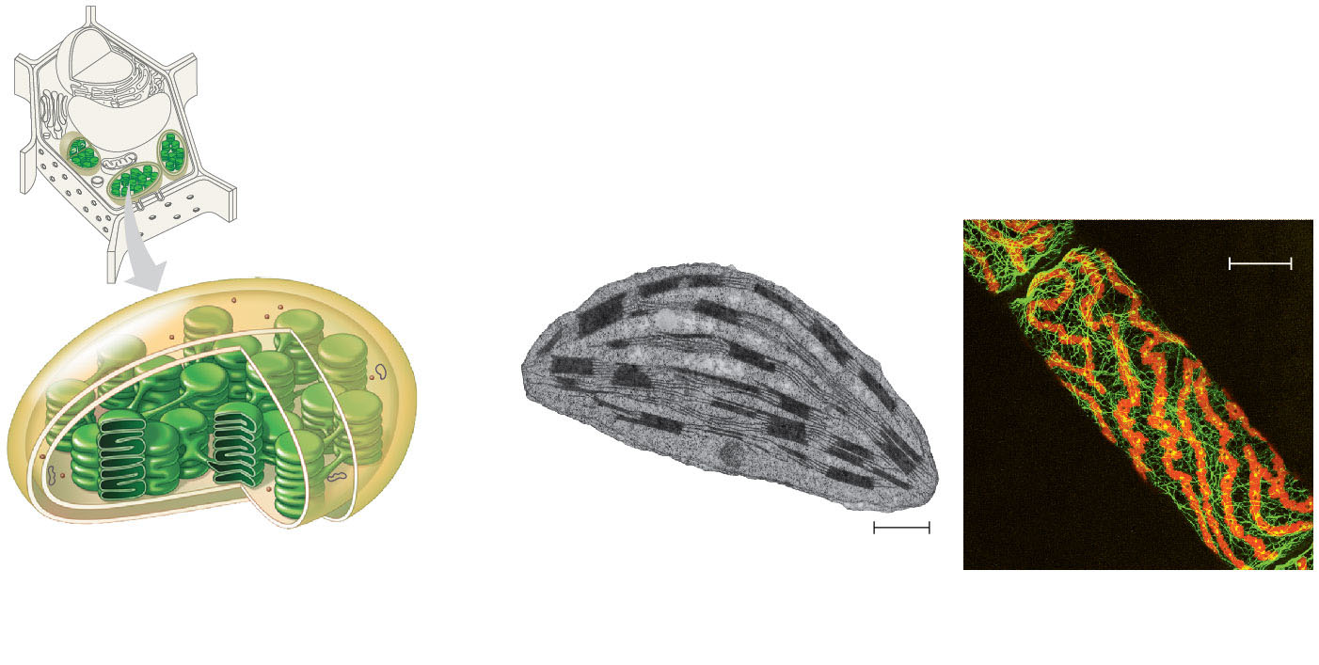
Figure 4.18
Chloroplast
Stroma
Ribosomes
Inner and outer
membranes
50 μm
Granum
DNA
Chloroplasts
(red)
Thylakoid
Intermembrane space
1 μm
(a) Diagram and TEM of chloroplast
(b) Chloroplasts in an algal
cell
© 2016 Pearson Education, Inc.
Notes:
Figure 4.18 The chloroplast, site of photosynthesis

Slide 40
Peroxisomes: Oxidation
Peroxisomes are specialized metabolic compartments bounded by a single membrane
Peroxisomes produce hydrogen peroxide and then convert it to water
Peroxisomes perform reactions with many different functions
Notes:
40

Slide 41
Concept 4.6: The cytoskeleton is a network of fibers that organizes structures and activities in the cell
The cytoskeleton is a network of fibers extending throughout the cytoplasm
It organizes the cell’s structures and activities
Notes:
41

Slide 42
Roles of the Cytoskeleton: Support and Motility
The cytoskeleton helps to support the cell and maintain its shape
It provides anchorage for many organelles and molecules
It interacts with motor proteins to produce motility
Inside the cell, vesicles and other organelles can “walk” along the tracks provided by the cytoskeleton
Notes:
42

Slide 43
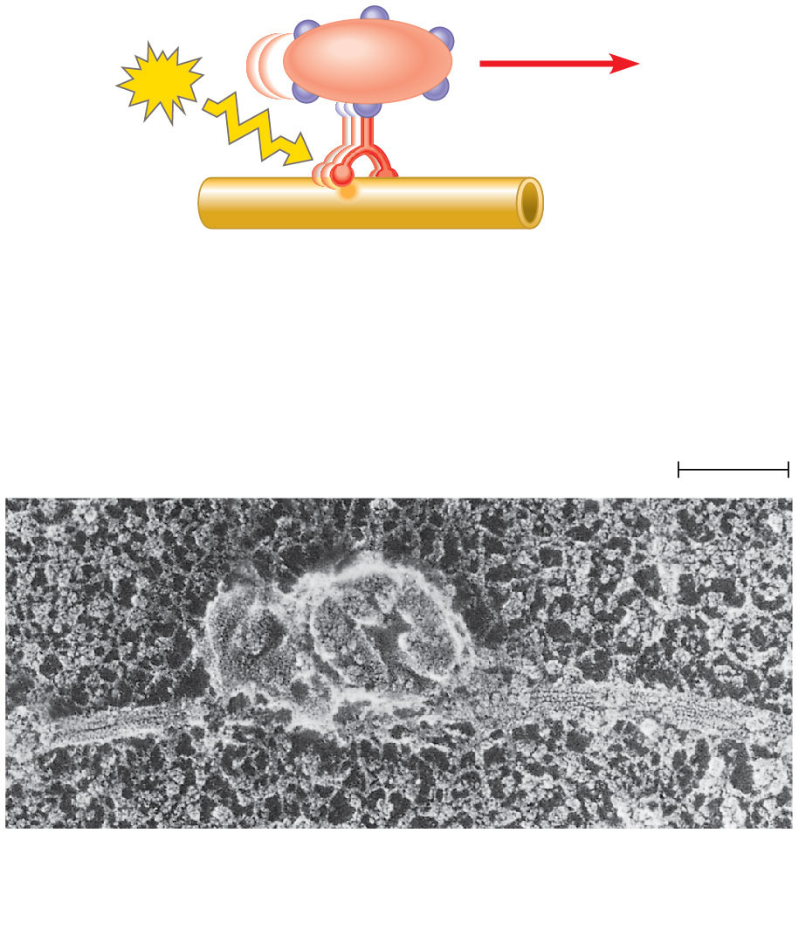
Figure 4.21
Vesicle
ATP
Receptor for
motor protein
Motor protein
(ATP powered)
Microtubule
of cytoskeleton
(a) Motor proteins “walkˮ vesicles along
cytoskeletal fibers.
Microtubule
Vesicles
0.25 μm
(b) Two vesicles move toward the tip of a nerve
cell extension called an axon (SEM)
© 2016 Pearson Education, Inc.
Notes:
Figure 4.21 Motor proteins and the cytoskeleton

Slide 44
Components of the Cytoskeleton
Three main types of fibers make up the cytoskeleton
Microtubules are the thickest of the three components of the cytoskeleton
Microfilaments, also called actin filaments, are the thinnest components
Intermediate filaments are fibers with diameters in a middle range
Notes:
44

Slide 45
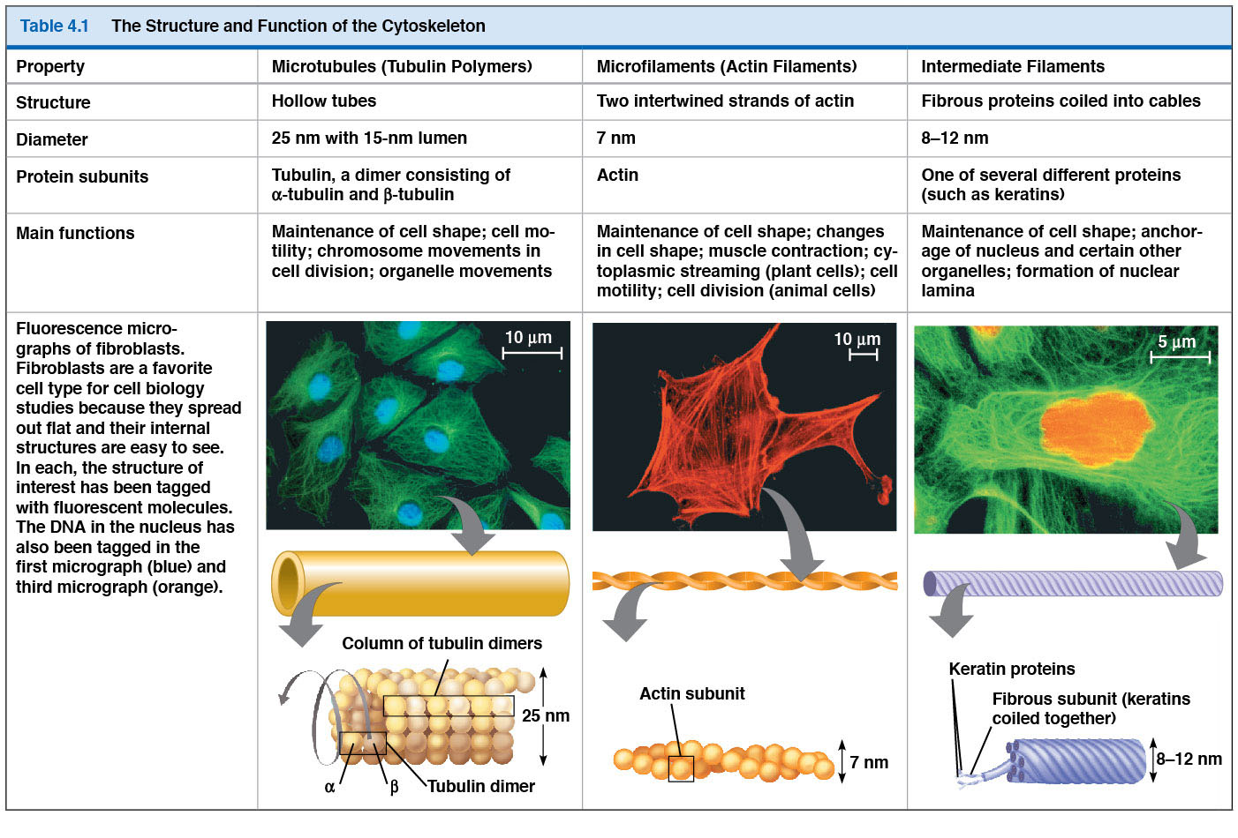
Figure 4.T01
© 2016 Pearson Education, Inc.
Notes:
Figure 4.T01 The structure and function of the cytoskeleton

Slide 46
Microtubules
Microtubules are hollow rods constructed from globular protein dimers called tubulin
Functions of microtubules
Shape and support the cell
Guide movement of organelles
Separate chromosomes during cell division
Notes:
46

Slide 47
Centrosomes and Centrioles
In animal cells, microtubules grow out from a centrosome near the nucleus
The centrosome is a “microtubule-organizing center”
The centrosome has a pair of centrioles, each with nine triplets of microtubules arranged in a ring
Notes:
47

Slide 48
Animation: Cilia Flagella

Slide 49
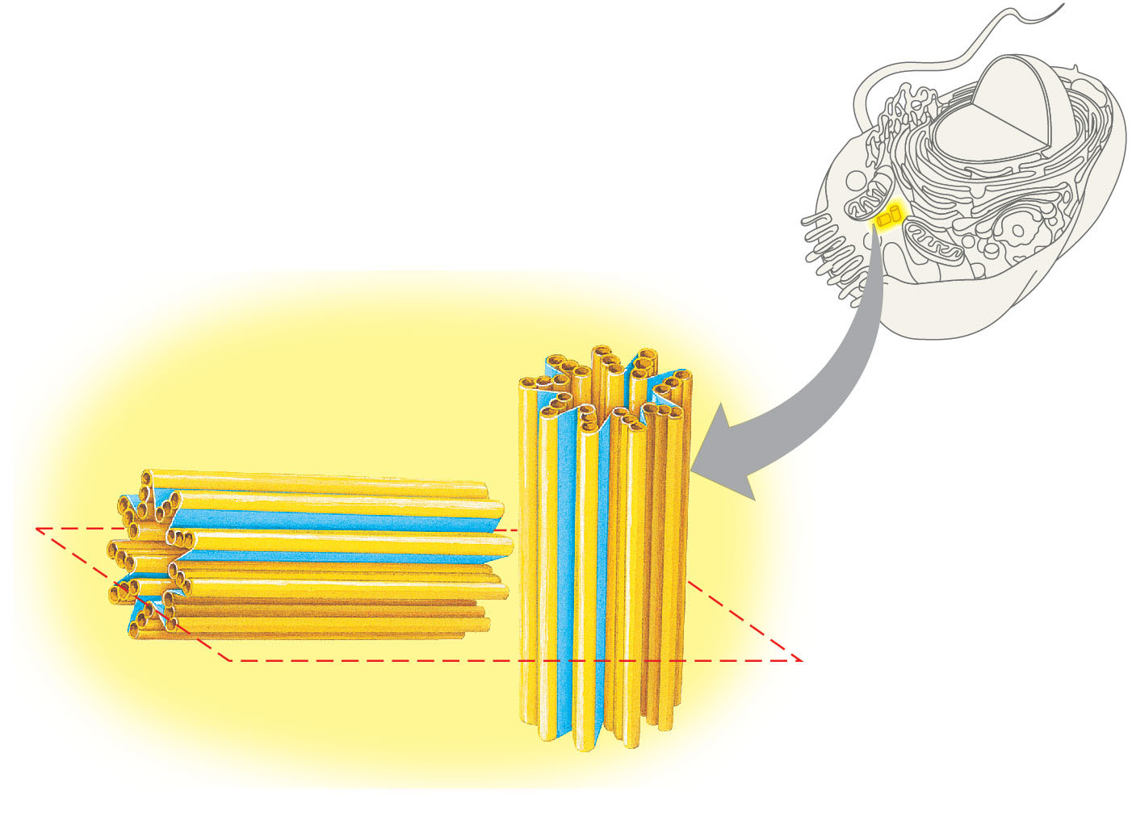
Figure 4.22
Centrosome
Microtubule
Centrioles
© 2016 Pearson Education, Inc.
Notes:
Figure 4.22 Centrosome containing a pair of centrioles

Slide 50
Cilia and Flagella
Microtubules control the beating of cilia and flagella, microtubule-containing extensions projecting from some cells
Flagella are limited to one or a few per cell, while cilia occur in large numbers on cell surfaces
Cilia and flagella also differ in their beating patterns
Notes:
50

Slide 51
Microfilaments (Actin Filaments)
Microfilaments are thin solid rods, built from molecules of globular actin subunits
The structural role of microfilaments is to bear tension, resisting pulling forces within the cell
Bundles of microfilaments make up the core of microvilli of intestinal cells
Notes:
51

Slide 52
Concept 4.7: Extracellular components and connections between cells help coordinate cellular activities
Most cells synthesize and secrete materials that are external to the plasma membrane
These extracellular materials are involved in many cellular functions
Notes:
52

Slide 53
Cell Walls of Plants
The cell wall is an extracellular structure that distinguishes plant cells from animal cells
The cell wall protects the plant cell, maintains its shape, and prevents excessive uptake of water
Plant cell walls are made of cellulose fibers embedded in other polysaccharides and protein
Notes:
53

Slide 54
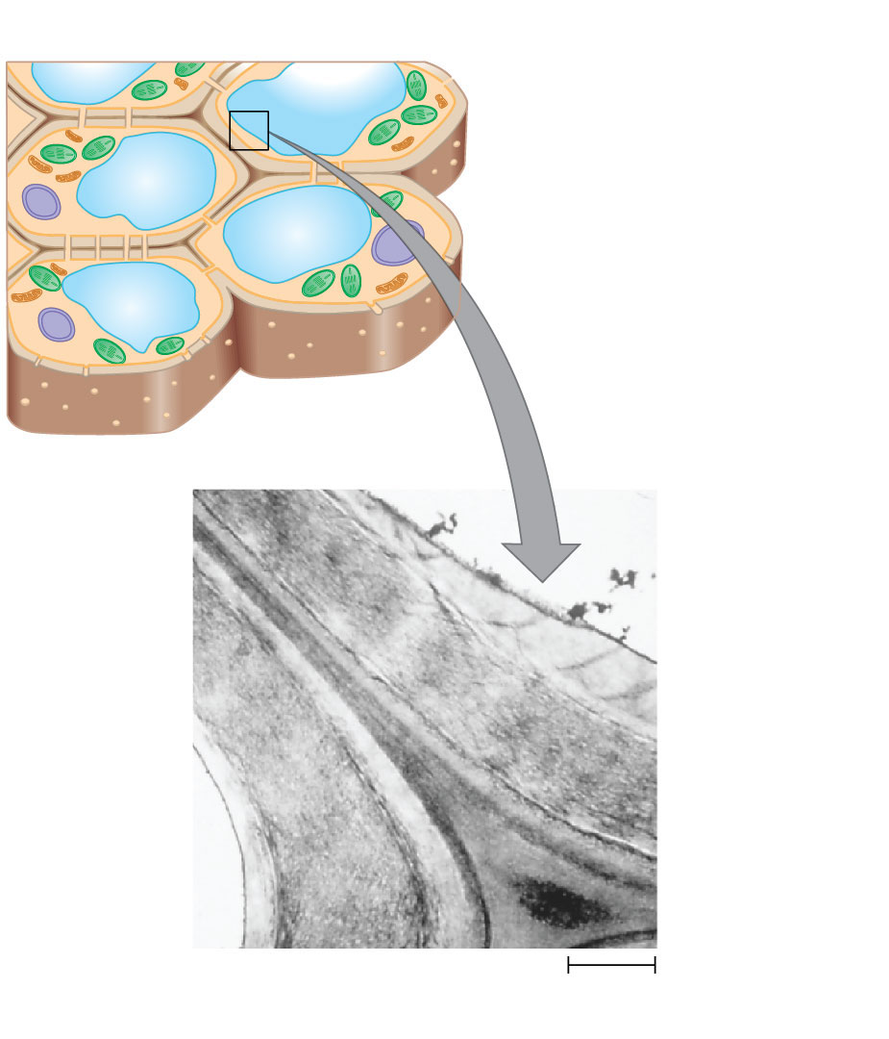
Figure 4.25
Central vacuole
Cytosol
Plasma membrane
Plant cell walls
Plasmodesmata
Secondary
cell wall
Primary
cell wall
Middle
lamella
1 μm
© 2016 Pearson Education, Inc.
Notes:
Figure 4.25 Plant cell walls

Slide 55
The Extracellular Matrix (ECM) of Animal Cells
Animal cells lack cell walls but are covered by an elaborate extracellular matrix (ECM)
The ECM is made up of glycoproteins such as collagen, proteoglycans, and fibronectin
ECM proteins bind to receptor proteins in the plasma membrane called integrins
Notes:
55

Slide 56
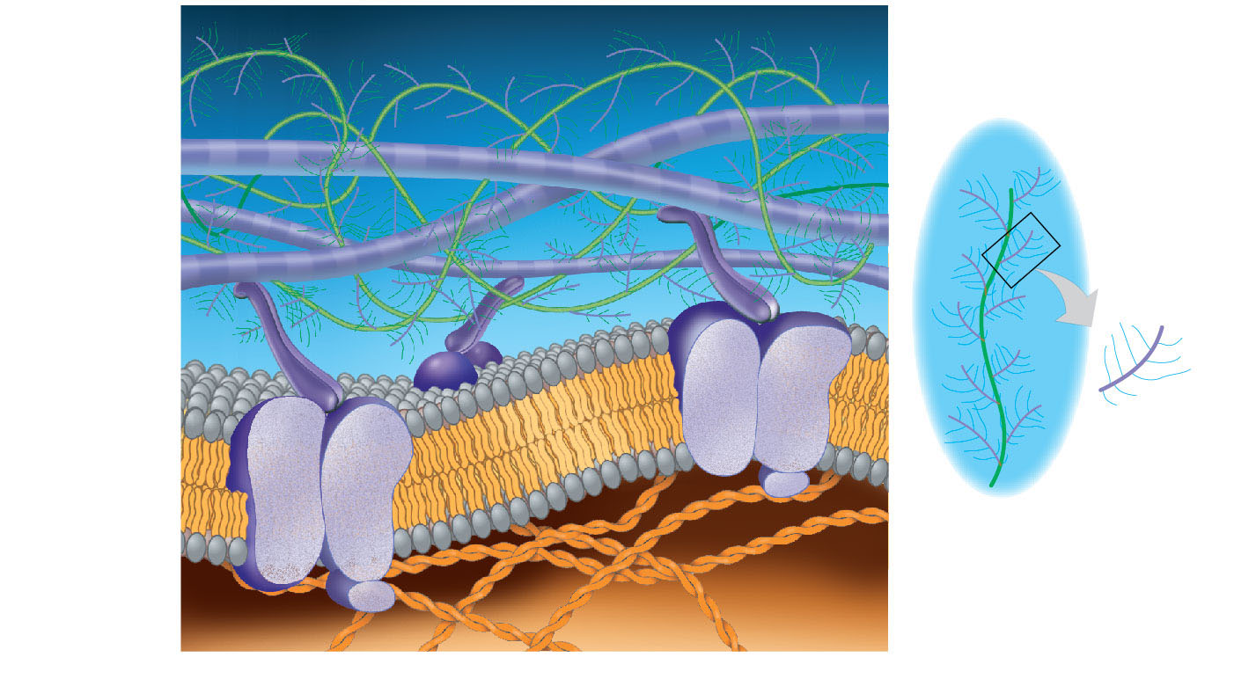
Figure 4.26
A proteoglycan complex:
Collagen
EXTRACELLULAR FLUID
Polysaccharide
molecule
Carbo-
hydrates
Fibronectin
Core
protein
Plasma
membrane
Proteoglycan
molecule
Micro-
filaments
CYTOPLASM
Integrins
© 2016 Pearson Education, Inc.
Notes:
Figure 4.26 Extracellular matrix (ECM) of an animal cell

Slide 57
Cell Junctions
Neighboring cells in an animal or plant often adhere, interact, and communicate through direct physical contact
There are several types of intercellular junctions that facilitate this
Plasmodesmata
Tight junctions
Desmosomes
Gap junctions
Notes:
57

Slide 58
Plasmodesmata in Plant Cells
Plasmodesmata are channels that perforate plant cell walls
Through plasmodesmata, water and small solutes (and sometimes proteins and RNA) can pass from cell to cell
Notes:
58

Slide 59
Tight Junctions, Desmosomes, and Gap Junctions in Animal Cells
Animal cells have three main types of cell junctions
Tight junctions
Desmosomes
Gap junctions
All are especially common in epithelial tissue
Notes:
59

