Slide 1
22
The Origin of Species

Slide 2
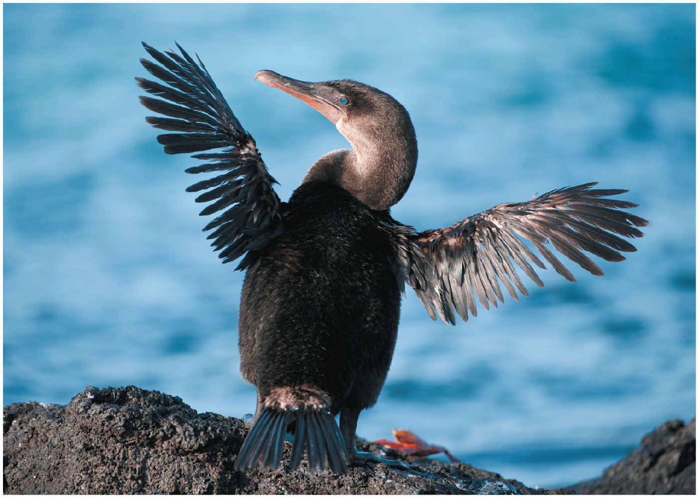
Figure 22.1
Notes:
Figure 22.1 How did this flightless bird come to live on the isolated Galápagos Islands?

Slide 3
Speciation is the process by which one species splits into two or more species
Speciation explains the features shared between organisms due to inheritance from their recent common ancestor
Notes:
3

Slide 4
Speciation forms a conceptual bridge between microevolution and macroevolution
Microevolution consists of changes in allele frequency in a population over time
Macroevolution refers to broad patterns of evolutionary change above the species level
Notes:
4

Slide 5
Reproductive Isolation
Reproductive isolation is the existence of biological barriers that impede two species from producing viable, fertile offspring
Sometimes hybrids, the offspring of crosses between different species, are successfully produced
Reproductive barriers can be classified by whether they act before or after fertilization
Notes:
5

Slide 6
Prezygotic barriers block fertilization from occurring by
Impeding different species from attempting to mate
Preventing the successful completion of mating
Hindering fertilization if mating is successful
Notes:
6

Slide 7
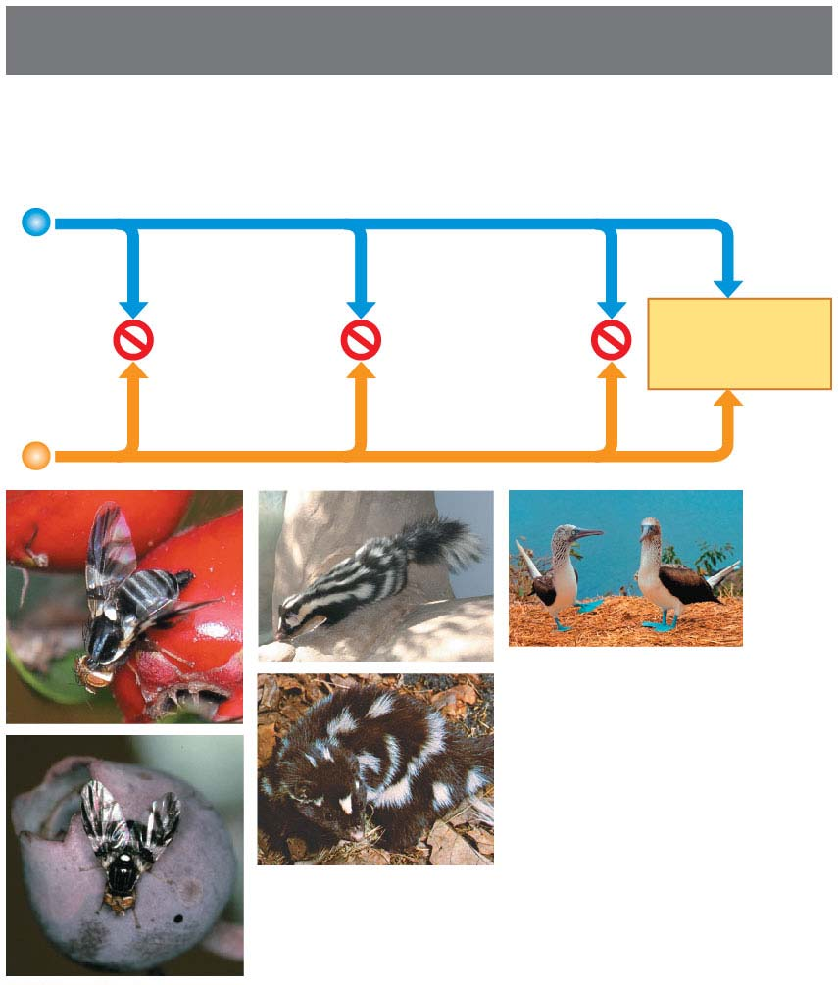
Figure 22.3-1
Prezygotic barriers
Habitat
isolation
Temporal
isolation
Behavioral
isolation
MATING
ATTEMPT
(a)
(c)
(e)
(d)
(b)
Notes:
Figure 22.3-1 Exploring reproductive barriers (part 1: prezygotic barriers)

Slide 8
Habitat isolation: Two species encounter each other rarely, or not at all, because they occupy different habitats, even though not isolated by physical barriers
Notes:
8

Slide 9
Temporal isolation: Species that breed at different times of the day, different seasons, or different years cannot mix their gametes
Notes:
9

Slide 10
Behavioral isolation: Courtship rituals and other behaviors unique to a species are effective barriers
Notes:
10

Slide 11
Figure 22.3-2
Prezygotic barriers
Mechanical
isolation
Gametic
isolation
MATING
ATTEMPT
FERTILIZATION
(f)
(g)
Notes:
Figure 22.3-2 Exploring reproductive barriers (part 2: prezygotic barriers)

Slide 12
Mechanical isolation: Morphological differences prevent successful mating
Notes:
12

Slide 13
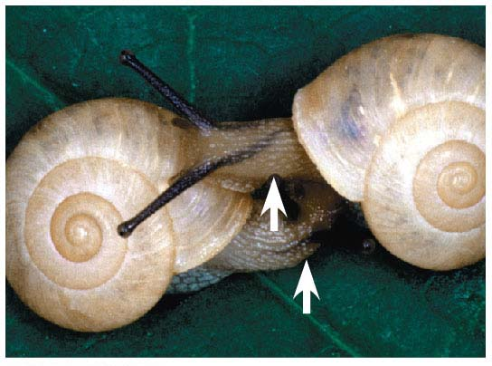
Figure 22.3-2f
(f)
Notes:
Figure 22.3-2f Exploring reproductive barriers (part 2f: mechanical isolation)

Slide 14
Gametic isolation: Sperm of one species may not be able to fertilize eggs of another species
Notes:
14

Slide 15
Postzygotic barriers prevent the hybrid zygote from developing into a viable, fertile adult by
Reduced hybrid viability
Reduced hybrid fertility
Hybrid breakdown
Notes:
15

Slide 16
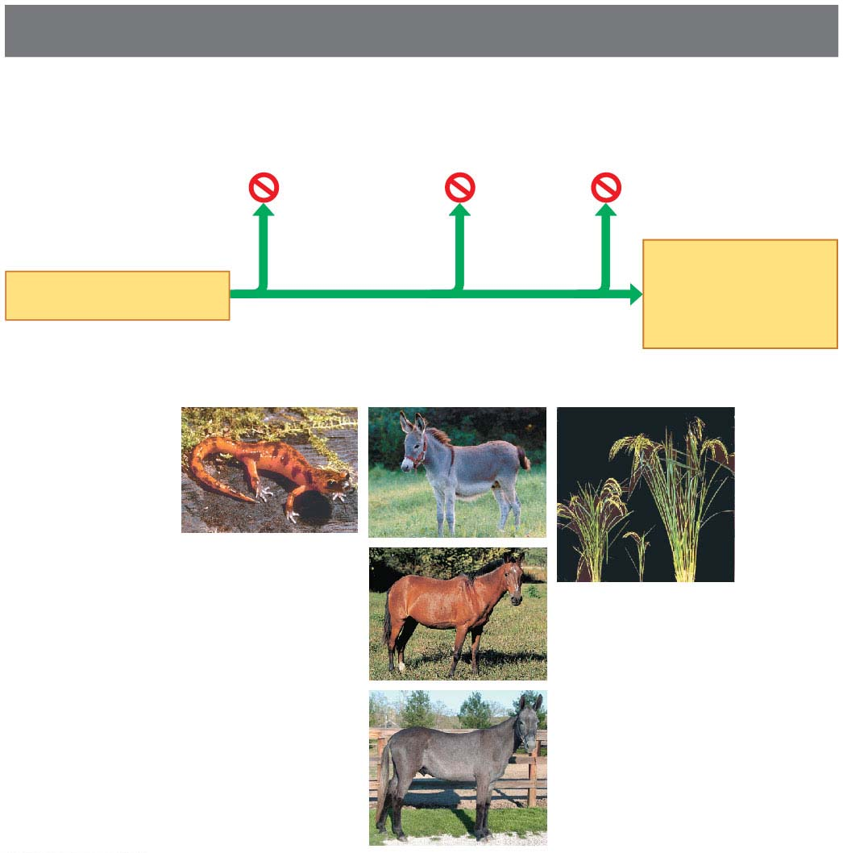
Figure 22.3-3
Postzygotic barriers
Reduced
hybrid
viability
Reduced
hybrid
fertility
Hybrid
breakdown
VIABLE,
FERTILE
OFFSPRING
FERTILIZATION
(h)
(i)
(l)
(j)
(k)
Notes:
Figure 22.3-3 Exploring reproductive barriers (part 3: postzygotic barriers)

Slide 17
Reduced hybrid viability: Genes of the different parent species may interact and impair the hybrid’s development or survival
Notes:
17

Slide 18
Reduced hybrid fertility: Even if hybrids are vigorous, they may be sterile
Notes:
18

Slide 19
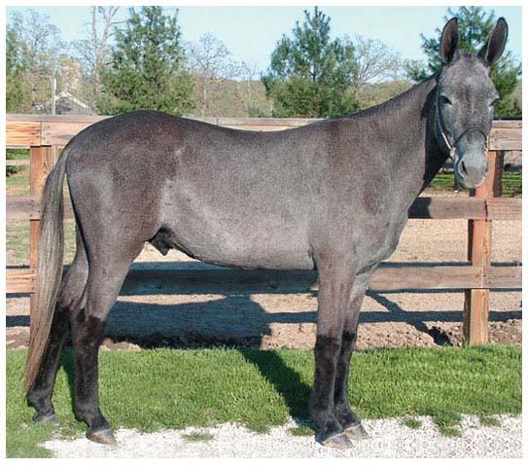
Figure 22.3-3k
(k)
Notes:
Figure 22.3-3k Exploring reproductive barriers (part 3k: reduced hybrid fertility, mule)

Slide 20
Hybrid breakdown: Some first-generation hybrids are fertile, but when they mate with another species or with either parent species, offspring of the next generation are feeble or sterile
Notes:
20

Slide 21
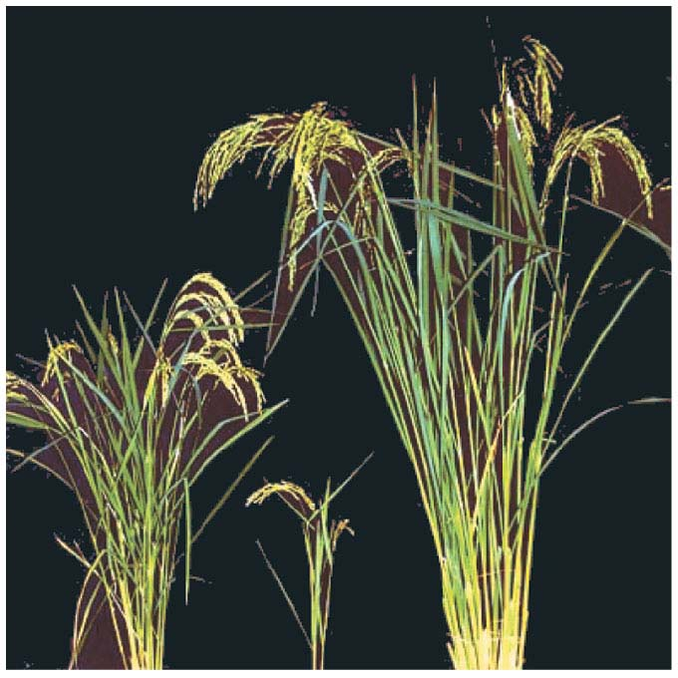
Figure 22.3-3l
(l)
Notes:
Figure 22.3-3l Exploring reproductive barriers (part 3l: hybrid breakdown)

Slide 22
Figure 22.3
Prezygotic barriers
Postzygotic barriers
Habitat
isolation
Temporal
isolation
Behavioral
isolation
Mechanical
isolation
Gametic
isolation
Reduced
hybrid
viability
Reduced
hybrid
fertility
Hybrid
breakdown
VIABLE,
FERTILE
OFF-
SPRING
MATING
ATTEMPT
FERTILI-
ZATION
(a)
(c)
(e)
(f)
(g)
(h)
(i)
(l)
(d)
(j)
(b)
(k)
Notes:
Figure 22.3 Exploring reproductive barriers

Slide 23
Limitations of the Biological Species Concept
The biological species concept cannot be applied to fossils or asexual organisms (including all prokaryotes)
The biological species concept emphasizes absence of gene flow
However, gene flow can occur between distinct species
For example, grizzly bears and polar bears can mate to produce “grolar bears”
Notes:
23

Slide 24
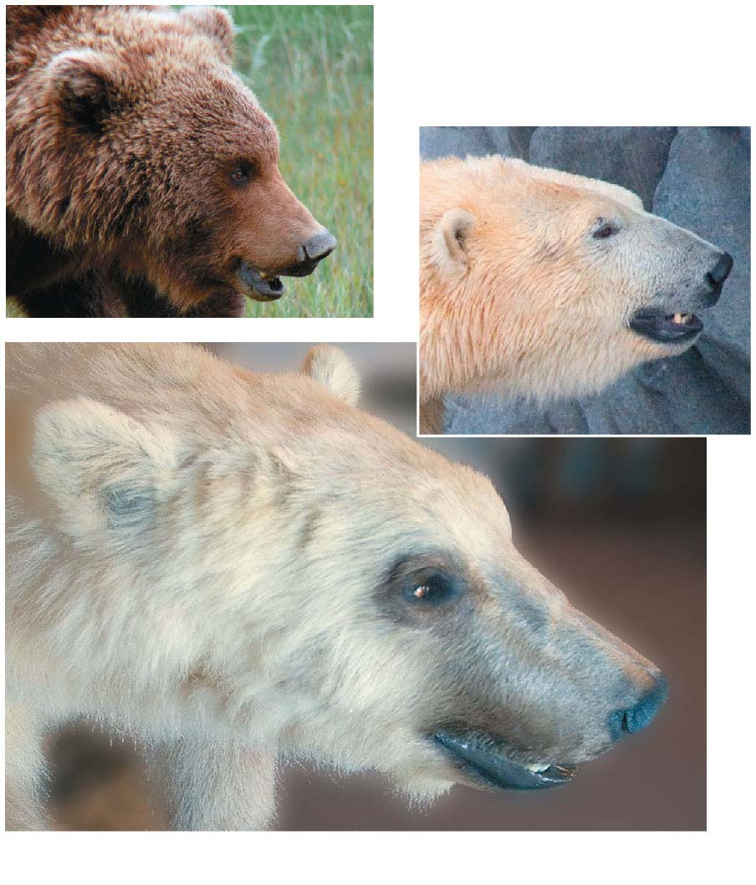
Figure 22.4
Grizzly bear (U. arctos)
Polar bear
(U. maritimus)
Hybrid “grolar bear”
Notes:
Figure 22.4 Hybridization between two species of bears in the genus Ursus

Slide 25
Concept 22.2: Speciation can take place with or without geographic separation
Speciation can occur in two ways
Allopatric speciation
Sympatric speciation
Notes:
25

Slide 26
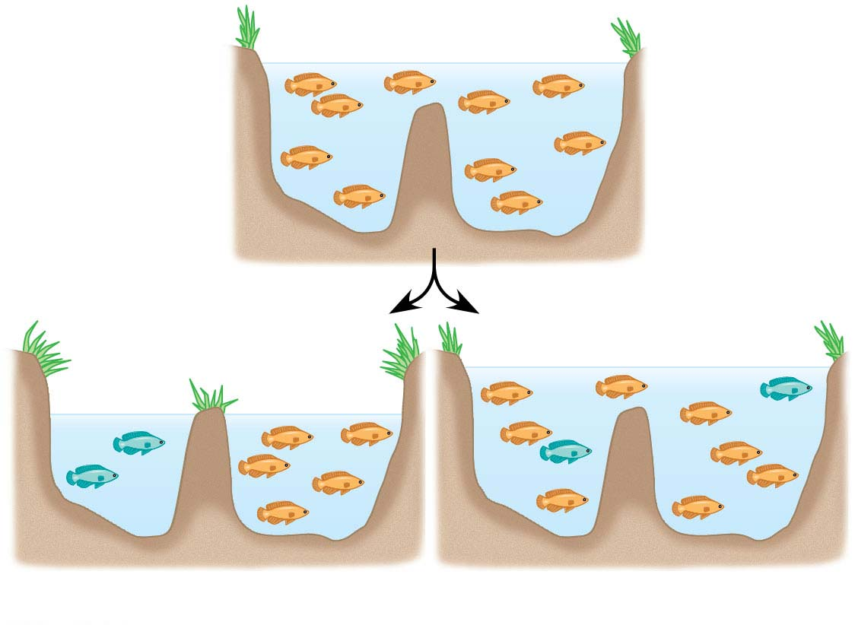
Figure 22.5
(a) Allopatric speciation
(b) Sympatric speciation
Notes:
Figure 22.5 The geography of speciation

Slide 27
Allopatric (“Other Country”) Speciation
In allopatric speciation, gene flow is interrupted when a population is divided into geographically isolated subpopulations
For example, the flightless cormorant of the Galápagos likely originated from a flying species on the mainland
Notes:
27

Slide 28
The Process of Allopatric Speciation
The definition of a geographic barrier depends on the ability of a population to disperse
For example, a canyon may create a barrier for small rodents, but not birds, coyotes, or pollen
Notes:
28

Slide 29
Separate populations may evolve independently through mutation, natural selection, and genetic drift
Reproductive isolation may arise as a result of genetic divergence
For example, mosquitofish in the Bahamas comprise several isolated populations in different ponds
Populations in ponds with high predation rates have evolved different body shapes from populations in “low-predation” ponds
Notes:
29

Slide 30
Evidence of Allopatric Speciation
Reproductive barriers can develop in lab populations that are experimentally isolated and subjected to different environmental conditions
For example, isolated lab populations of fruit flies raised on different diets evolve to digest their food source more efficiently and prefer to mate with partners adapted to the same food source
Notes:
30

Slide 31
Regions with many geographic barriers typically have more species than do regions with fewer barriers
Reproductive isolation between populations generally increases as the geographic distance between them increases
Reproductive isolation is the result of intrinsic barriers; physical separation is not a biological barrier
Notes:
31

Slide 32
Sympatric (“Same Country”) Speciation
In sympatric speciation, speciation takes place in populations that live in the same geographic area
Sympatric speciation occurs when gene flow is reduced between groups that remain in contact through factors including
Polyploidy
Habitat differentiation
Sexual selection
Notes:
32

Slide 33
Polyploidy
Polyploidy is the presence of extra sets of chromosomes due to accidents during cell division
Polyploidy is much more common in plants than in animals
An autopolyploid is an individual with more than two chromosome sets, derived from one species
The offspring of mating between autopolyploids and diploids have reduced fertility
Notes:
33

Slide 34
An allopolyploid is a species with multiple sets of chromosomes derived from different species
Allopolyploids can successfully mate with each other but cannot interbreed with either parent species
Notes:
34

Slide 35
At least five new plant species have evolved by polyploidy speciation since 1850
For example, three diploid species of goatsbeard plant (Tragopogon) have interbred to produce two new tetraploid species
Notes:
35

Slide 36
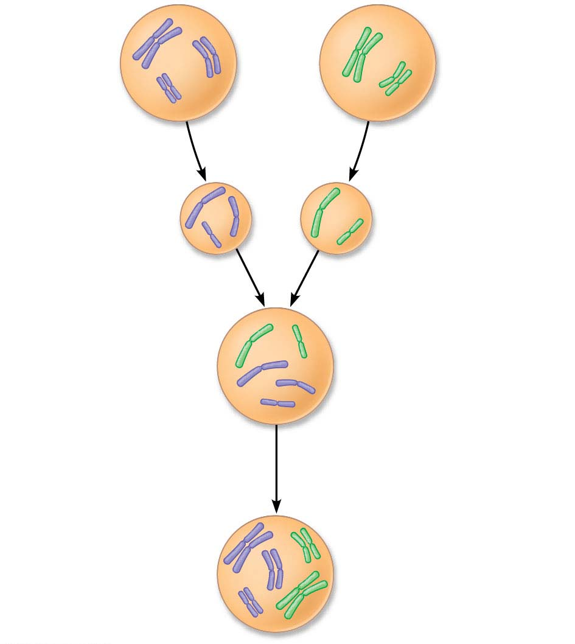
Figure 22.10-s3
Species A
2n = 6
Species B
2n = 4
Normal gamete
n = 3
Normal gamete
n = 2
Sterile hybrid with
5 chromosomes
Mitotic or meiotic error
doubles the chromosome
number.
New species:
viable, fertile hybrid
(allopolyploid)
2n = 10
Notes:
Figure 22.10-s3 One mechanism for allopolyploid speciation in plants (step 3)

Slide 37
Many important crops (oats, cotton, potatoes, tobacco, and wheat) are polyploids
Plant geneticists can produce new polyploid species using chemicals to induce errors in cell division
Notes:
37

Slide 38
Habitat Differentiation
Sympatric speciation can also result from the appearance of new ecological niches
For example, the North American maggot fly can live on native hawthorn trees as well as more recently introduced apple trees
Flies that use different host species are reproductively isolated by both habitat and temporal barriers
Notes:
38

Slide 39
Sexual Selection
Sexual selection can drive sympatric speciation
Sexual selection for mates of different colors has likely contributed to speciation in cichlid fish in Lake Victoria
Notes:
39

Slide 40
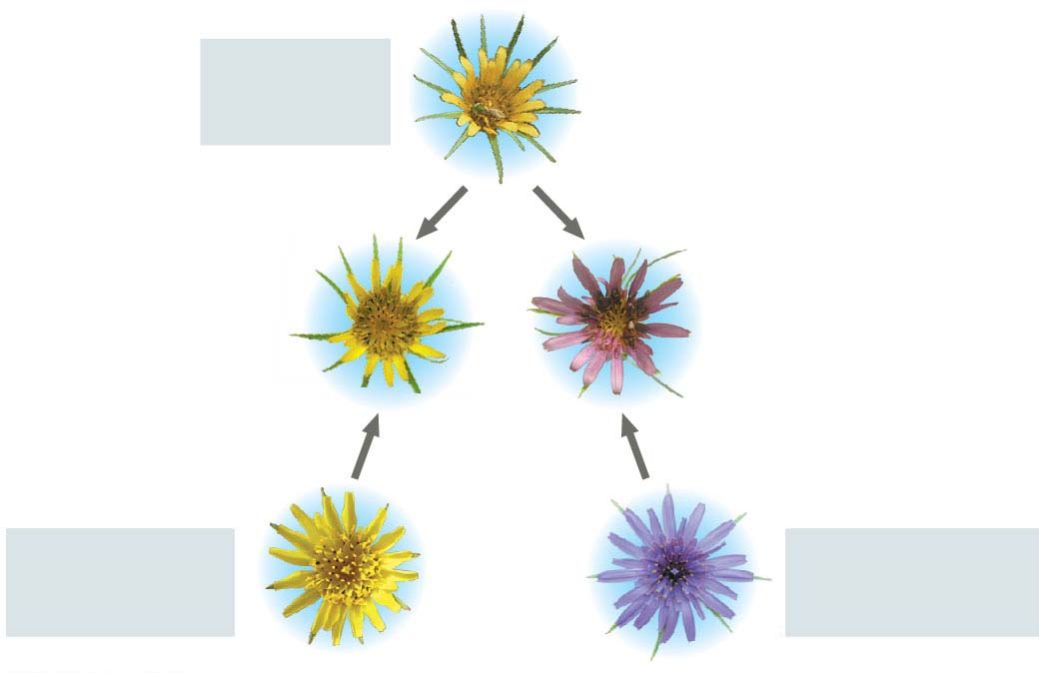
Figure 22.11
T. dubius
(12)
Hybrid species:
T. miscellus
(24)
Hybrid species:
T. mirus
(24)
T. pratensis
(12)
T. porrifolius
(12)
Notes:
Figure 22.11 Allopolyploid speciation in Tragopogon

Slide 41
Concept 22.3: Hybrid zones reveal factors that cause reproductive isolation
A hybrid zone is a region in which members of different species mate and produce hybrids
Hybrids are the result of mating between species with incomplete reproductive barriers
Notes:
41

Slide 42
Patterns Within Hybrid Zones
A hybrid zone can occur in a single band where adjacent species meet
For example, two species of toad in the genus Bombina interbreed in a long and narrow hybrid zone
Notes:
42

Slide 43
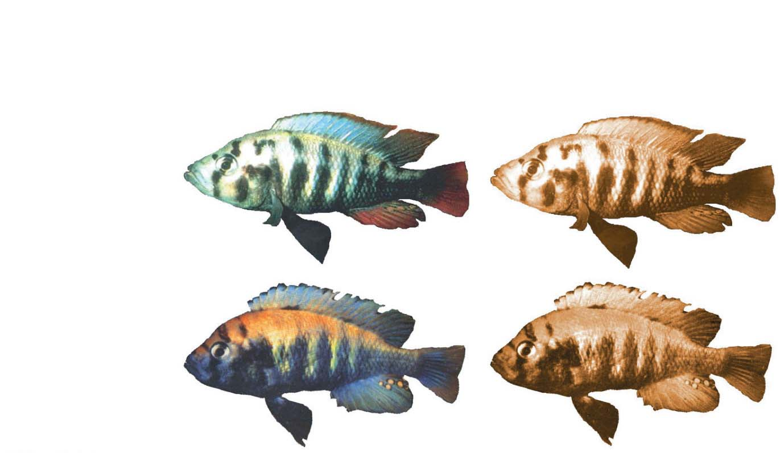
Figure 22.12
Experiment
Monochromatic
orange light
Normal light
P. pundamilia
P. nyererei
Notes:
Figure 22.12 Inquiry: Does sexual selection in cichlids result in reproductive isolation?

Slide 44
Hybrids often have reduced fitness compared with parent species
The distribution of hybrid zones can be more complex if parent species are found in patches within the same region
Notes:
44

Slide 45
Hybrid Zones over Time
When closely related species meet in a hybrid zone, there are three possible outcomes
Reinforcement
Fusion
Stability
Notes:
45

Slide 46
Reinforcement occurs when hybrids are less fit than the parent species
Natural selection strengthens (reinforces) reproductive barriers, and over time the rate of hybridization decreases
Where reinforcement occurs, reproductive barriers should be stronger for sympatric than for allopatric species
Notes:
46

Slide 47
Fusion of the parent species into a single species may occur if hybrids are as fit as parents, allowing substantial gene flow between species
For example, fusion of cichlid species in Lake Victoria may be occurring because water pollution has reduced the ability of female cichlids to distinguish males of different species by color
Notes:
47

Slide 48
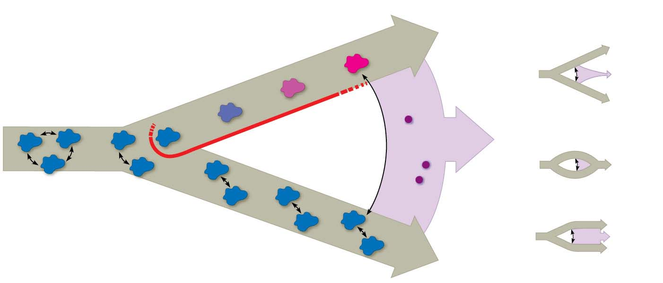
Figure 22.14-s4
Isolated
population
diverges.
Possible
outcomes:
Hybrid
zone
Reinforcement
Gene flow
Fusion
Population
Barrier to
gene flow
Hybrid
individual
Stability
Notes:
Figure 22.14-s4 Formation of a hybrid zone and possible outcomes for hybrids over time (step 4)

Slide 49
Stability of the hybrid zone will result if hybrids continue to be produced over time
This may occur if hybrids are at least as likely to survive and reproduce as their parent species
If they are not, gene flow from outside may overwhelm selection for increased reproductive isolation inside the hybrid zone
Notes:
49

Slide 50
Concept 22.4: Speciation can occur rapidly or slowly and can result from changes in few or many genes
Many questions remain concerning how long it takes for new species to form, or how many genes need to differ between species
Notes:
50

Slide 51
Patterns in the Fossil Record
The fossil record includes examples of species that appear suddenly, persist essentially unchanged for some time, and then disappear
These periods of apparent stasis punctuated by sudden change are called punctuated equilibria
The punctuated equilibrium model contrasts with a model of gradual change in a species’ existence
Notes:
51

Slide 52
Speciation Rates
The punctuated pattern in the fossil record and evidence from lab studies suggest that speciation can be rapid
For example, the sunflower Helianthus anomalus originated from the hybridization of two other sunflower species and quickly diverged into a new species
Notes:
52

Slide 53
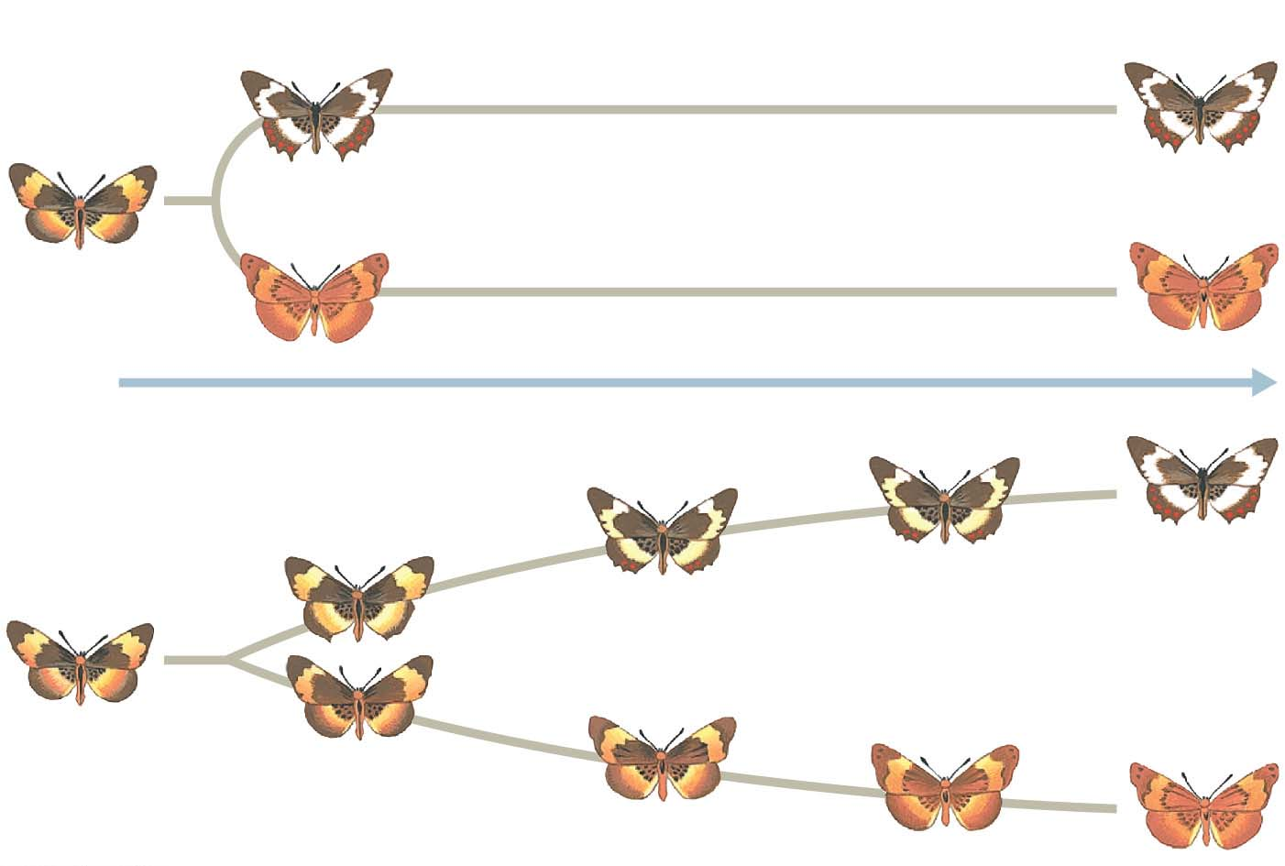
Figure 22.16
(a) Punctuated model
Time
(b) Gradual model
Notes:
Figure 22.16 Two models for the tempo of speciation

Slide 54
The interval between documented speciation events ranges from 4,000 years (some cichlids) to 40 million years (some beetles), with an average of 6.5 million years
Notes:
54

Slide 55
Studying the Genetics of Speciation
A fundamental question of evolutionary biology persists: How many genes change when a new species forms?
Depending on the species in question, speciation might require the change of only a single gene or many genes
For example, in Japanese Euhadra snails, the direction of shell spiral affects mating and is controlled by a single gene
Notes:
55

Slide 56
In monkey flowers (Mimulus), two genes affect flower color, which influences pollinator attraction
Monkey flowers with different alleles at the flower color loci are less likely to interbreed because they attract different species of pollinators
Notes:
56

Slide 57
In other organisms, speciation can be influenced by larger numbers of genes and gene interactions
For example, isolation between species of sunflowers in the genus Helianthus is influenced by at least 26 chromosome sections (number of genes unknown)
Notes:
57

Slide 58
From Speciation to Macroevolution
Macroevolution is large-scale evolutionary change resulting from the cumulative effect of many speciation and extinction events
Notes:
58

Slide 59
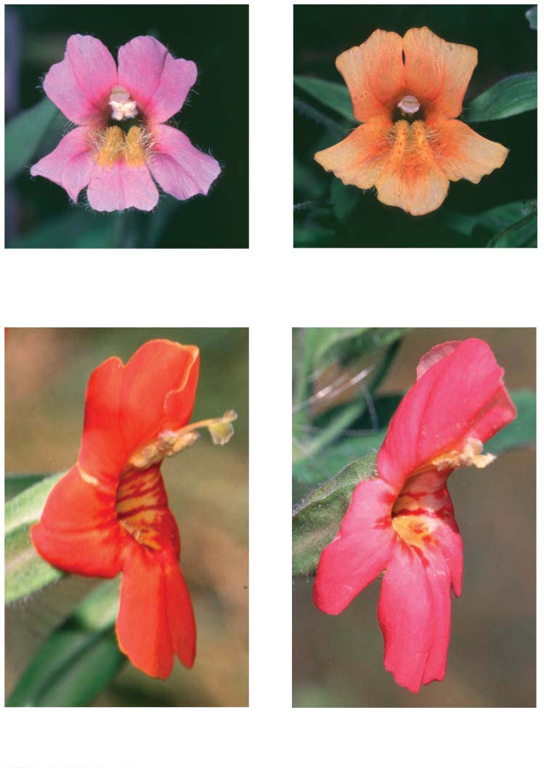
Figure 22.19
(a) Mimulus lewisii
(b) M. lewisii with M. cardinalis allele
(c) Mimulus cardinalis
(d) M. cardinalis with M. lewisii allele
Notes:
Figure 22.19 A locus that influences pollinator choice

