Slide 1
20
Phylogeny

Slide 2
Investigating the Evolutionary History of Life
Legless lizards and snakes evolved from different lineages of lizards with legs
Legless lizards have evolved independently in several different groups through adaptation to similar environments

Slide 3
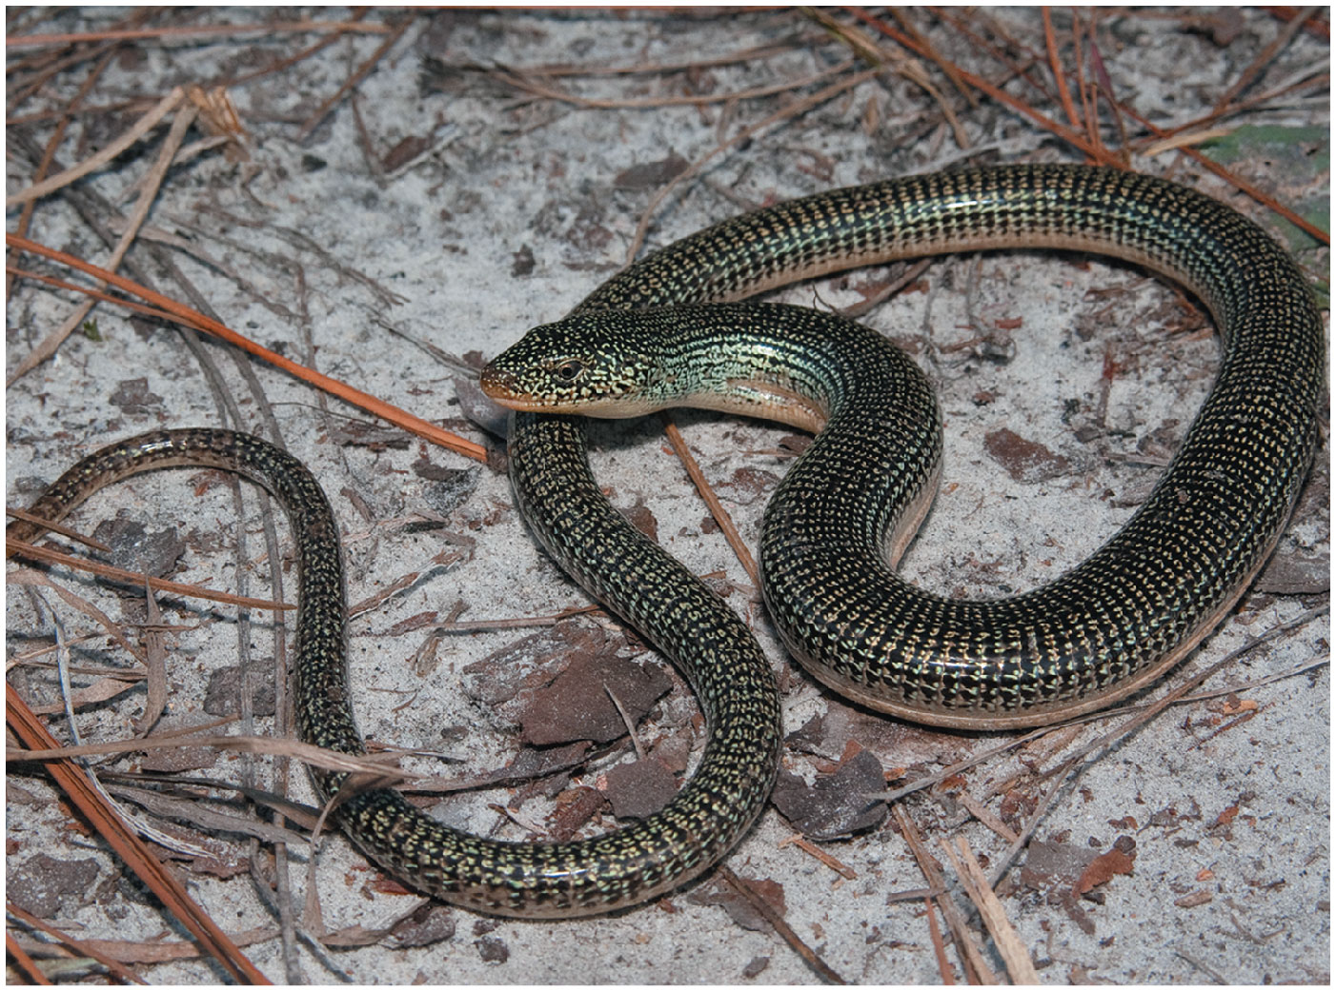
Figure 20.1
Notes:
Figure 20.1 What kind of organism is this?

Slide 4
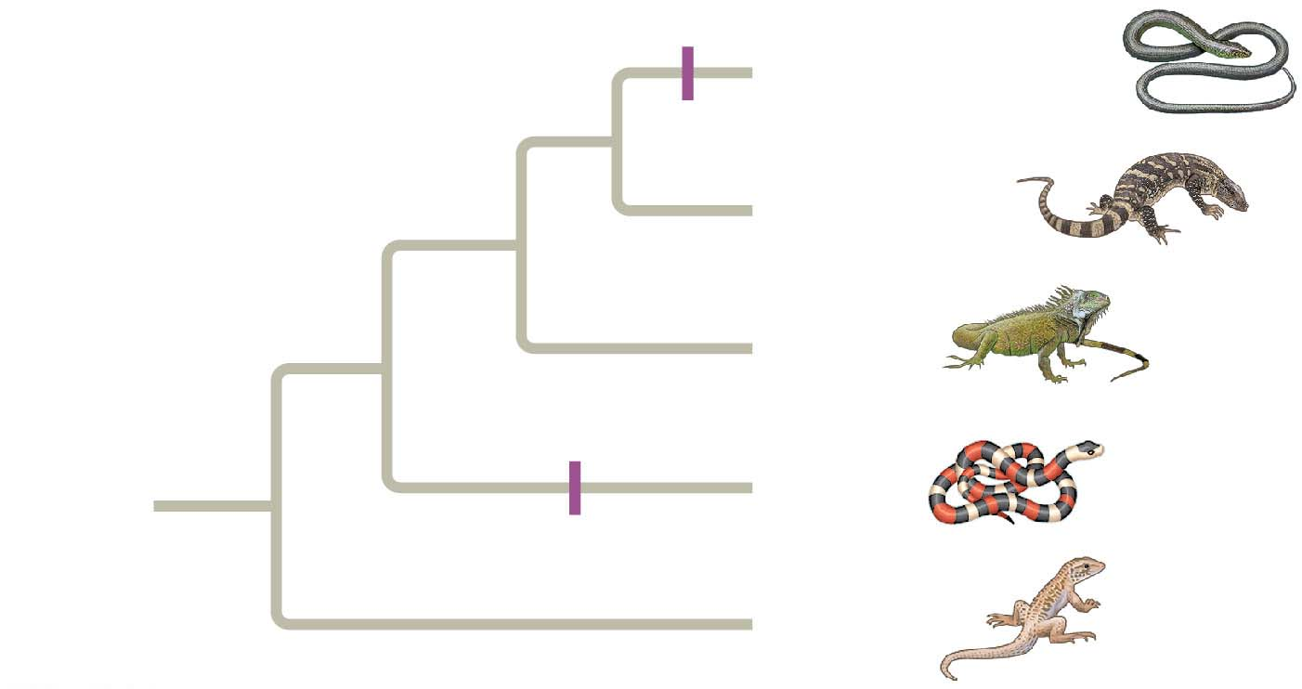
Figure 20.2
No limbs
Eastern glass lizard
Monitor lizard
Iguanas
ANCESTRAL
LIZARD
(with limbs)
Snakes
No limbs
Geckos
Notes:
Figure 20.2 Convergent evolution of limbless bodies

Slide 5
Phylogeny is the evolutionary history of a species or group of related species
The discipline of systematics classifies organisms and determines their evolutionary relationships
Notes:
5

Slide 6
Concept 20.1: Phylogenies show evolutionary relationships
Organisms share many characteristics because of common ancestry
Taxonomy is the ordered division and naming of organisms
Notes:
6

Slide 7
Binomial Nomenclature
In the 18th century, Carolus Linnaeus published a system of taxonomy based on resemblances
Two key features of his system remain useful today: two-part names for species and hierarchical classification
Notes:
7

Slide 8
The two-part scientific name of a species is called a binomial
The first part of the name is the genus
The second part, called the specific epithet, is unique for each species within the genus
The first letter of the genus is capitalized, and the entire species name is italicized
Both parts together name the species (not the specific epithet alone)
Notes:
8

Slide 9
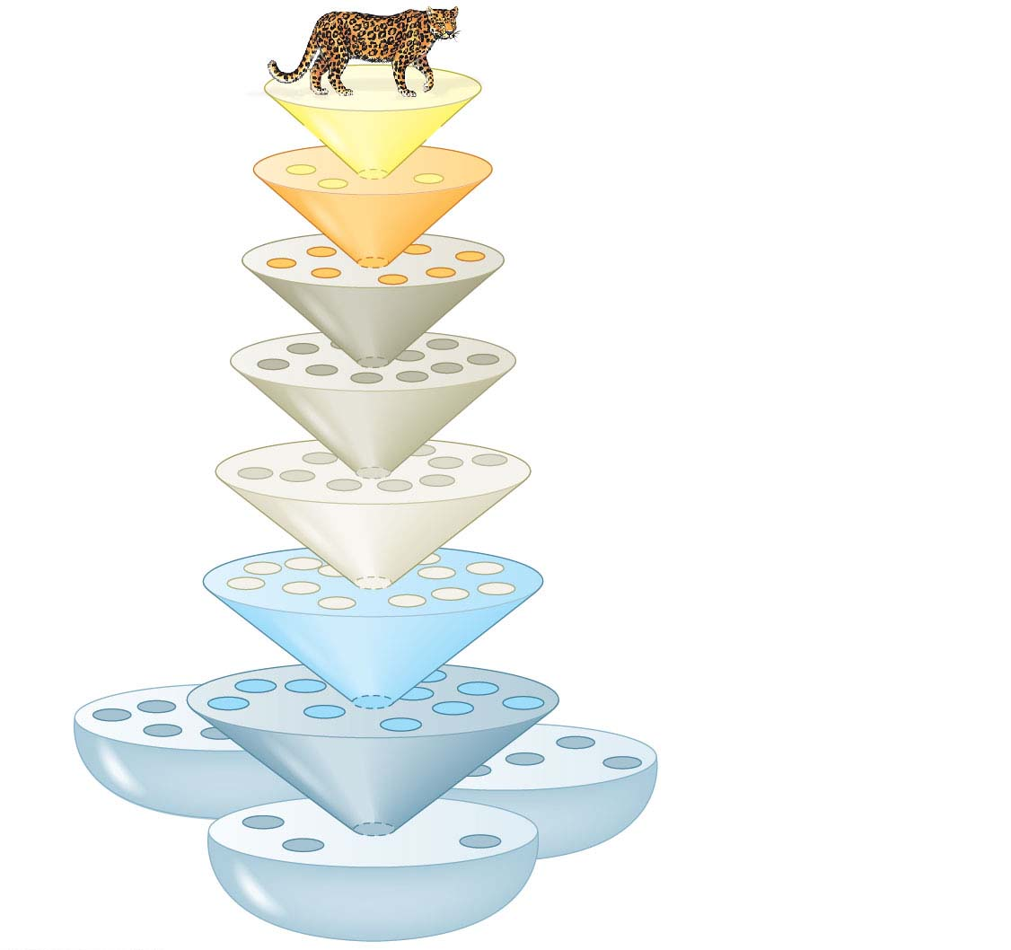
Figure 20.3
Species: Panthera pardus
Genus: Panthera
Family: Felidae
Order: Carnivora
Class: Mammalia
Phylum: Chordata
Domain: Bacteria
Kingdom:
Animalia
Domain:
Archaea
Domain:
Eukarya
Notes:
Figure 20.3 Linnaean classification

Slide 10
A taxonomic unit at any level of hierarchy is called a taxon
The broader taxa are not comparable between lineages
For example, an order of snails has less genetic diversity than an order of mammals
Notes:
10

Slide 11
Concept 20.5: New information continues to revise our understanding of evolutionary history
Recently, systematists have gained insight into the very deepest branches of the tree of life through analysis of DNA sequence data
Notes:
11

Slide 12
From Two Kingdoms to Three Domains
Early taxonomists classified all species as either plants or animals
Later, five kingdoms were recognized: Monera (prokaryotes), Protista, Plantae, Fungi, and Animalia
More recently, the three-domain system has been adopted: Bacteria, Archaea, and Eukarya
The three-domain system is supported by data from many sequenced genomes
Notes:
12

Slide 13
Animation: Class Schemes

Slide 14
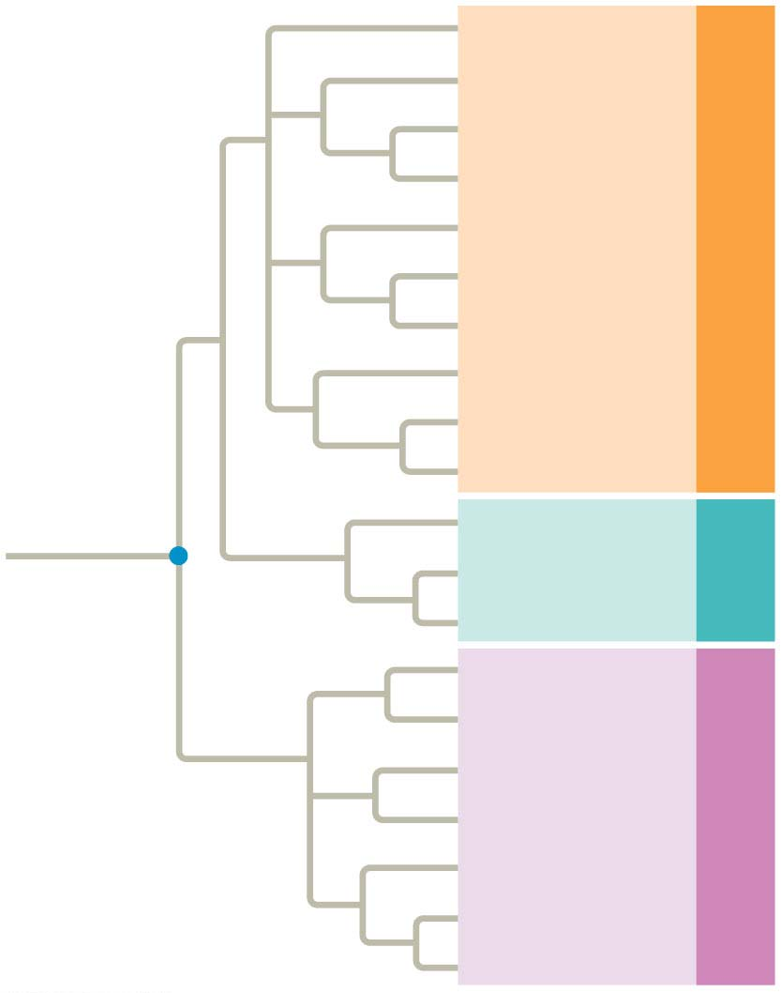
Figure 20.21
Euglenozoans
Forams
Diatoms
Ciliates
Domain Eukarya
Red algae
Green algae
Plants
Amoebas
Fungi
Animals
Nanoarchaeotes
Archaea
Domain
Euryarcheotes
COMMON
ANCESTOR
OF ALL LIFE
Crenarcheotes
Proteobacteria
(Mitochondria)*
Domain Bacteria
Chlamydias
Spirochetes
Gram-positive
bacteria
Cyanobacteria
(Chloroplasts)*
Notes:
Figure 20.21 The three domains of life

Slide 15
The three-domain system highlights the importance of single-celled organisms in the history of life
Domains Bacteria and Archaea are single-celled prokaryotes
Only three lineages in the domain Eukarya are dominated by multicellular organisms, kingdoms Plantae, Fungi, and Animalia
Notes:
15

Slide 16
The Important Role of Horizontal Gene Transfer
The tree of life suggests that eukaryotes and archaea are more closely related to each other than to bacteria
The tree of life is based largely on rRNA genes, which have evolved slowly, allowing detection of homologies between distantly related organisms
Other genes indicate different evolutionary relationships
Notes:
16

Slide 17
There have been substantial interchanges of genes between organisms in different domains
Horizontal gene transfer is the movement of genes from one genome to another
Horizontal gene transfer occurs by exchange of transposable elements and plasmids, viral infection, and fusion of organisms
Horizontal gene transfer complicates efforts to build a tree of life
Notes:
17

Slide 18
Horizontal gene transfer may have been common enough that the early history of life is better depicted by a tangled web than a branching tree
Notes:
18

Slide 19
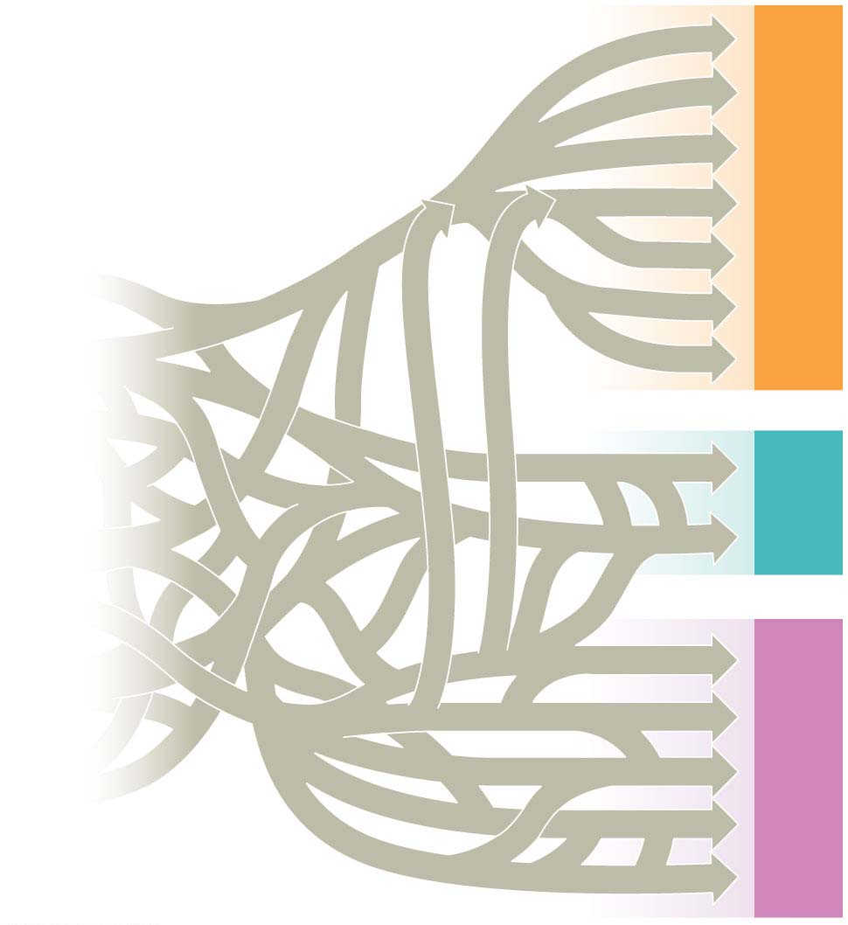
Figure 20.22
malia
Domain Eukarya
Ani
Fungi
Plantae
Chloropl
asts
Archaea
Domain
Mitochondria
Methanogens
Ancestral cell
populations
Thermophiles
Cyanobacteria
Domain Bacteria
Proteobacteria
Notes:
Figure 20.22 A tangled web of life

Slide 20
Linking Classification and Phylogeny
Systematists depict evolutionary relationships in branching phylogenetic trees
Notes:
20

Slide 21
Figure 20.4
Order
Family Genus
Species
Felidae
Panthera
Panthera
pardus
(leopard)
Taxidea
Carnivora
Taxidea
taxus
(American
badger)
Mustelidae
Lutra
Lutra lutra
(European
otter)
Canis
latrans
(coyote)
Canidae
Canis
Canis
lupus
(gray wolf)
Notes:
Figure 20.4 The connection between classification and phylogeny

Slide 22
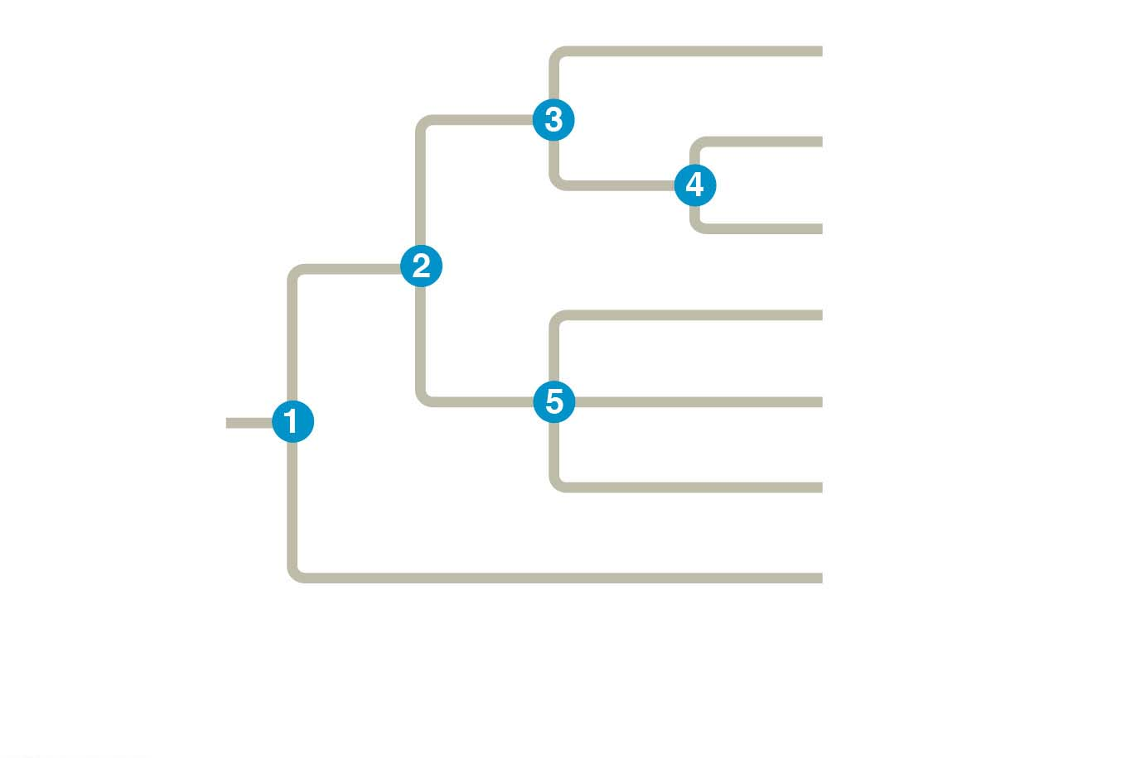
Figure 20.5
Branch point:
where lineages diverge
Taxon A
Taxon B
Sister
taxa
Taxon C
Taxon D
Taxon E
ANCESTRAL
LINEAGE
Taxon F
Basal
taxon
Taxon G
This branch point
represents the common
ancestor of taxa A–G.
This branch point forms a
polytomy: an unresolved
pattern of divergence.
Notes:
Figure 20.5 How to read a phylogenetic tree

Slide 23
A phylogenetic tree represents a hypothesis about evolutionary relationships
Each branch point represents the divergence of two taxa from a common ancestor
Sister taxa are groups that share an immediate common ancestor
Notes:
23

Slide 24
A rooted tree includes a branch to represent the most recent common ancestor of all taxa in the tree
A basal taxon diverges early in the history of a group and originates near the common ancestor of the group
A polytomy is a branch from which more than two groups emerge
Notes:
24

Slide 25
What We Can and Cannot Learn from Phylogenetic Trees
Phylogenetic trees show patterns of descent, not phenotypic similarity
Phylogenetic trees do not generally indicate when a species evolved or how much change occurred in a lineage
It should not be assumed that a taxon evolved from the taxon next to it
Notes:
25

Slide 26
Concept 20.2: Phylogenies are inferred from morphological and molecular data
To infer phylogeny, systematists gather information about morphologies, genes, and biochemistry of the relevant organisms
The similarities used to infer phylogenies must result from shared ancestry
Notes:
26

Slide 27
Morphological and Molecular Homologies
Phenotypic and genetic similarities due to shared ancestry are called homologies
Organisms with similar morphologies or DNA sequences are likely to be more closely related than organisms with different structures or sequences
Notes:
27

Slide 28
Sorting Homology from Analogy
When constructing a phylogeny, systematists need to distinguish whether a similarity is the result of homology or analogy
Homology is similarity due to shared ancestry
Analogy is similarity due to convergent evolution
Notes:
28

Slide 29
Bat and bird wings are homologous as forelimbs, but analogous as functional wings
Analogous structures or molecular sequences that evolved independently are also called homoplasies
Homology can be distinguished from analogy by comparing fossil evidence and the degree of complexity
The more complex two similar structures are, the more likely it is that they are homologous
Notes:
29

Slide 30
Evaluating Molecular Homologies
Molecular homologies are determined based on the degree of similarity in nucleotide sequence between taxa
Systematists use computer programs when analyzing comparable DNA segments from different organisms
Notes:
30

Slide 31
Concept 20.3: Shared characters are used to construct phylogenetic trees
Once homologous characters have been identified, they can be used to infer a phylogeny
Notes:
31

Slide 32
Cladistics
Cladistics classifies organisms by common descent
A clade is a group of species that includes an ancestral species and all its descendants
Clades can be nested within larger clades, but not all groupings of organisms qualify as clades
Notes:
32

Slide 33
A valid clade is monophyletic, signifying that it consists of the ancestor species and all its descendants
Notes:
33

Slide 34
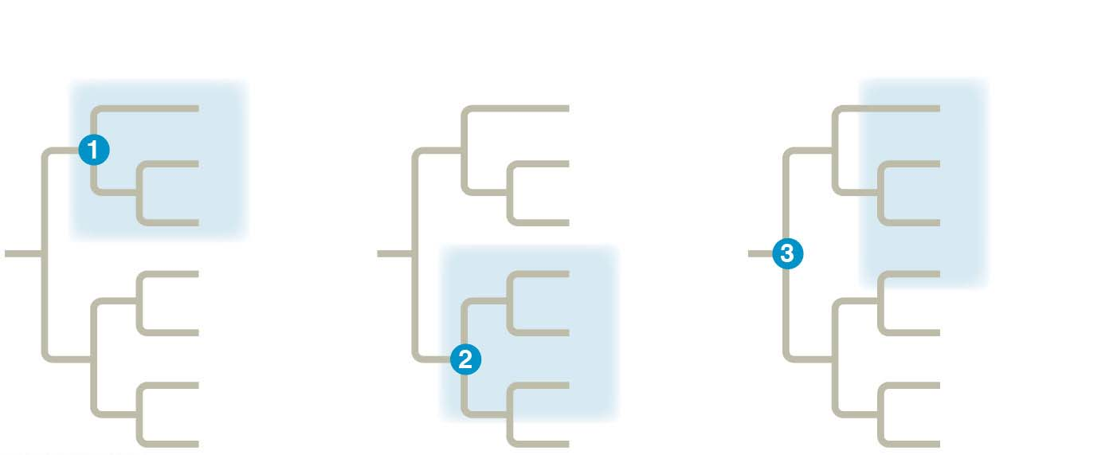
Figure 20.10
(a) Monophyletic group (clade)
(b) Paraphyletic group
(c) Polyphyletic group
A
A
A
B
Group I
B
B
Group III
C
C
C
D
D
D
E
E
Group II
E
F
F
F
G
G
G
Notes:
Figure 20.10 Monophyletic, paraphyletic, and polyphyletic groups

Slide 35
A paraphyletic grouping consists of an ancestral species and some, but not all, of the descendants
Notes:
35

Slide 36
A polyphyletic grouping consists of various taxa with different ancestors
Notes:
36

Slide 37
Shared Ancestral and Shared Derived Characters
In comparison with its ancestor, an organism has both shared and different characteristics
Notes:
37

Slide 38
A shared ancestral character is a character that originated in an ancestor of the taxon
A shared derived character is an evolutionary novelty unique to a particular clade
A character can be both ancestral and derived, depending on the context
Notes:
38

Slide 39
Inferring Phylogenies Using Derived Characters
When inferring evolutionary relationships, it is useful to know in which clade a shared derived character first appeared
Notes:
39

Slide 40
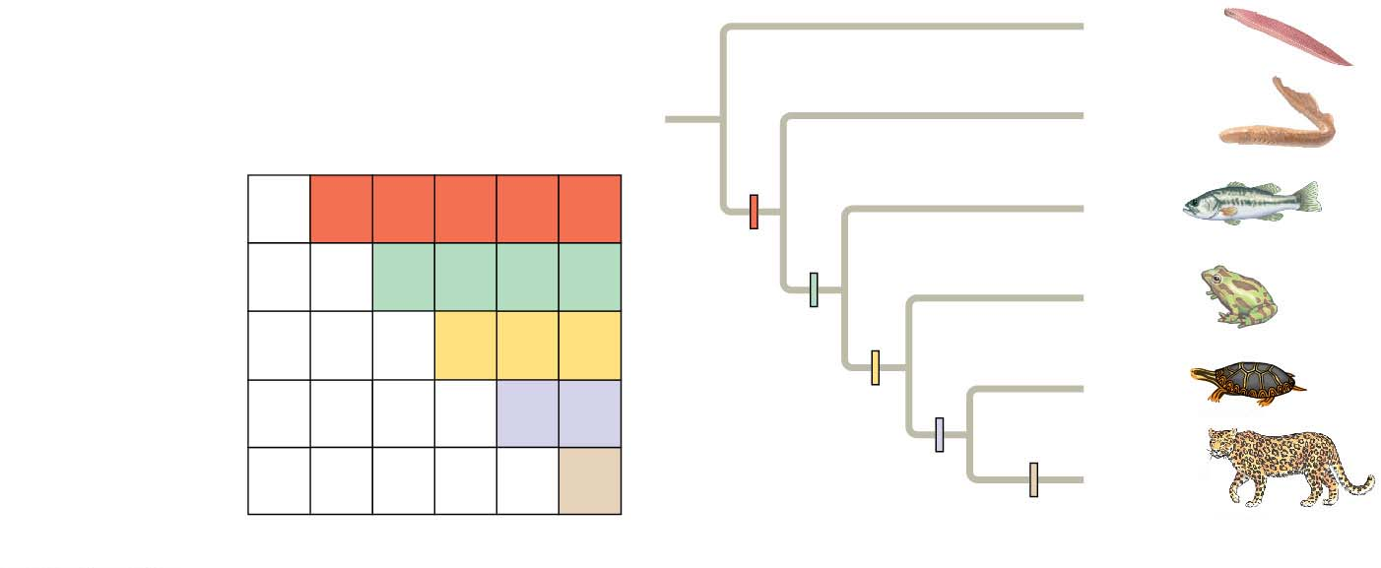
Figure 20.12
TAXA
Lancelet
(outgroup)
(outgroup)
Lancelet
Lamprey
Leopard
Bass
Frog
Turtle
Lamprey
Vertebral column
(backbone)
0
1
1
1
1
1
Bass
CHARACTERS
Vertebral
column
Hinged jaws
0
0
1
1
1
1
Frog
Four limbs
0
0
0
1
1
1
Hinged jaws
Four limbs
Turtle
Amnion
0
0
0
0
1
1
Hair
0
0
0
0
0
1
Amnion
Leopard
Hair
(a) Character table
(b) Phylogenetic tree
Notes:
Figure 20.12 Using derived characters to infer phylogeny

Slide 41
An outgroup is a species or group of species that is closely related to the ingroup, the various species being studied
The outgroup is a group that has diverged before the ingroup
Systematists compare each ingroup species with the outgroup to differentiate between shared derived and shared ancestral characteristics
Notes:
41

Slide 42
Maximum Parsimony
Systematists can never be sure of finding the best tree in a large data set
They narrow possibilities by applying the principle of maximum parsimony
Notes:
42

Slide 43
Maximum parsimony assumes that the tree that requires the fewest evolutionary events (appearances of shared derived characters) is the most likely
Computer programs are used to search for trees that are parsimonious
Notes:
43

Slide 44
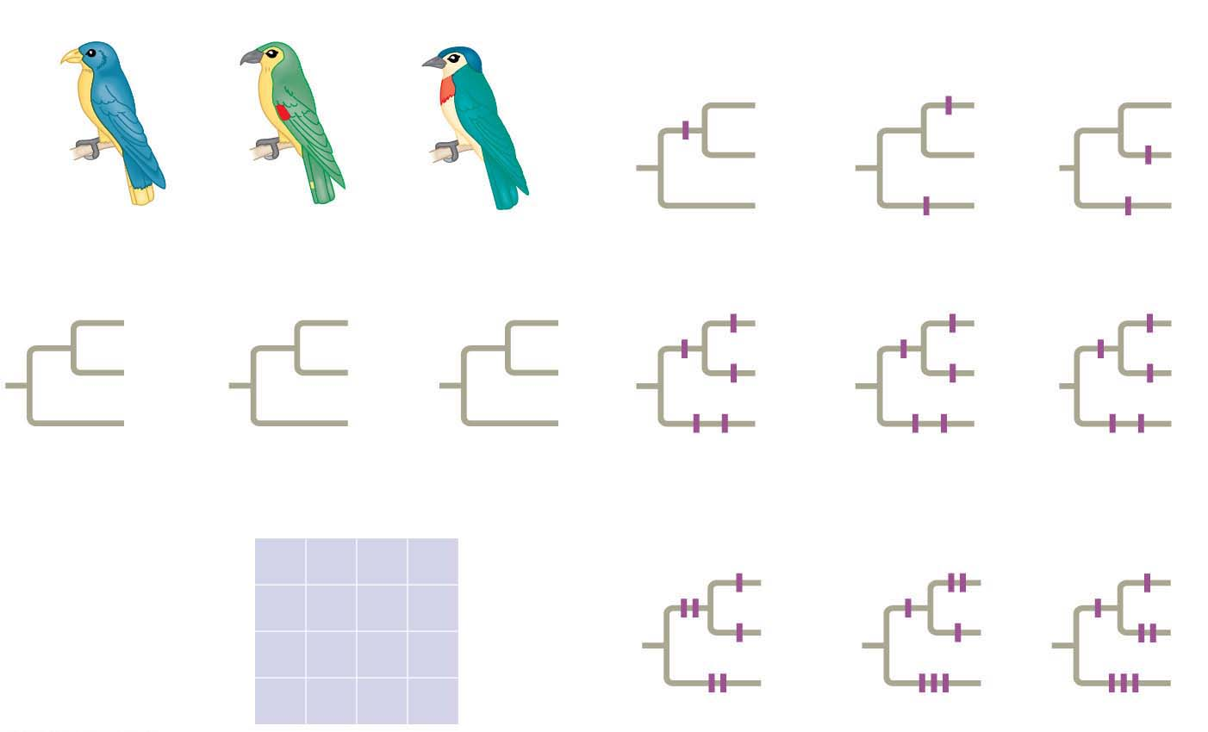
Figure 20.15
Technique
I
1/C
I
III
1/C
II
III
II
1/C
III
II
I
Species I
Species II
Species III
1/C
1/C
Three phylogenetic hypotheses:
3/A
2/T
3/A
I
I
III
2/T
I
3/A
I
4/C
III
II
III
II
II
III
II
4/C
4/C
2/T
III
II
I
III
II
I
3/A
4/C
2/T
4/C
2/T
3/A
Site
1
2
3
4
Results
Species I
C
T
A
T
I
I
III
Species II
C
T
T
C
II
III
II
Species III
A
G
A
C
III
II
I
Ancestral sequence
A
G
T
T
6 events
7 events
7 events
Notes:
Figure 20.15 Research method: applying parsimony to a problem in molecular systematics

Slide 45
Phylogenetic Trees as Hypotheses
The best hypothesized phylogenetic tree fits the most data: morphological, molecular, and fossil
Phylogenetic hypotheses are modified when new evidence arises
Notes:
45

