Slide 1
0
18
Genomes and Their Evolution

Slide 2
Genomics is the study of whole sets of genes and their interactions
Bioinformatics is the application of computational methods to the storage and analysis of biological data
Notes:
2

Slide 3
Concept 18.1: The Human Genome Project fostered development of faster, less expensive sequencing techniques
The Human Genome Project officially began in 1990, and the sequencing was largely completed by 2003
Even with automation, the sequencing of all 3 billion base pairs in a haploid set presented a formidable challenge
A major thrust of the Human Genome Project was the development of technology for faster sequencing
Notes:
3

Slide 4
The whole-genome shotgun approach was developed by J. Craig Venter and colleagues
This approach starts with cloning and sequencing random DNA fragments
Powerful computer programs are used to assemble the resulting short overlapping sequences into a single continuous sequence
Notes:
4

Slide 5
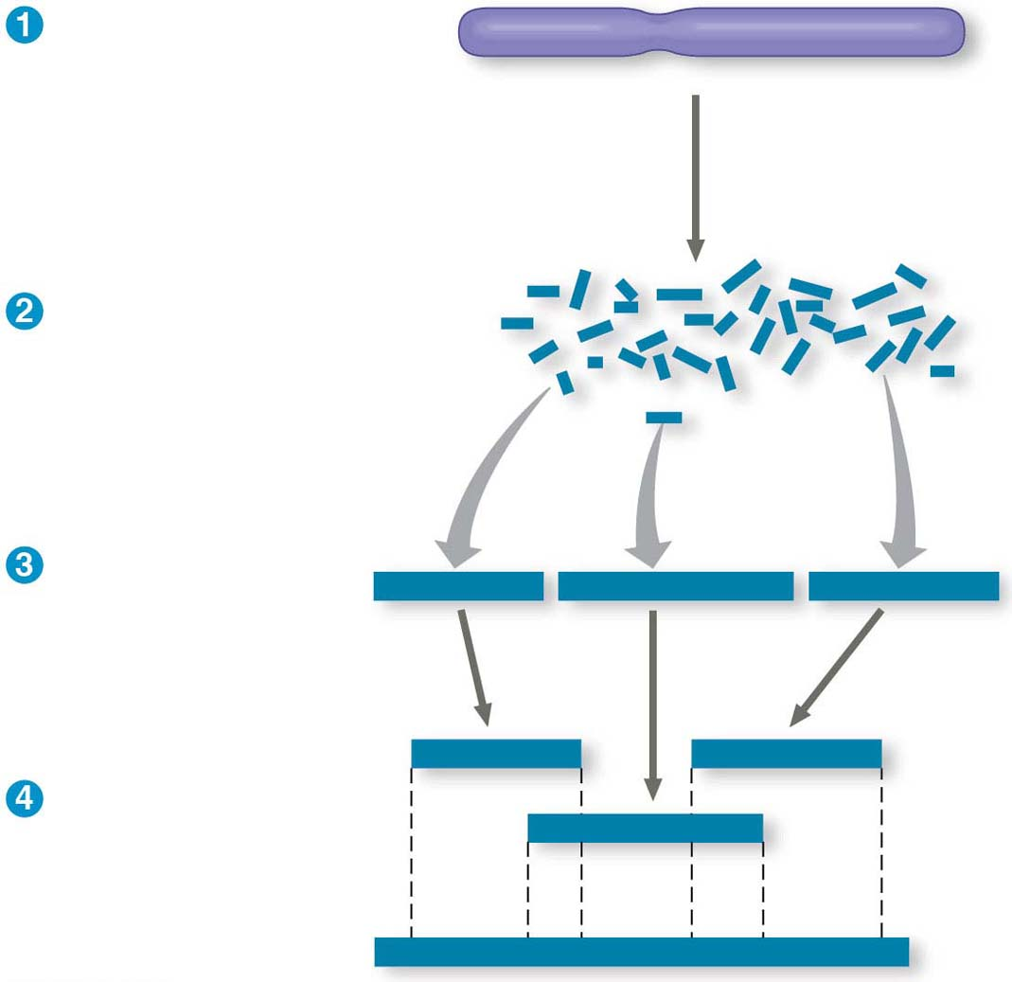
Figure 18.2-s3
Cut the DNA
into overlapping
fragments short
enough for
sequencing.
Clone the fragments
in plasmid or other
vectors.
Sequence each
fragment.
CGCCATCAGT
AGTCCGCTATACGA
ACGATACTGGT
CGCCATCAGT
ACGATACTGGT
Order the
sequences into one
overall sequence
with computer
software.
AGTCCGCTATACGA
…CGCCATCAGTCCGCTATACGATACTGGT…
Notes:
Figure 18.2-s3 Whole-genome shotgun approach to sequencing (step 3)

Slide 6
The new sequencing techniques have facilitated an approach called metagenomics
In this approach, DNA from a group of species in an environmental sample is collected and sequenced
Computer software sorts out the partial sequences and assembles them into their specific genomes
Notes:
6

Slide 7
Concept 18.2: Scientists use bioinformatics to analyze genomes and their functions
The Human Genome Project established databases and refined analytical software to make data available on the Internet
This has accelerated progress in DNA sequence analysis
Notes:
7

Slide 8
Centralized Resources for Analyzing Genome Sequences
Bioinformatics resources are provided by a number of sources
National Library of Medicine and the National Institutes of Health (NIH) created the National Center for Biotechnology Information (NCBI)
European Molecular Biology Laboratory
DNA Data Bank of Japan
BGI in Shenzhen, China
Notes:
8

Slide 9
Figure 18.3
Notes:
Figure 18.3 Bioinformatics tools that are available on the Internet

Slide 10
Understanding the Functions of Protein-Coding Genes
DNA sequence may vary more than the protein sequence does
Scientists interested in proteins often compare the predicted amino acid sequence of a protein with that of other proteins
Protein function can be deduced from sequence similarity or a combination of biochemical and functional studies
Notes:
10

Slide 11
Systems Biology
Proteomics is the systematic study of the full protein sets (proteomes) expressed by cells
We must study when and where proteins are produced in an organism in order to understand the function of cells and organisms
Systems biology aims to model the dynamic behavior of whole biological systems based on the study of interactions among the system’s parts
Notes:
11

Slide 12
Application of Systems Biology to Medicine
A systems biology approach has several medical applications
The Cancer Genome Atlas project (completed in 2010) attempted to identify all the common mutations in three types of cancer by comparing gene sequences and expression in cancer versus normal cells
This was so fruitful that it will be extended to ten other common cancers
Silicon and glass “chips” have been produced that hold a microarray of most known human genes
Notes:
12

Slide 13
Analyzing which genes are over- or underexpressed in cancers may allow physicians to tailor treatment to particular patients and the specifics of their cancers
Ultimately, medical records may include an individual’s DNA sequence
The use of such sequences for personalized medicine has great potential
Notes:
13

Slide 14
Genome Size
Genomes of most bacteria and archaea range from 1 to 6 million base pairs (Mb); genomes of eukaryotes are usually larger
Most plants and animals have genomes greater than 100 Mb; humans have 3,000 Mb
Within each domain there is no systematic relationship between genome size and phenotype
Notes:
14

Slide 15
Number of Genes
Free-living bacteria and archaea have 1,500 to 7,500 genes
Unicellular fungi have about 5,000 genes
Multicellular eukaryotes can have up to at least 40,000 genes
Notes:
15

Slide 16
Number of genes is not correlated to genome size
Vertebrate genomes can produce more than one polypeptide per gene because of alternative splicing of RNA transcripts
Notes:
16

Slide 17
Gene Density and Noncoding DNA
Humans and other mammals have the lowest gene density, or number of genes, in a given length of DNA
Multicellular eukaryotes have many introns within genes and noncoding DNA between genes
Notes:
17

Slide 18
Concept 18.4: Multicellular eukaryotes have much noncoding DNA and many multigene families
The bulk of most eukaryotic genomes encodes neither proteins nor functional RNAs
Sequencing of the human genome reveals that 98.5% does not code for proteins, rRNAs, or tRNAs
About a quarter of the human genome codes for introns and gene-related regulatory sequences
Notes:
18

Slide 19
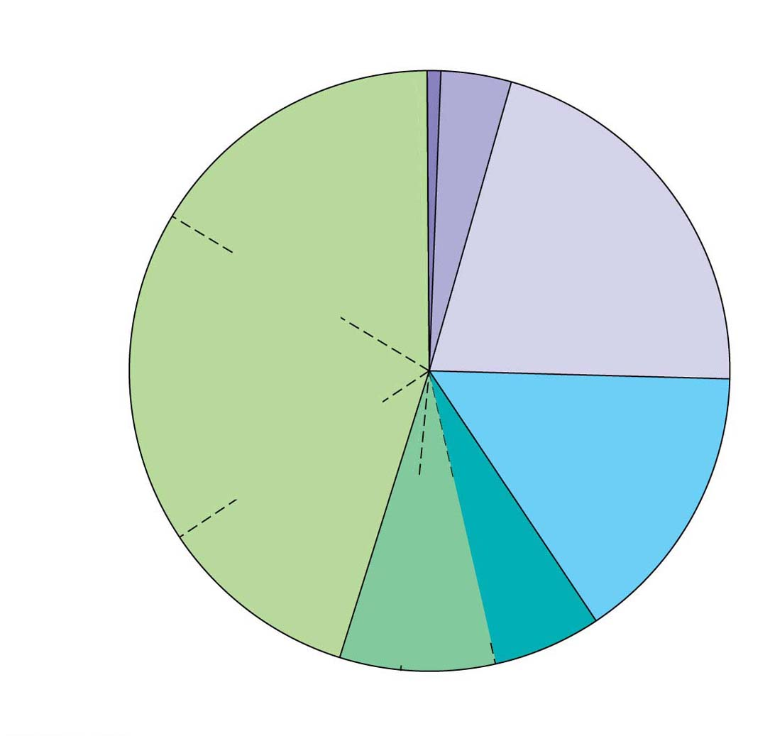
Figure 18.5
Regulatory
sequences (5%)
Exons (1.5%)
Introns
(~20%)
Repetitive
DNA that
includes
transposable
elements
and related
sequences
(44%)
Unique
noncoding
DNA (15%)
L1
sequences
(17%)
Repetitive
DNA
unrelated to
transposable
elements
(14%)
Alu elements
(10%)
Large-segment
duplications (5–6%)
Simple sequence DNA (3%)
Notes:
Figure 18.5 Types of DNA sequences in the human genome

Slide 20
Transposable Elements and Related Sequences
Both prokaryotes and eukaryotes have stretches of DNA that can move from one location to another within the genome, called transposable elements
The movement of these transposable genetic elements is called transposition
About 75% of repetitive DNA is made up of transposable elements and sequences related to them
Notes:
20

Slide 21
Movement of Transposons and Retrotransposons
Eukaryotic transposable elements are of two types, transposons and retrotransposons
Transposons move by a “cut and paste” method or by a “copy and paste” method that leaves a copy behind
Transposons require an enzyme, called transposase, to move
Notes:
21

Slide 22
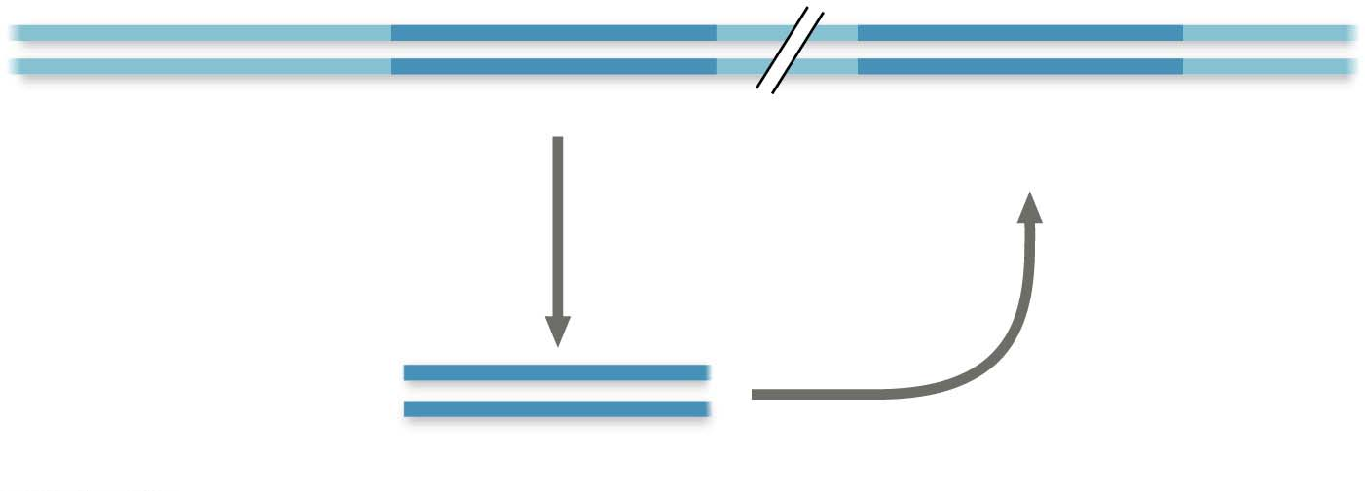
Figure 18.7
DNA of
genome
Transposon
New copy of
transposon
Transposon
is copied
Insertion
Mobile copy of transposon
Notes:
Figure 18.7 Transposon movement

Slide 23
Retrotransposons move by means of an RNA intermediate and always leave a copy behind
The RNA intermediate must be converted back to DNA by reverse transcriptase, an enzyme encoded by the retrotransposon
Retroviruses may have evolved from retrotransposons
Notes:
23

Slide 24
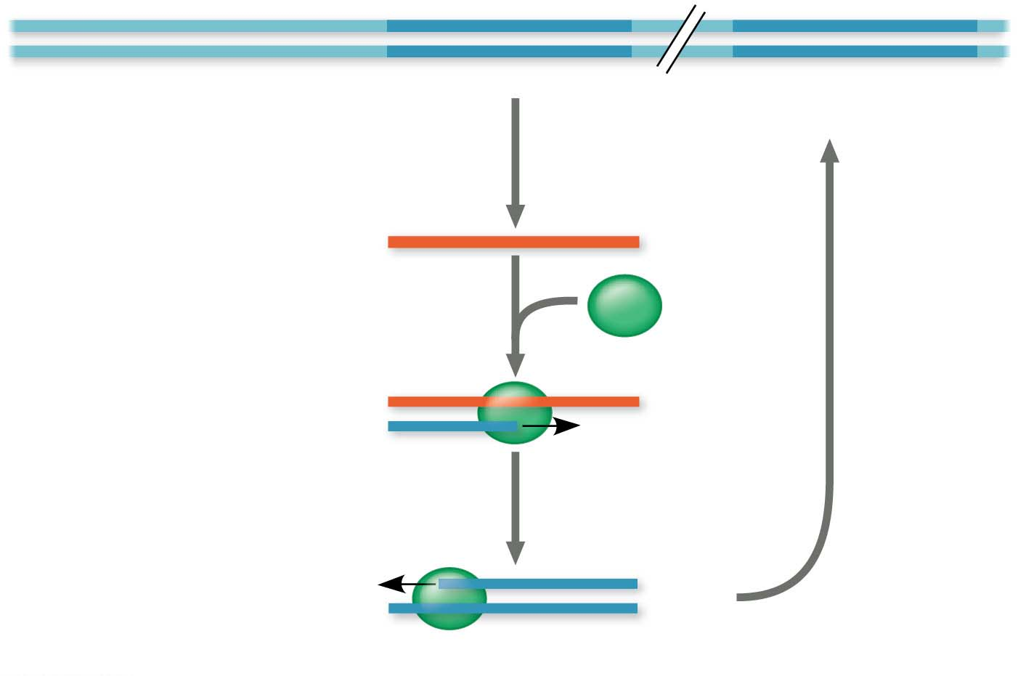
Figure 18.8
Retrotransposon
New copy of
retrotransposon
Synthesis of a single-stranded
RNA intermediate
RNA
Reverse transcriptase
synthesizes a DNA strand
complementary to the
RNA strand.
Insertion
RNA
DNA
Reverse transcriptase
synthesizes a second DNA
strand complementary
to the first DNA strand.
DNA
DNA
Mobile copy of retrotransposon
Notes:
Figure 18.8 Retrotransposon movement

Slide 25
Other Repetitive DNA, Including Simple Sequence DNA
About 14% of the human genome consists of repetitive DNA resulting from errors during replication or recombination
About a third of this consists of duplication of long sequences of DNA from one location to another
In contrast, simple sequence DNA contains many copies of tandemly repeated short sequences
Notes:
25

Slide 26
A series of repeating units of two to five nucleotides is called a short tandem repeat (STR)
The repeat number for STRs can vary among sites (within a genome) or individuals
STR diversity can be used to identify a unique set of genetic markers for each individual, his or her genetic profile
Forensic scientists can use STR analysis on DNA samples to identify victims of crime or natural disasters
Notes:
26

Slide 27
Genes and Multigene Families
Many eukaryotic genes are present in one copy per haploid set of chromosomes
The rest occur in multigene families, collections of identical or very similar genes
Some multigene families consist of identical DNA sequences, usually clustered tandemly, such as those that code for rRNA products
Notes:
27

Slide 28
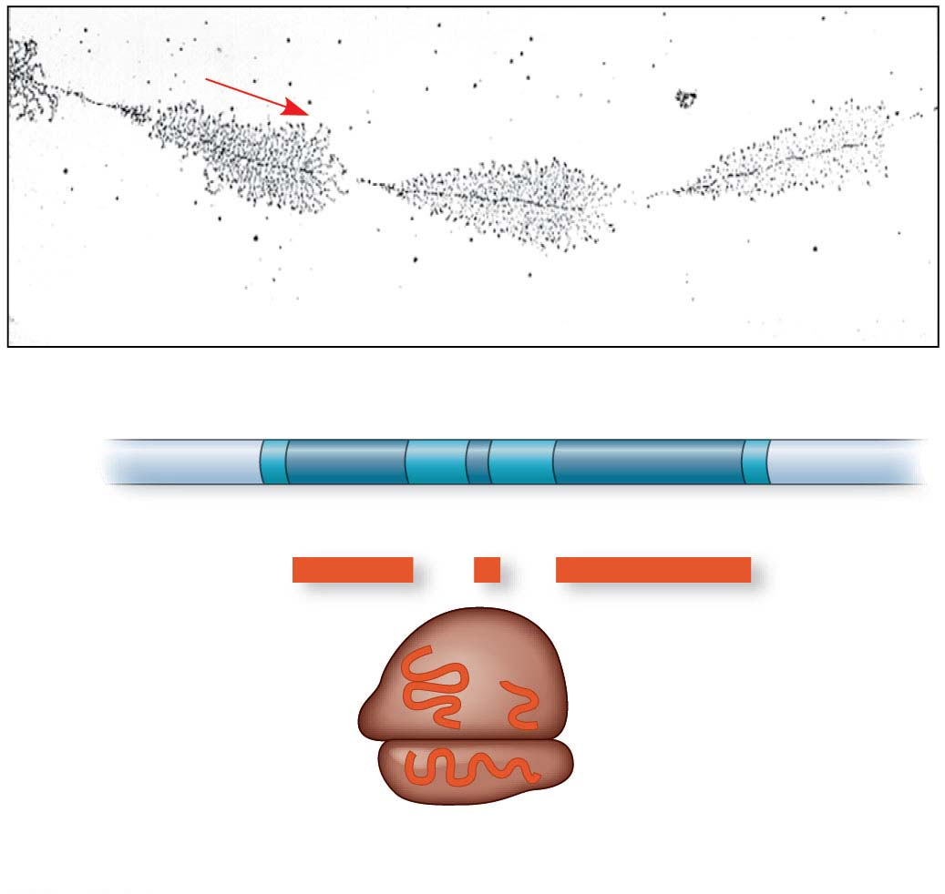
Figure 18.9-1
Direction of transcription
DNA
RNA transcripts
Nontranscribed
spacer
Transcription unit
DNA
18S
5.8S
28S
rRNA
5.8S
28S
18S
(a) Part of the ribosomal RNA gene family
Notes:
Figure 18.9-1 Gene families (part 1: ribosomal RNA family)

Slide 29
The classic examples of multigene families of nonidentical genes are two related families of genes that encode globins
α-globins and β-globins are polypeptides of hemoglobin and are coded by genes on different human chromosomes and are expressed at different times in development
Notes:
29

Slide 30
Concept 18.5: Duplication, rearrangement, and mutation of DNA contribute to genome evolution
The basis of change at the genomic level is mutation, which underlies much of genome evolution
The earliest forms of life likely had the minimal number of genes necessary for survival and reproduction
The size of genomes has increased over evolutionary time, with the extra genetic material providing raw material for gene diversification
Notes:
30

Slide 31
Duplication of Entire Chromosome Sets
Accidents in meiosis can lead to one or more extra sets of chromosomes, a condition known as polyploidy
The genes in one or more of the extra sets can diverge by accumulating mutations
These variations may persist if the organism carrying them survives and reproduces
Polyploidy is rare in animals but relatively common in plants, especially flowering plants
Notes:
31

Slide 32
Alterations of Chromosome Structure
Humans have 23 pairs of chromosomes, while chimpanzees have 24 pairs
Following the divergence of humans and chimpanzees from a common ancestor, two ancestral chromosomes fused in the human line
Notes:
32

Slide 33
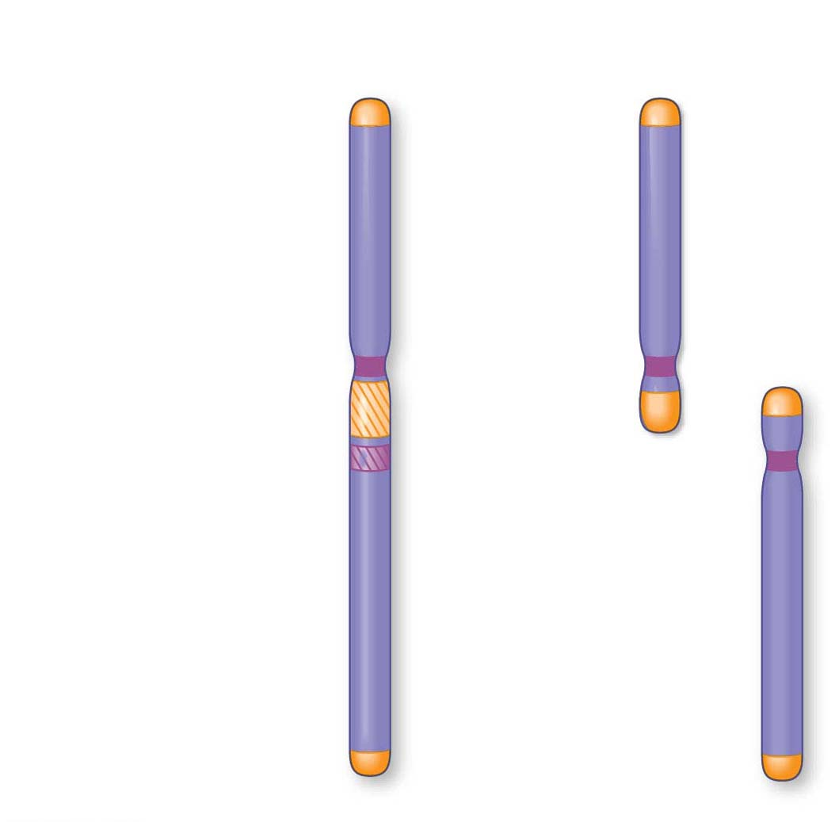
Figure 18.10
Human
chromosome
Chimpanzee
chromosomes
Telomere
sequences
Centromere
sequences
Telomere-like
sequences
12
Centromere-like
sequences
2
13
Notes:
Figure 18.10 Human and chimpanzee chromosomes

Slide 34
Researchers have compared the DNA sequences of human chromosomes with those of the mouse
Large blocks of genes from human chromosome 16 can be found on four mouse chromosomes
This indicates that these blocks of genes have stayed together during evolution of mouse and human lineages
Notes:
34

Slide 35
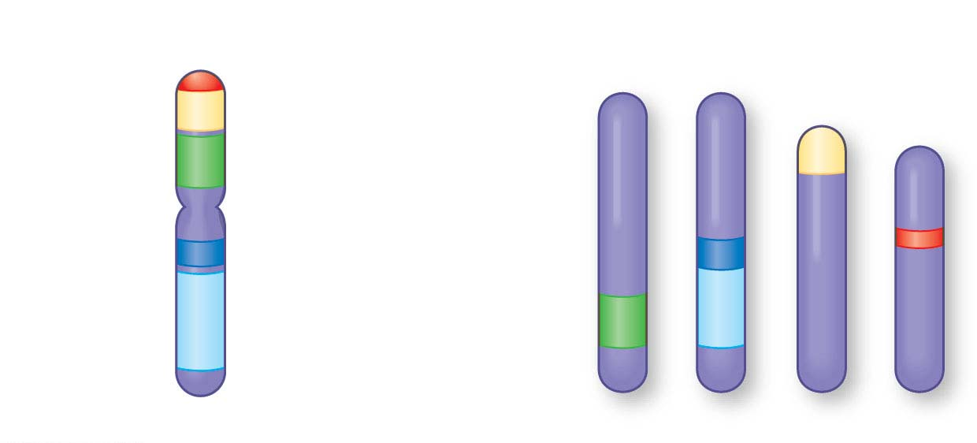
Figure 18.11
Human chromosome
Mouse chromosomes
16
7
8
16
17
Notes:
Figure 18.11 Human and mouse chromosomes

Slide 36
Duplications and inversions result from mistakes during meiotic recombination
The rate of duplications and inversions seems to have accelerated about 100 million years ago
This coincides with the time that large dinosaurs went extinct and mammals diversified
Notes:
36

Slide 37
Duplication and Divergence of Gene-Sized Regions of DNA
Unequal crossing over during prophase I of meiosis can result in one chromosome with a deletion and another with a duplication of a particular region
Transposable elements can provide sites for crossover between nonsister chromatids
Slippage can occur during DNA replication so that a part of the template region is either skipped or used twice by the replication machinery
Notes:
37

Slide 38
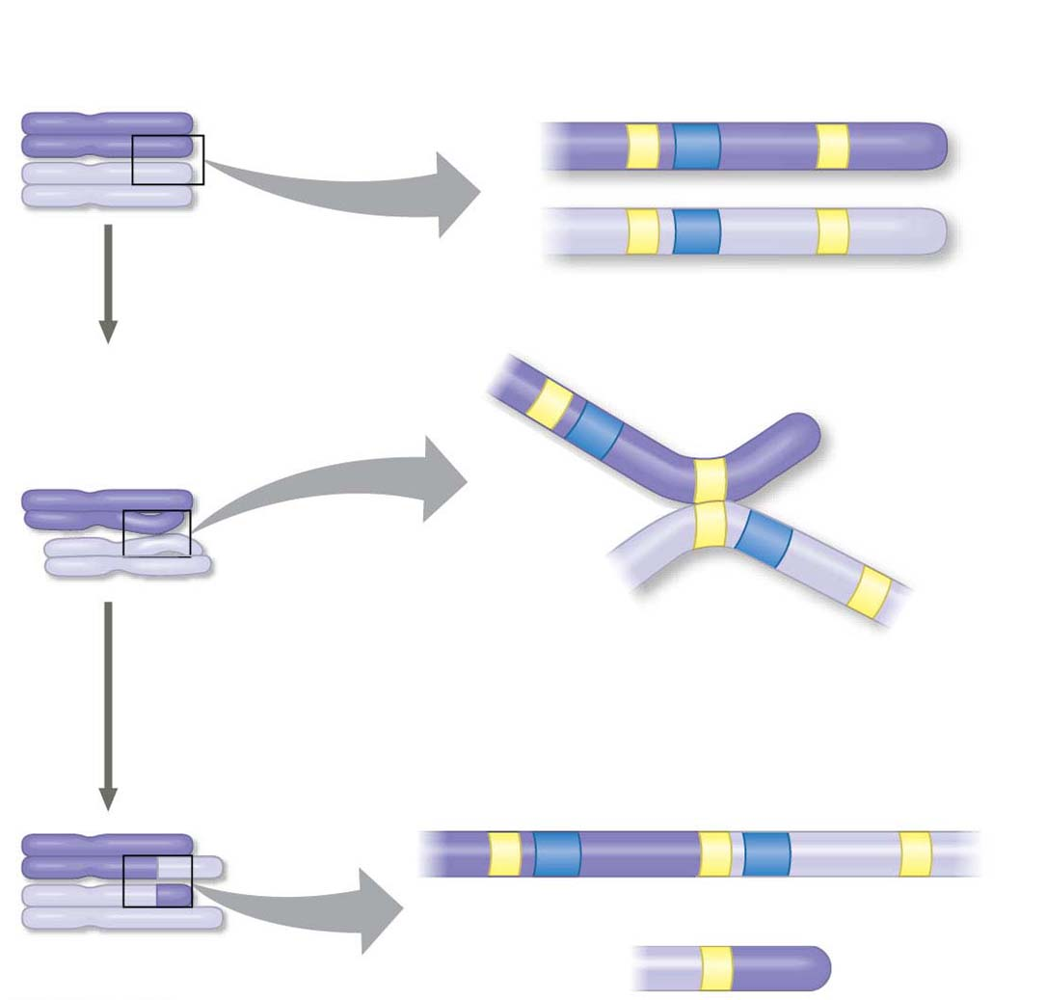
Figure 18.12
Nonsister
chromatids
Gene
Transposable
element
Incorrect pairing
of two homologs
during meiosis
Crossover
point
and
Notes:
Figure 18.12 Gene duplication due to unequal crossing over

Slide 39
How Transposable Elements Contribute to Genome Evolution
Multiple copies of similar transposable elements may facilitate recombination, or crossing over, between different chromosomes
Insertion of transposable elements within a protein-coding sequence may block protein production
Insertion of transposable elements within a regulatory sequence may increase or decrease protein production
Notes:
39

Slide 40
Transposable elements may carry a gene or groups of genes to a new position
In a similar process, an exon from one gene could be inserted into another by a mechanism similar to exon shuffling
These sorts of changes are usually detrimental but may on occasion prove advantageous to an organism
Notes:
40

Slide 41
Concept 18.6: Comparing genome sequences provides clues to evolution and development
Genome sequencing and data collection have advanced rapidly in the last 25 years
Comparative studies of genomes
Reveal much about the evolutionary history of life
Help clarify mechanisms that generated the great diversity of present-day life-forms
Notes:
41

Slide 42
Comparing Genomes
Genome comparisons of closely related species help us understand recent evolutionary events
Genome comparisons of distantly related species help us understand ancient evolutionary events
Evolutionary relationships among species can be represented by a tree-shaped diagram
Notes:
42

Slide 43
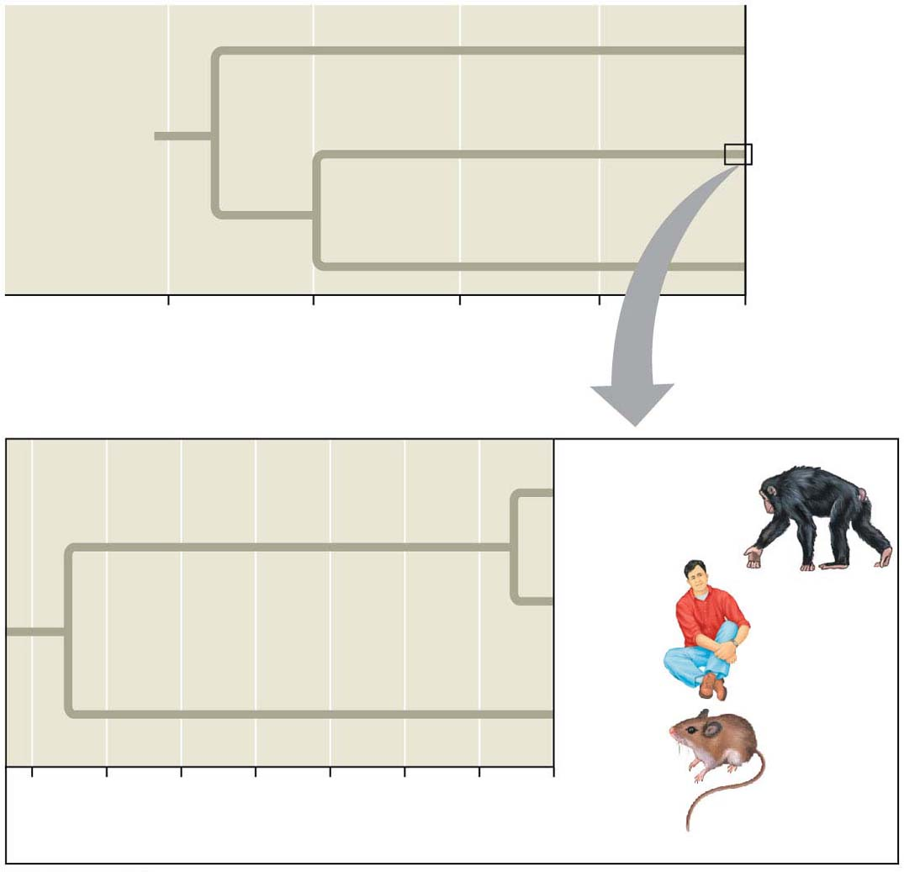
Figure 18.15
Bacteria
Most recent
common
ancestor
of all living
things
Eukarya
Archaea
4
3
2
1
0
Billions of years ago
Chimpanzee
Human
Mouse
70
60
50
40
30
20
10
0
Millions of years ago
Notes:
Figure 18.15 Evolutionary relationships of the three domains of life

Slide 44
Comparing Distantly Related Species
Highly conserved genes have remained similar over time
These help clarify relationships among species that diverged from each other long ago
Bacteria, archaea, and eukaryotes diverged from each other between 2 and 4 billion years ago
Comparative genomic studies confirm the relevance of research on model organisms to our understanding of biology in general and human biology in particular
Notes:
44

Slide 45
Comparing Closely Related Species
The genomes of two closely related species are likely to be organized similarly
Particular genetic differences between the two species can be easily correlated with phenotypic differences between them
Notes:
45

Slide 46
Human and chimpanzee genomes differ by 1.2% at single base pairs and by 2.7% because of insertions and deletions
Several genes are evolving faster in humans than in chimpanzees
These include genes involved in defense against malaria and tuberculosis and in regulation of brain size
Genes that seem to be evolving fastest code for transcription factors
Notes:
46

Slide 47
Comparing Genomes Within a Species
As a species, humans have only existed for about 200,000 years and have low within-species genetic variation
Most of the variation within humans is due to single nucleotide polymorphisms (SNPs)
There are also inversions, deletions, and duplications and a large number of copy-number variants (CNVs)
These variations are useful for studying human evolution and human health
Notes:
47

Slide 48
Widespread Conservation of Developmental Genes Among Animals
Evolutionary developmental biology, or evo-devo, compares the developmental processes of different multicellular organisms
Genomic information shows that minor differences in gene sequence or regulation can result in striking differences in form
Notes:
48

Slide 49
Molecular analysis of the homeotic genes in Drosophila has shown that they all include a sequence called a homeobox
An identical or very similar nucleotide sequence has been discovered in the homeotic genes of both vertebrates and invertebrates
The vertebrate genes homologous to homeotic genes of flies have kept the same chromosomal arrangement
Notes:
49

Slide 50
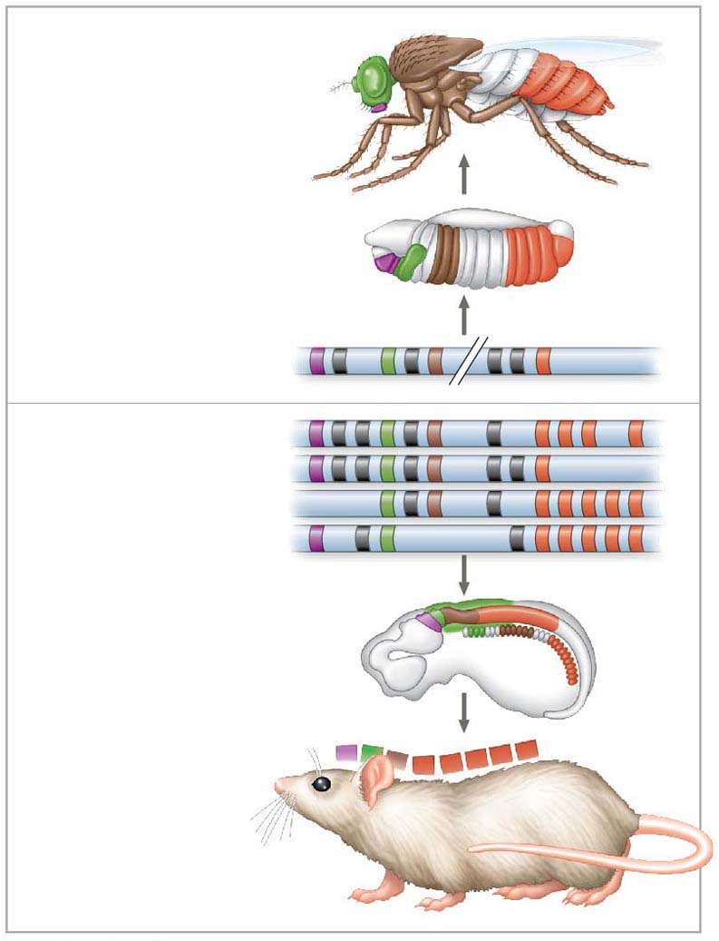
Figure 18.17
Adult
fruit fly
Fruit fly embryo
(10 hours)
Fruit fly
chromosome
Mouse
chromosomes
Mouse embryo
(12 days)
Adult mouse
Notes:
Figure 18.17 Conservation of homeotic genes in a fruit fly and a mouse

Slide 51
Related homeobox sequences have been found in regulatory genes of yeasts and plants
The homeodomain is the part of the protein that binds to DNA when the protein functions as a transcriptional regulator
The more variable domains in the protein recognize particular DNA sequences and specify which genes are regulated by the protein
Notes:
51

Slide 52
Sometimes small changes in regulatory sequences of certain genes lead to major changes in body form
For example, variation in Hox gene expression controls variation in leg-bearing segments of crustaceans and insects
Notes:
52

Slide 53
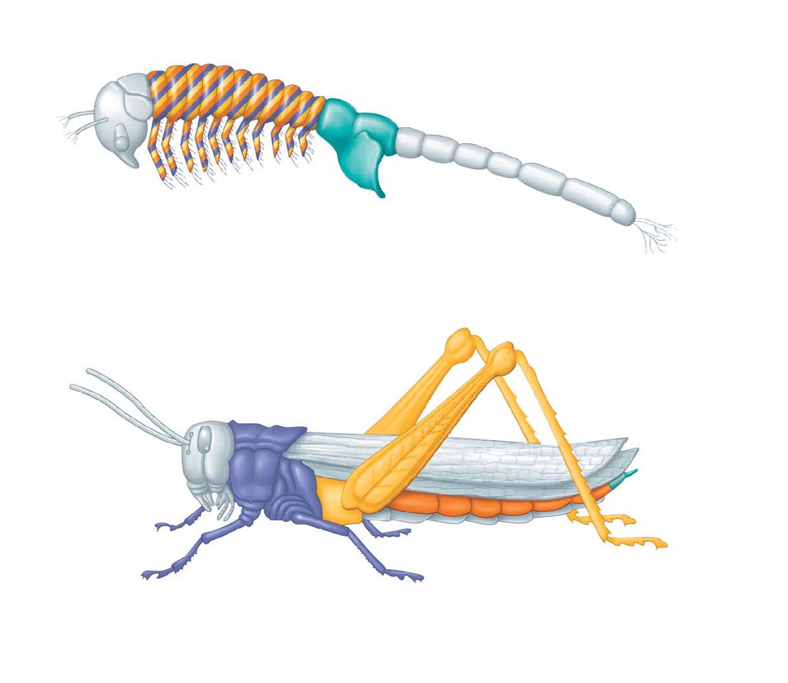
Figure 18.18
Genital
segments
(a) Expression of four Hox genes in the brine shrimp Artemia
Genital
segments
(b) Expression of the grasshopper versions of the same four Hox genes
© 1995 The Royal Society
Notes:
Figure 18.18 Effect of differences in Hox gene expression in a crustacean and an insect

