Slide 1
Overview: Locating Genes Along Chromosomes
Mendel’s “hereditary factors” were genes
Today we know that genes are located on chromosomes
The location of a particular gene can be seen by tagging isolated chromosomes with a fluorescent dye that highlights the gene
© 2016 Pearson Education, Inc.
Notes:
1

Slide 2
Mitosis and meiosis were first described in the late 1800s
The chromosome theory of inheritance states
Mendelian genes have specific loci (positions) on chromosomes
Chromosomes undergo segregation and independent assortment
The behavior of chromosomes during meiosis can account for Mendel’s laws of segregation and independent assortment
© 2016 Pearson Education, Inc.
Notes:
2

Slide 3
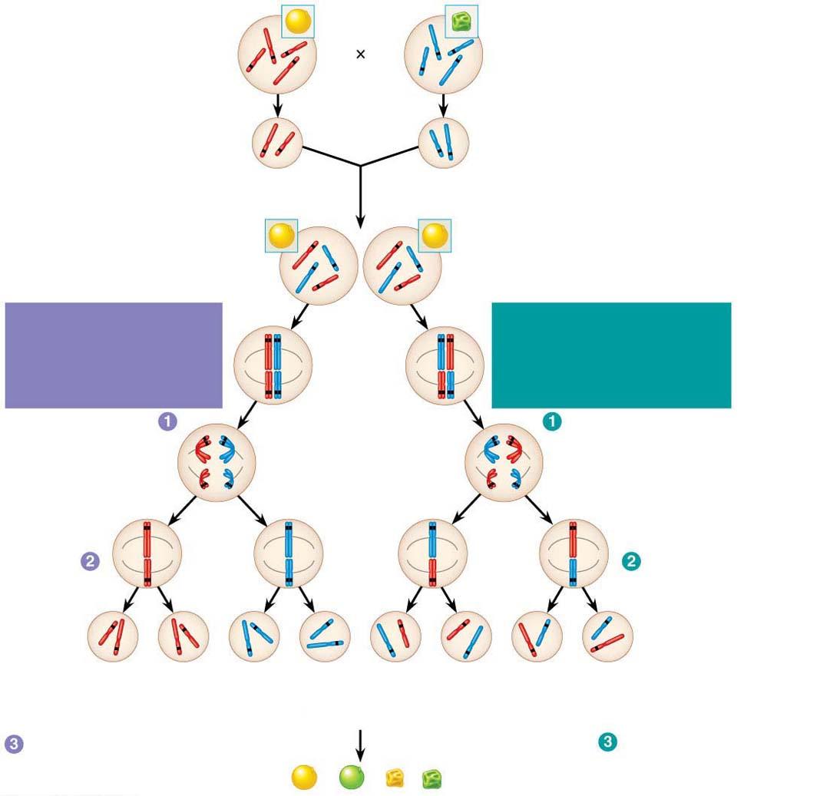
Figure 12.2
P Generation
Yellow round
seeds (YYRR)
Green wrinkled
seeds (yyrr)
Y
r
y
Y
R
R
y
r
Meiosis
Fertilization
y
r
Gametes
R
Y
All F₁ plants produce
yellow round seeds (YyRr).
F₁ Generation
R
R
r
y
r
y
Y
Y
LAW OF SEGREGATION
The two alleles for each
gene separate.
Meiosis
LAW OF INDEPENDENT
ASSORTMENT Alleles of
genes on nonhomologous
chromosomes assort
independently.
R
r
Metaphase
r
R
I
Y
y
Y
y
R
r
r
R
Anaphase I
Y
y
Y
y
R
r
Metaphase
II
r
R
Y
y
Y
y
Y
Y
y
y
Y
Y
y
y
R
R
r
r
r
r
R
R
1
4
YR
1
4
yr
1
4
Yr
1
4
yR
F₂ Generation
An F₁ × F₁ cross-fertilization
Fertilization
recombines the R and
r alleles at random.
Fertilization results in the
9:3:3:1 phenotypic ratio
in the F₂ generation.
© 2016 Pearson Education, Inc.
9
: 3
: 3
: 1
Notes:
Figure 12.2 The chromosomal basis of Mendel’s laws

Slide 4
Concept 12.1: Morgan showed that Mendelian inheritance has its physical basis in the behavior of chromosomes: scientific inquiry
The first solid evidence associating a specific gene with a specific chromosome came from the work of Thomas Hunt Morgan in the early 1900s
© 2016 Pearson Education, Inc.
Notes:
4

Slide 5
Morgan’s Choice of Experimental Organism
Morgan selected a species of fruit fly, Drosophila melanogaster, as his research organism
Several characteristics make fruit flies a convenient organism for genetic studies
They produce many offspring
A generation can be bred every two weeks
They have only four pairs of chromosomes
© 2016 Pearson Education, Inc.
Notes:
5

Slide 6
Morgan noted wild-type, or normal, phenotypes that were common in the fly populations
Traits alternative to the wild type are called mutant phenotypes
The first mutant phenotype he discovered was a fly with white eyes instead of the wild type red
© 2016 Pearson Education, Inc.
Notes:
6

Slide 7
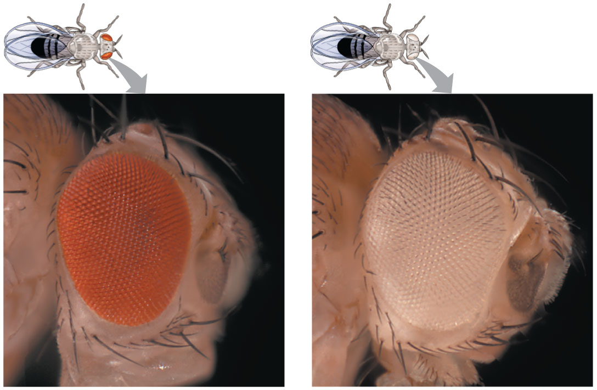
Figure 12.3
© 2016 Pearson Education, Inc.
Notes:
Figure 12.3 Morgan’s first mutant

Slide 8
Correlating Behavior of a Gene’s Alleles with Behavior of a Chromosome Pair
In one experiment, Morgan mated male flies with white eyes (mutant) with female flies with red eyes (wild type)
The F₁ generation all had red eyes
The F₂ generation showed the classical 3:1 red:white ratio, but only males had white eyes
Morgan concluded that the eye color was related to the sex of the fly
© 2016 Pearson Education, Inc.
Notes:
8

Slide 9
Morgan determined that the white-eyed mutant allele must be located on the X chromosome
Morgan’s finding supported the chromosome theory of inheritance
© 2016 Pearson Education, Inc.
Notes:
9

Slide 10
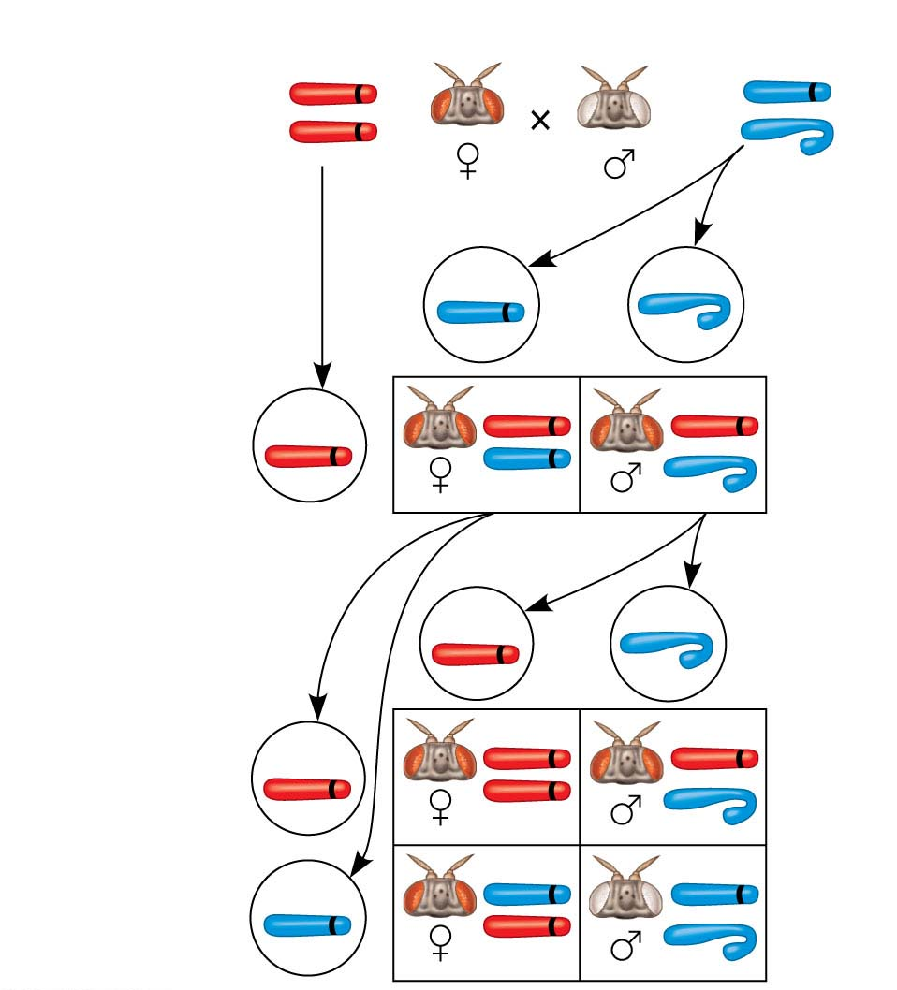
Figure 12.4-2
Conclusion
P
Generation
X
w⁺
w
X
X
Y
w⁺
w
Sperm
Eggs
F₁
Generation
w⁺
w⁺
w⁺
w
w⁺
Sperm
Eggs
w⁺
w⁺
F₂
Generation
w⁺
w⁺
w
w
w
w⁺
© 2016 Pearson Education, Inc.
Notes:
Figure 12.4-2 Inquiry: In a cross between a wild-type female fruit fly and a mutant white-eyed male, what color eyes will the F₁ and F₂ offspring have? (part 2: conclusion)

Slide 11
Concept 12.2: Sex-linked genes exhibit unique patterns of inheritance
The behavior of the members of the pair of sex chromosomes can be correlated with the behavior of the two alleles of the eye-color gene white
© 2016 Pearson Education, Inc.
Notes:
11

Slide 12
The Chromosomal Basis of Sex
Humans and other mammals have two types of sex chromosomes: a larger X chromosome and a smaller Y chromosome
Only the ends of the Y chromosome have regions that are homologous with corresponding regions of the X chromosome
The SRY gene on the Y chromosome is required for the developments of testes
© 2016 Pearson Education, Inc.
Notes:
12

Slide 13
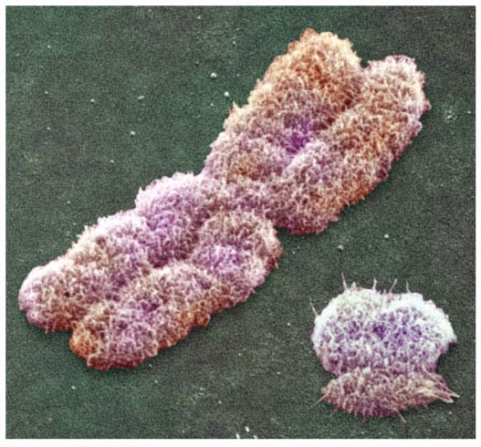
Figure 12.5
X
Y
© 2016 Pearson Education, Inc.
Notes:
Figure 12.5 Human sex chromosomes

Slide 14
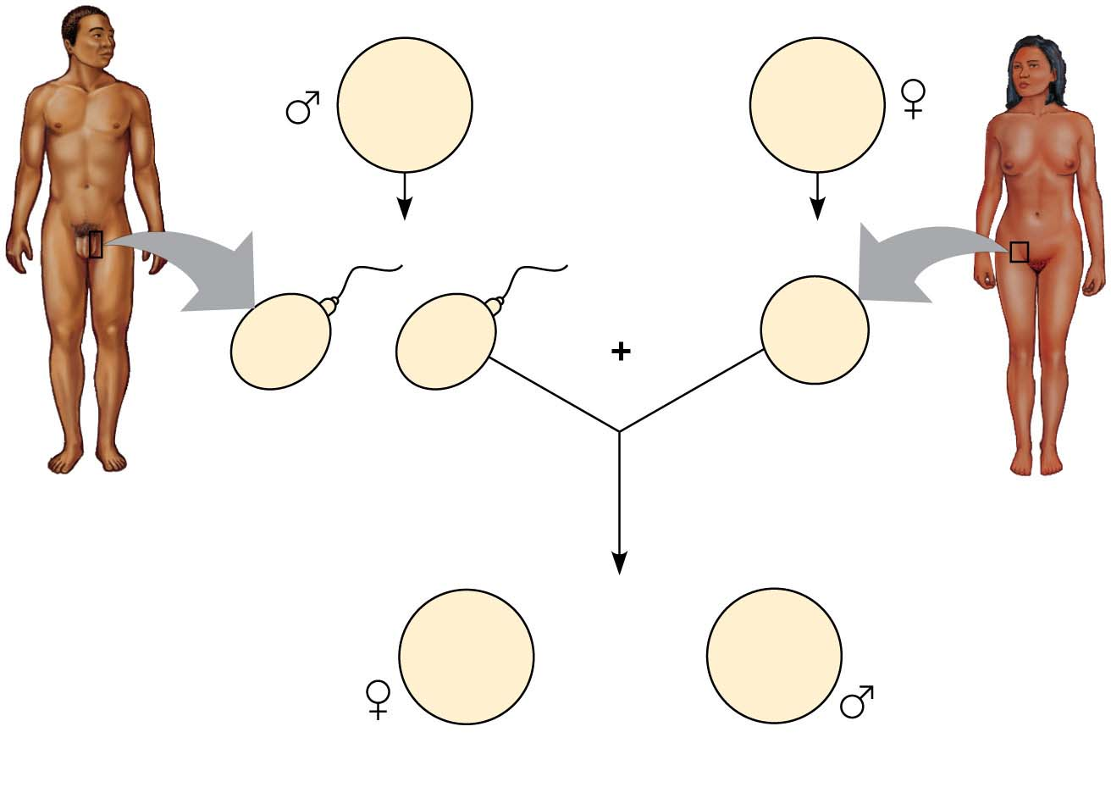
Figure 12.6
44 +
XY
Parents
44 +
XX
22 +
X
22 +
Y
22 +
X
or
Sperm
Egg
44 +
XX
44 +
XY
or
Zygotes (offspring)
© 2016 Pearson Education, Inc.
Notes:
Figure 12.6 The mammalian X-Y chromosomal system of sex determination

Slide 15
A gene that is located on either sex chromosome is called a sex-linked gene
Genes on the Y chromosome are called Y-linked genes; there are few of these
Genes on the X chromosome are called X-linked genes
© 2016 Pearson Education, Inc.
Notes:
15

Slide 16
Inheritance of X-Linked Genes
Most Y-linked genes help determine sex
The X chromosomes have genes for many characters unrelated to sex
© 2016 Pearson Education, Inc.
Notes:
16

Slide 17
X-linked genes follow specific patterns of inheritance
For a recessive X-linked trait to be expressed
A female needs two copies of the allele (homozygous)
A male needs only one copy of the allele (hemizygous)
X-linked recessive disorders are much more common in males than in females
© 2016 Pearson Education, Inc.
Notes:
17

Slide 18
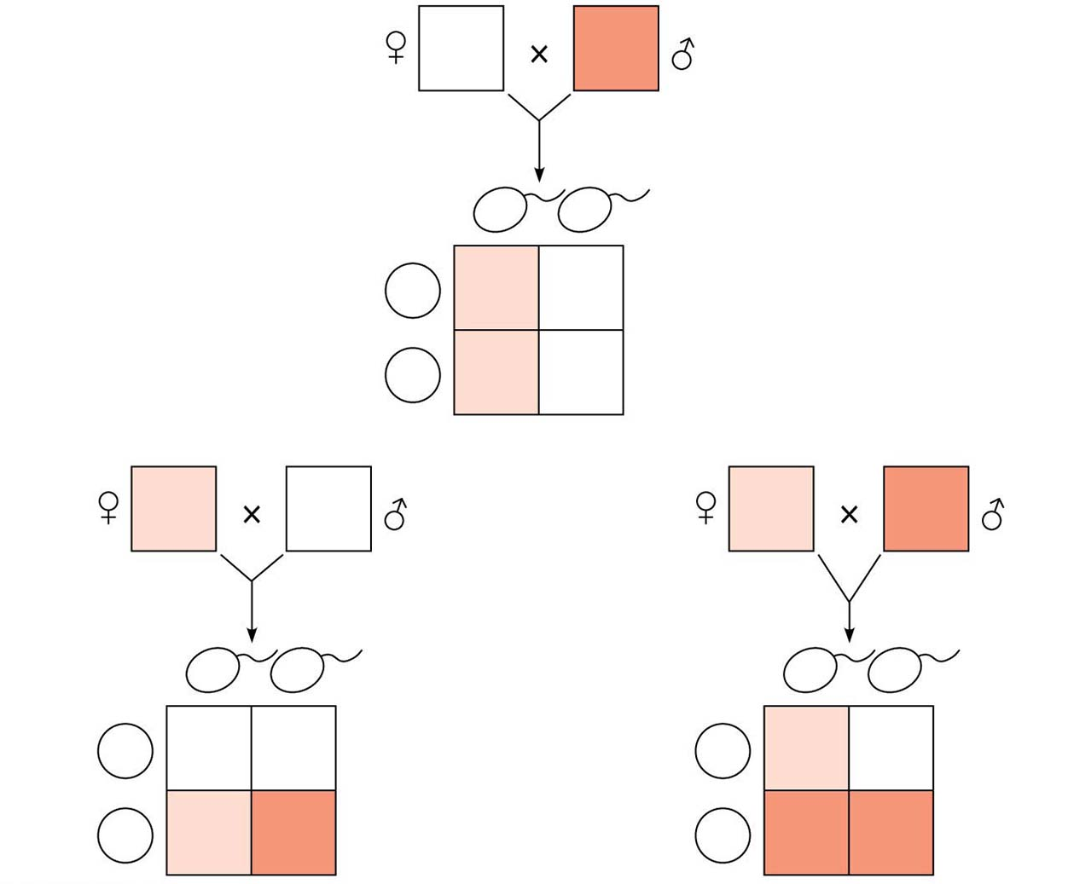
Figure 12.7
X^{N}X^{N}
X^{n}Y
X^{n}
Y
Sperm
Eggs
X^{N}
X^{N}X^{n}
X^{N}Y
X^{N}
X^{N}X^{n}
X^{N}Y
(a)
X^{N}X^{n}
X^{N}Y
X^{N}X^{n}
X^{n}Y
X^{N}
Y
Sperm
X^{n}
Y
Sperm
Eggs
X^{N}
X^{N}X^{N}
X^{N}Y
Eggs
X^{N}
X^{N}X^{n}
X^{N}Y
X^{n}
X^{N}X^{n}
X^{n}Y
X^{n}
X^{n}X^{n}
X^{n}Y
(b)
(c)
© 2016 Pearson Education, Inc.
Notes:
Figure 12.7 The transmission of X-linked recessive traits

Slide 19
Some disorders caused by recessive alleles on the X chromosome in humans:
Color blindness (mostly X-linked)
Duchenne muscular dystrophy
Hemophilia
© 2016 Pearson Education, Inc.
Notes:
19

Slide 20
X Inactivation in Female Mammals
In mammalian females, one of the two X chromosomes in each cell is randomly inactivated during embryonic development
The inactive X condenses into a Barr body
If a female is heterozygous for a particular gene located on the X chromosome, she will be a mosaic for that character
© 2016 Pearson Education, Inc.
Notes:
20

Slide 21
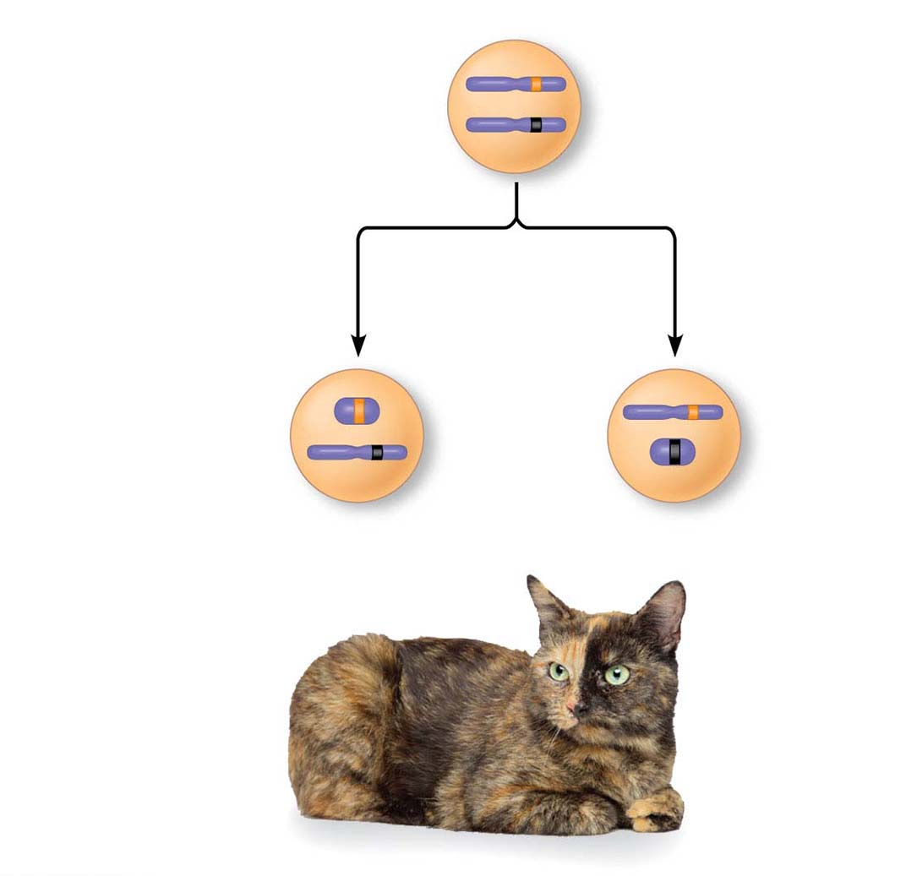
Figure 12.8
X chromosomes
Allele for
orange fur
Early embryo:
Allele for
black fur
Cell division and
X chromosome
inactivation
Two cell
populations
in adult cat:
Active X
Inactive X
Active X
Black fur
Orange fur
© 2016 Pearson Education, Inc.
Notes:
Figure 12.8 X inactivation and the tortoiseshell cat

Slide 22
Concept 12.3: Linked genes tend to be inherited together because they are located near each other on the same chromosome
Each chromosome has hundreds or thousands of genes (except the Y chromosome)
Genes located on the same chromosome that tend to be inherited together are called linked genes
© 2016 Pearson Education, Inc.
Notes:
22

Slide 23
How Linkage Affects Inheritance
Morgan did experiments with fruit flies that show how linkage affects inheritance of two characters
Morgan crossed flies that differed in traits of body color and wing size
© 2016 Pearson Education, Inc.
Notes:
23

Slide 24
Morgan found that body color and wing size are usually inherited together in specific combinations (parental phenotypes)
He reasoned that since these genes did not assort independently, they were on the same chromosome
© 2016 Pearson Education, Inc.
Notes:
24

Slide 25
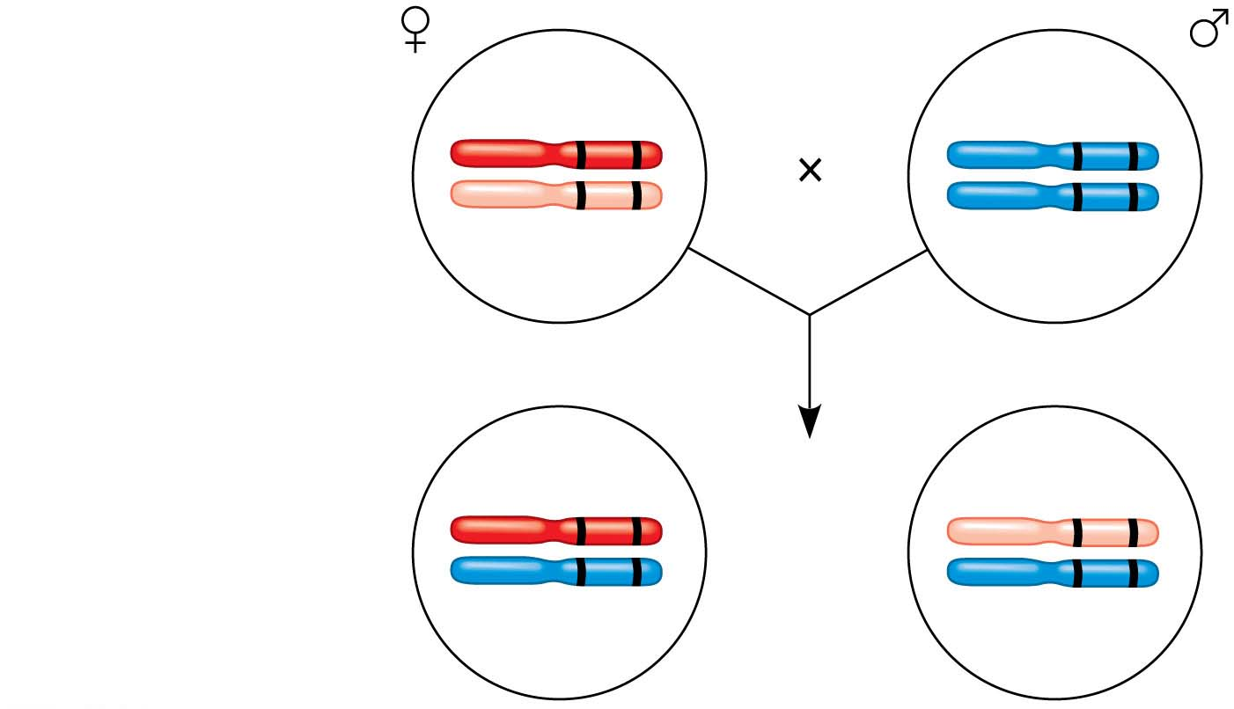
Figure 12.UN01
F₁ dihybrid female
and homozygous
recessive male
in testcross
b⁺
vg ⁺
b
vg
b
vg
b
vg
b⁺
vg ⁺
b
vg
Most offspring
or
b
vg
b
vg
© 2016 Pearson Education, Inc.
Notes:
Figure 12.UN01 In-text figure, testcross, p. 242

Slide 26
However, nonparental phenotypes were also produced
Understanding this result involves exploring genetic recombination, the production of offspring with combinations of traits differing from either parent
© 2016 Pearson Education, Inc.
Notes:
26

Slide 27
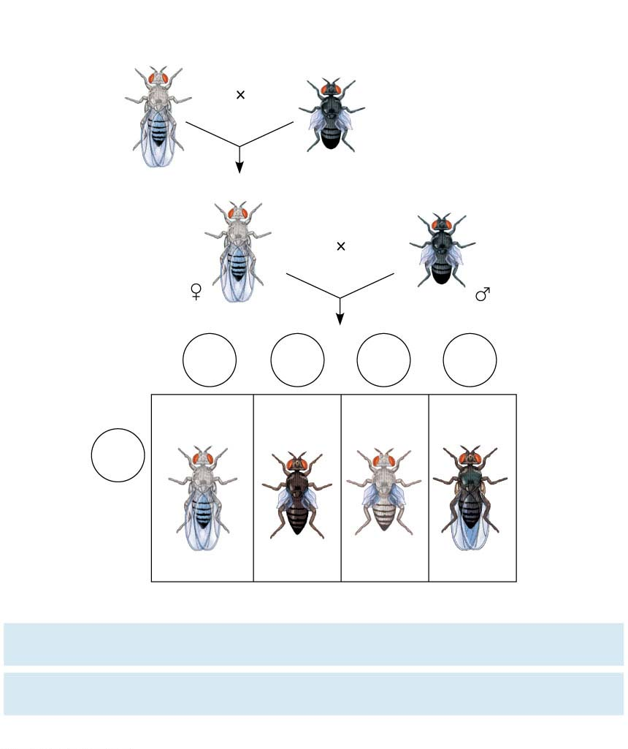
Figure 12.9
Experiment
P Generation
(homozygous)
Wild type
(gray body,
normal wings)
Double mutant
(black body,
vestigial wings)
b⁺
b⁺
vg⁺
vg⁺
b b
vg vg
F1 dihybrid testcross
Homozygous
recessive (black
body, vestigial
wings)
Wild-type F₁ dihybrid
(gray body, normal wings)
b⁺
b
vg⁺
vg
b b
vg vg
Testcross
offspring
Eggs
b⁺
vg⁺
b
vg
b⁺
vg⁺
b
vg⁺
Wild type
(gray normal)
Black
vestigial
Gray
vestigial
Black
normal
b vg
Sperm
b⁺
b
vg⁺
vg
b b vg vg
b⁺
b
vg
vg
b
b
vg⁺
vg
PREDICTED RATIOS
Genes on different
chromosomes:
1
:
1
:
1
:
1
Genes on same
chromosome:
1
:
1
:
0
:
0
Results
965
:
944
:
206
:
185
© 2016 Pearson Education, Inc.
Notes:
Figure 12.9 Inquiry: How does linkage between two genes affect inheritance of characters?

Slide 28
Genetic Recombination and Linkage
The genetic findings of Mendel and Morgan relate to the chromosomal basis of recombination
© 2016 Pearson Education, Inc.
Notes:
28

Slide 29
Recombination of Unlinked Genes: Independent Assortment of Chromosomes
Mendel observed that combinations of traits in some offspring differ from either parent
Offspring with a phenotype matching one of the parental phenotypes are called parental types
Offspring with nonparental phenotypes (new combinations of traits) are called recombinant types, or recombinants
A 50% frequency of recombination is observed for any two genes on different chromosomes
© 2016 Pearson Education, Inc.
Notes:
29

Slide 30
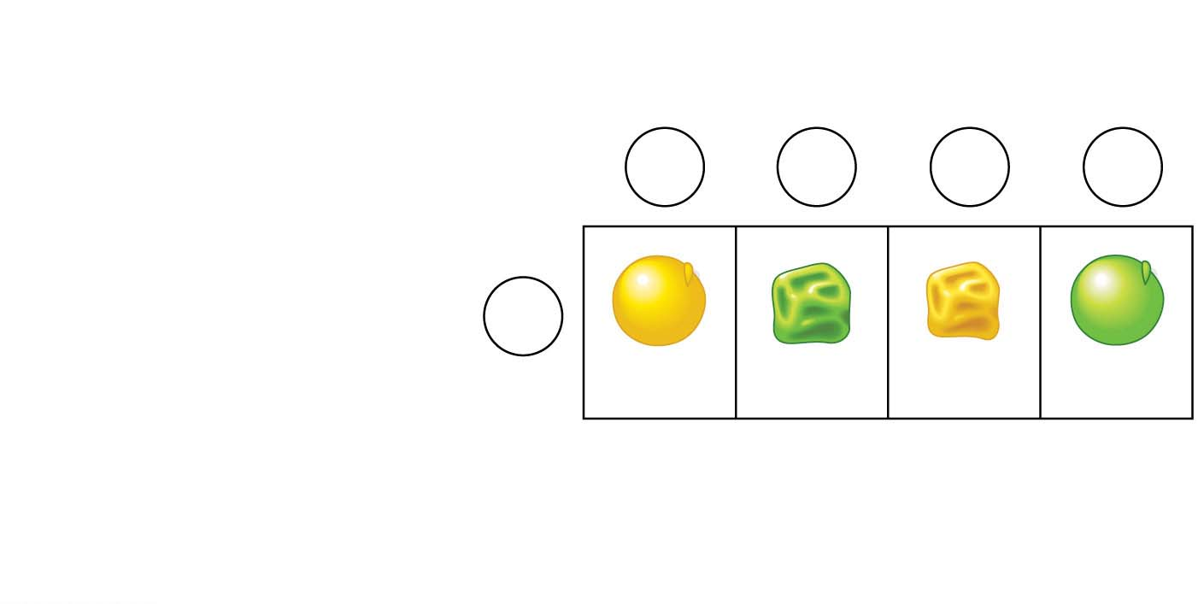
Figure 12.UN02
Gametes from yellow round
dihybrid parent (YyRr )
YR
yr
Yr
yR
Gametes from green
wrinkled homozygous
recessive parent (yyrr)
yr
YyRr
yyrr
Yyrr
yyRr
Parental-
type
offspring
Recombinant
offspring
© 2016 Pearson Education, Inc.
Notes:
Figure 12.UN02 In-text figure, Punnett square, p. 244

Slide 31
Recombination of Linked Genes: Crossing Over
Morgan discovered that even when two genes were on the same chromosome, some recombinant phenotypes were observed
He proposed that some process must occasionally break the physical connection between genes on the same chromosome
That mechanism was the crossing over between homologous chromosomes
© 2016 Pearson Education, Inc.
Notes:
31

Slide 32
Animation: Crossing Over

Slide 33
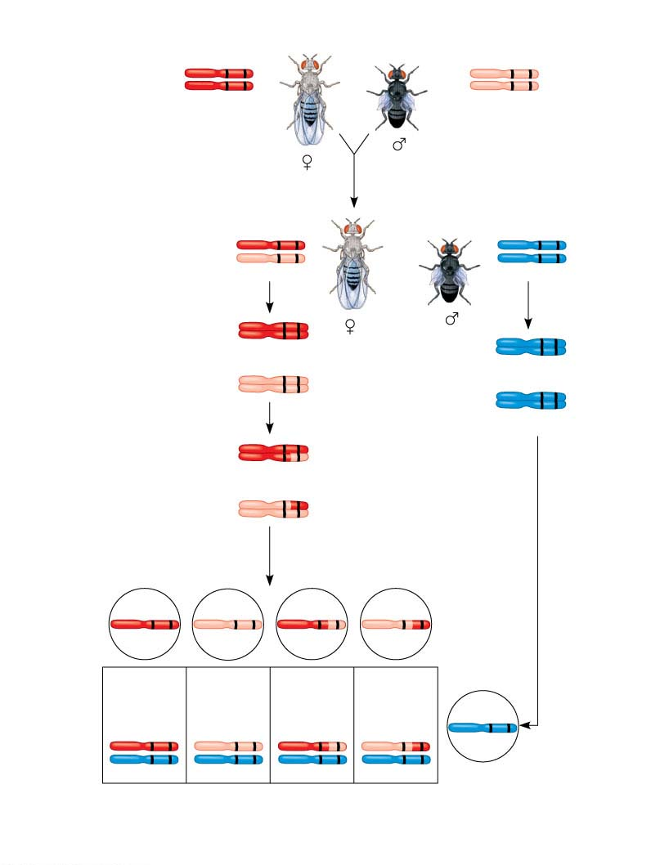
Figure 12.10
P generation
(homozygous)
Wild type
(gray body,
normal wings)
Double mutant
(black body,
vestigial wings)
b⁺
vg⁺
b
vg
b⁺
vg⁺
b
vg
F₁ dihybrid testcross
Wild-type F1 dihybrid
(gray body,
normal wings)
Homozygous recessive
(black body,
vestigial wings)
b⁺
vg⁺
b vg
b
vg
b vg
Replication
of chromosomes
Replication
of chromosomes
b⁺
vg⁺
b vg
b⁺
vg⁺
b vg
b vg
b vg
b vg
b vg
Meiosis I
b⁺
vg⁺
b⁺
vg
Meiosis I and II
b
vg⁺
Meiosis II
b
vg
Recombinant
chromosomes
Eggs
b⁺
vg⁺
b
vg
b⁺
vg
b
vg⁺
Testcross
offspring
965
Wild type
(gray normal)
944
Black
vestigial
206
Gray
vestigial
185
Black
normal
b⁺
vg⁺
b
vg
b vg
b⁺
vg
b
vg⁺
b
vg
b
vg
b
vg
b
vg
Sperm
Parental-type offspring
Recombinant offspring
Recombination
frequency
=
391 recombinants
×100 = 17%
© 2016 Pearson Education, Inc.
2,300 total offspring
Notes:
Figure 12.10 Chromosomal basis for recombination of linked genes

Slide 34
New Combinations of Alleles: Variation for Natural Selection
Recombinant chromosomes bring alleles together in new combinations in gametes
Random fertilization increases even further the number of variant combinations that can be produced
This abundance of genetic variation is the raw material upon which natural selection works
© 2016 Pearson Education, Inc.
Notes:
34

Slide 35
Mapping the Distance Between Genes Using Recombination Data: Scientific Inquiry
Alfred Sturtevant, one of Morgan’s students, constructed a genetic map, an ordered list of the genetic loci along a particular chromosome
Sturtevant predicted that the farther apart two genes are, the higher the probability that a crossover will occur between them and therefore the higher the recombination frequency
© 2016 Pearson Education, Inc.
Notes:
35

Slide 36
A linkage map is a genetic map of a chromosome based on recombination frequencies
Distances between genes can be expressed as map units; one map unit represents a 1% recombination frequency
© 2016 Pearson Education, Inc.
Notes:
36

Slide 37
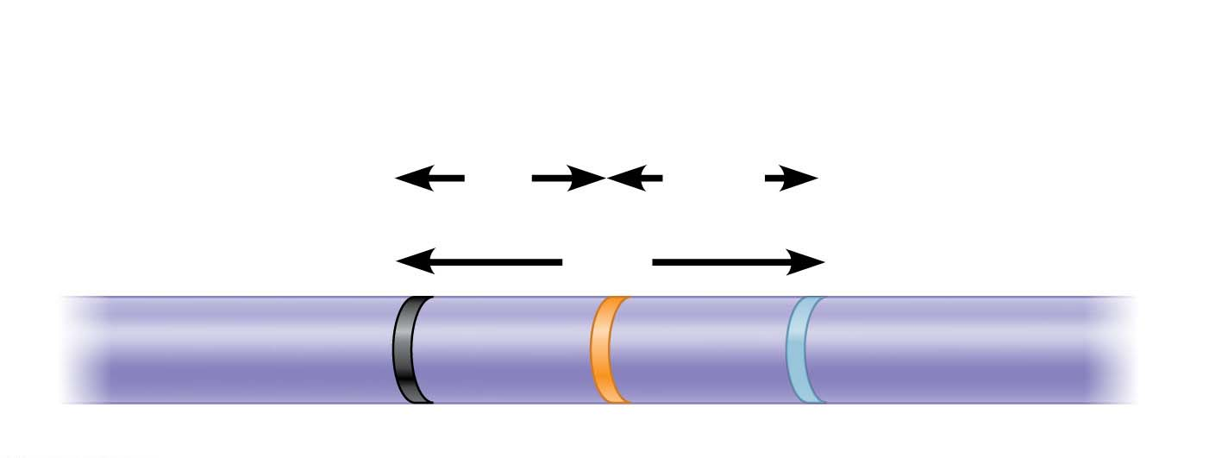
Figure 12.11
Results
Recombination
frequencies
9%
9.5%
Chromosome
17%
b
cn
vg
© 2016 Pearson Education, Inc.
Notes:
Figure 12.11 Research method: constructing a linkage map

Slide 38
Genes that are far apart on the same chromosome can have a recombination frequency near 50%
Such genes are physically connected, but genetically unlinked
© 2016 Pearson Education, Inc.
Notes:
38

Slide 39
Sturtevant used recombination frequencies to make linkage maps of fruit fly genes
Using methods like chromosomal banding, geneticists can develop cytogenetic maps of chromosomes
Cytogenetic maps indicate the positions of genes with respect to chromosomal features
© 2016 Pearson Education, Inc.
Notes:
39

Slide 40
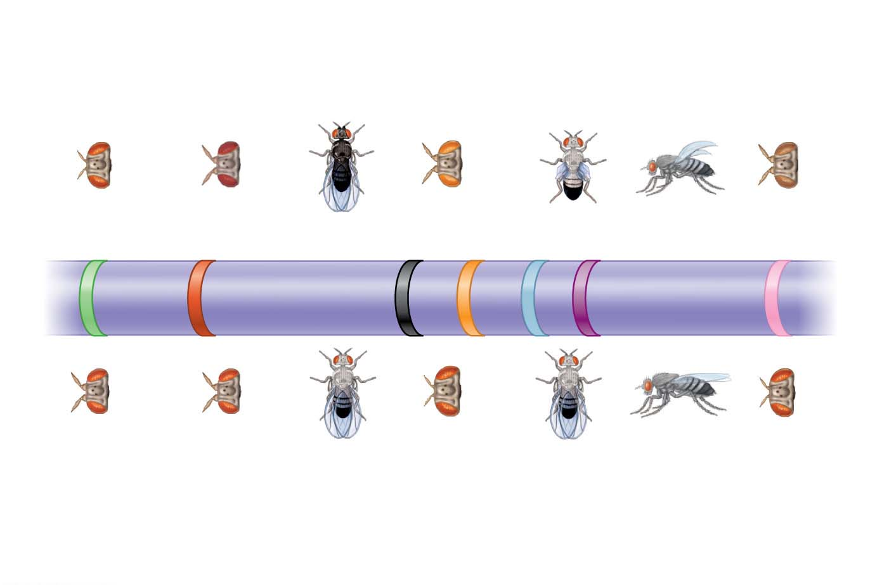
Figure 12.12
Mutant phenotypes
Short
aristae
Maroon
eyes
Black body
Cinnabar
eyes
Vestigial
wings
Down-
curved
wings
Brown
eyes
0
16.5
48.5
57.5
67.0
75.5
104.5
Long
aristae
(appendages
on head)
Red
eyes
Gray
body
Red
eyes
Normal
wings
Normal
wings
Red
eyes
Wild-type phenotypes
© 2016 Pearson Education, Inc.
Notes:
Figure 12.12 A partial genetic (linkage) map of a Drosophila chromosome

Slide 41
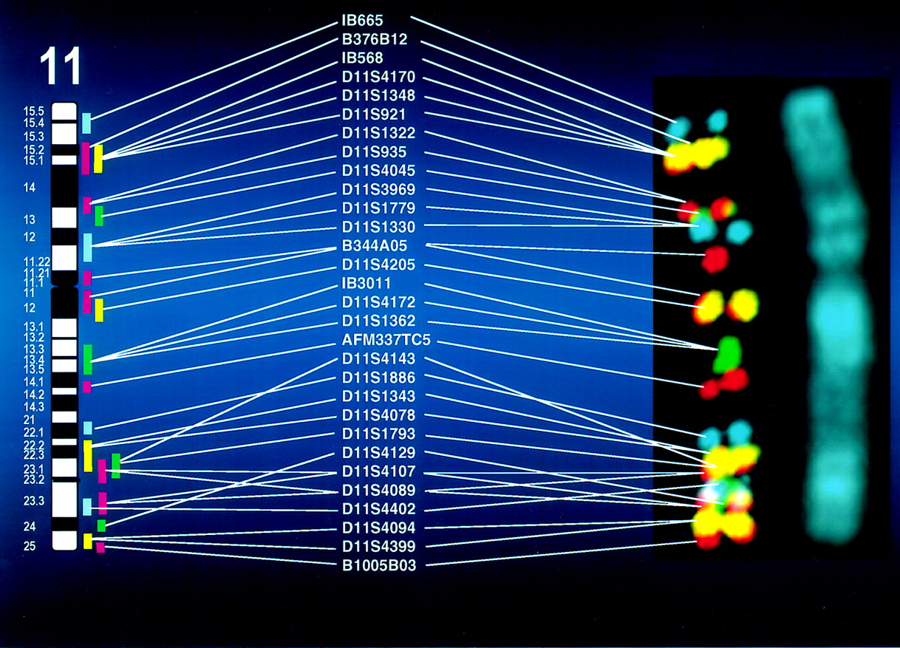

Slide 42
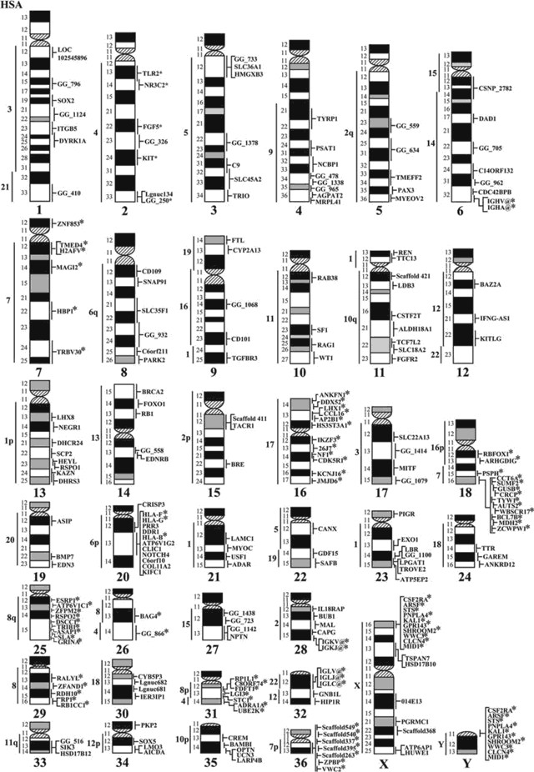

Slide 43
Concept 12.4: Alterations of chromosome number or structure cause some genetic disorders
Large-scale chromosomal alterations in humans and other mammals often lead to spontaneous abortions (miscarriages) or cause a variety of developmental disorders
Plants tolerate such genetic changes better than animals do
© 2016 Pearson Education, Inc.
Notes:
43

Slide 44
Abnormal Chromosome Number
In nondisjunction, pairs of homologous chromosomes do not separate normally during meiosis
As a result, one gamete receives two of the same type of chromosome, and another gamete receives no copy
© 2016 Pearson Education, Inc.
Notes:
44

Slide 45
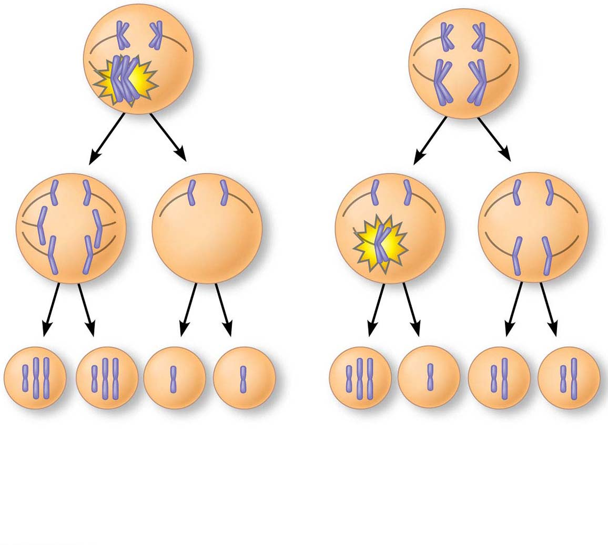
Figure 12.13-s3
Meiosis I
Nondisjunction
Meiosis II
Non-
disjunction
Gametes
n + 1
n + 1
n − 1
n − 1
n + 1
n − 1
n
n
Number of chromosomes
Nondisjunction of homologous chromosomes in meiosis I
(b) Nondisjunction of sister chromatids in meiosis II
© 2016 Pearson Education, Inc.
Notes:
Figure 12.13-s3 Meiotic nondisjunction (step 3)

Slide 46
Aneuploidy results from fertilization involving gametes in which nondisjunction occurred
Offspring with this condition have an abnormal number of a particular chromosome
© 2016 Pearson Education, Inc.
Notes:
46

Slide 47
A monosomic zygote has only one copy of a particular chromosome
A trisomic zygote has three copies of a particular chromosome
© 2016 Pearson Education, Inc.
Notes:
47

Slide 48
Polyploidy is a condition in which an organism has more than two complete sets of chromosomes
Triploidy (3n) is three sets of chromosomes
Tetraploidy (4n) is four sets of chromosomes
Polyploidy is common in plants, but not animals
Polyploids are more normal in appearance than aneuploids
© 2016 Pearson Education, Inc.
Notes:
48

Slide 49
Alterations of Chromosome Structure
Breakage of a chromosome can lead to four types of changes in chromosome structure
Deletion removes a chromosomal segment
Duplication repeats a segment
Inversion reverses orientation of a segment within a chromosome
Translocation moves a segment from one chromosome to another
© 2016 Pearson Education, Inc.
Notes:
49

Slide 50
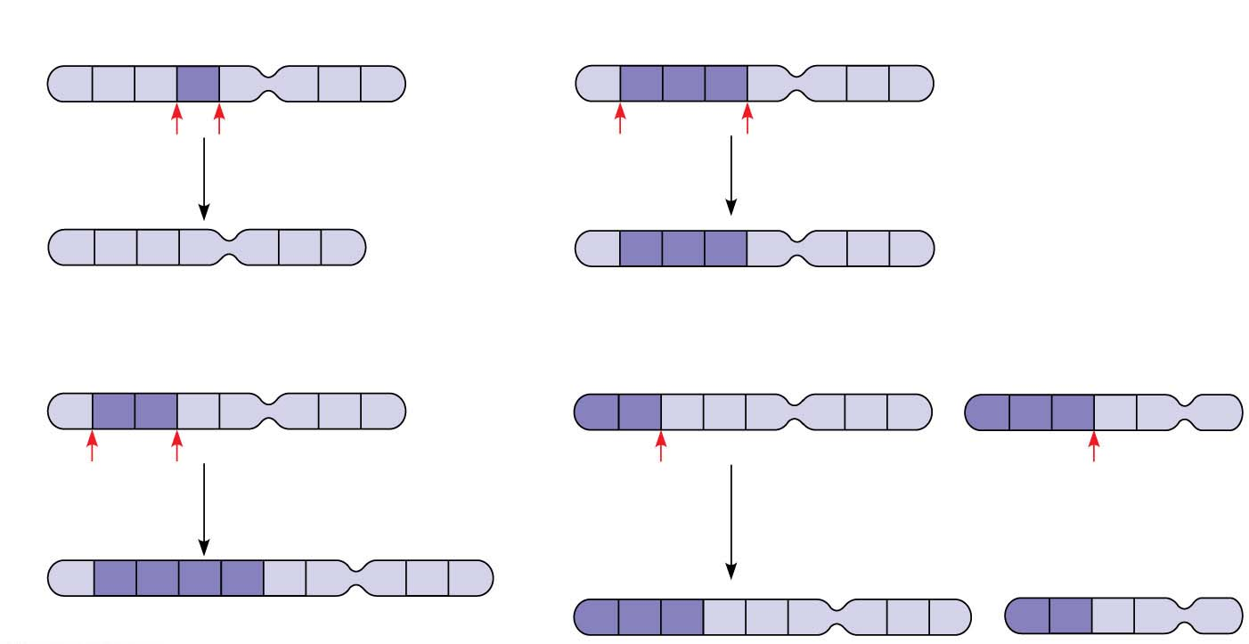
Figure 12.14
(a) Deletion
(c) Inversion
A
B
C
D
E
F
G
H
A
B
C
D
E
F
G
H
A deletion removes a
chromosomal segment.
An inversion reverses a segment
within a chromosome.
A
B
C
E
F
G
H
A
D
C
B
E
F
G
H
(b) Duplication
(d) Translocation
A
B
C
D
E
F
G
H
A
B
C
D
E
F
G
H
M
N
O
P
Q
R
A duplication repeats
a segment.
A translocation moves a segment
from one chromosome to a
nonhomologous chromosome.
A
B
C
B
C
D
E
F
G
H
M
N
O
C
D
E
F
G
H
A
B
P
Q
R
© 2016 Pearson Education, Inc.
Notes:
Figure 12.14 Alterations of chromosome structure

Slide 51
A diploid embryo that is homozygous for a large deletion is likely missing a number of essential genes; such a condition is generally lethal
Duplications and translocations also tend to be harmful
In inversions, the balance of genes is normal but phenotype may be influenced if the expression of genes is altered
© 2016 Pearson Education, Inc.
Notes:
51

Slide 52
Human Disorders Due to Chromosomal Alterations
Alterations of chromosome number and structure are associated with some serious disorders
Some types of aneuploidy upset the genetic balance less than others, resulting in individuals surviving to birth and beyond
These surviving individuals have a set of symptoms, or syndrome, characteristic of the type of aneuploidy
© 2016 Pearson Education, Inc.
Notes:
52

Slide 53
Down Syndrome (Trisomy 21)
Down syndrome is an aneuploid condition that results from three copies of chromosome 21
It affects about one out of every 830 children born in the United States
The frequency of Down syndrome increases with the age of the mother, a correlation that has not been explained
© 2016 Pearson Education, Inc.
Notes:
53

Slide 54
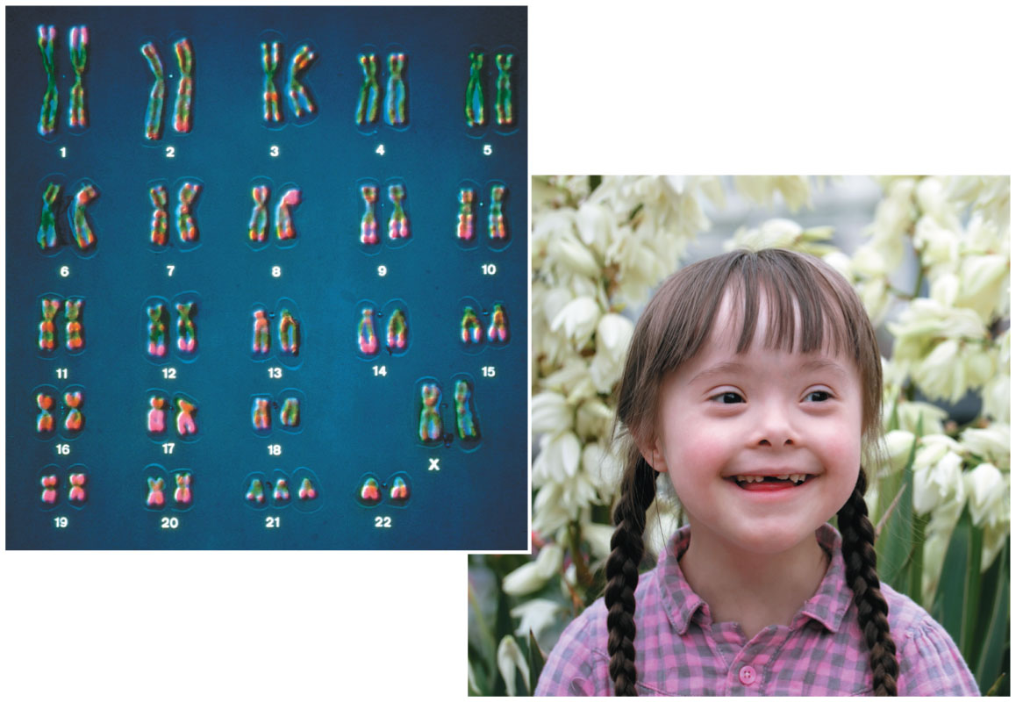
Figure 12.15
© 2016 Pearson Education, Inc.
Notes:
Figure 12.15 Down syndrome

Slide 55
Aneuploidy of Sex Chromosomes
Nondisjunction of sex chromosomes produces a variety of aneuploid conditions
Klinefelter syndrome is the result of an extra chromosome in a male, producing XXY individuals
About one in every 1,000 males is born with an extra Y chromosome (XYY) and does not exhibit any defined syndrome
Females with trisomy X (XXX) have no unusual physical features except being slightly taller than average
© 2016 Pearson Education, Inc.
Notes:
55

Slide 56
Monosomy X, called Turner syndrome, produces X0 females, who are sterile
It is the only known viable monosomy in humans
© 2016 Pearson Education, Inc.
Notes:
56

Slide 57
Disorders Caused by Structurally Altered Chromosomes
The syndrome cri du chat (“cry of the cat”) results from a specific deletion in chromosome 5
A child born with this syndrome is severely intellectually disabled and has a catlike cry; individuals usually die in infancy or early childhood
Certain cancers, including chronic myelogenous leukemia (CML), are caused by translocations of chromosomes
© 2016 Pearson Education, Inc.
Notes:
57

Slide 58
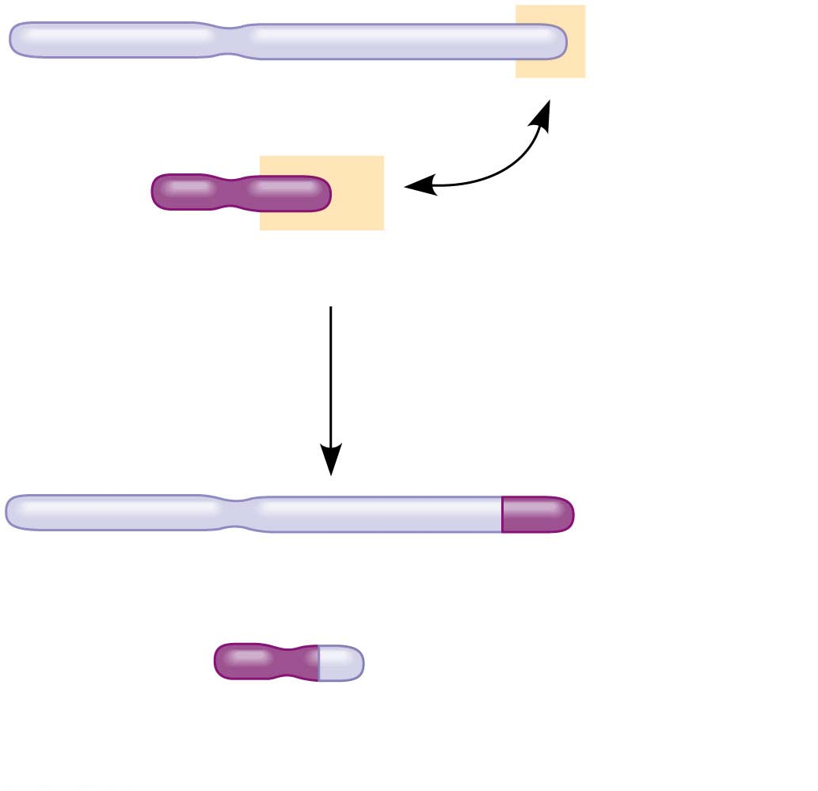
Figure 12.16
Normal chromosome 9
Normal chromosome 22
Reciprocal translocation
Translocated chromosome 9
Translocated chromosome 22
(Philadelphia chromosome)
© 2016 Pearson Education, Inc.
Notes:
Figure 12.16 Translocation associated with chronic myelogenous leukemia (CML)

