Slide 1
0
11
Mendel and the Gene Idea

Slide 2
Concept 11.1: Mendel used the scientific approach to identify two laws of inheritance
Mendel discovered the basic principles of heredity by breeding garden peas in carefully planned experiments
© 2016 Pearson Education, Inc.
Notes:
2

Slide 3
Mendel’s Experimental, Quantitative Approach
Mendel probably chose to work with peas because
There are many varieties with distinct heritable features, or characters (such as flower color); character variants (such as purple or white flowers) are called traits
He could control mating between plants
© 2016 Pearson Education, Inc.
Notes:
3

Slide 4
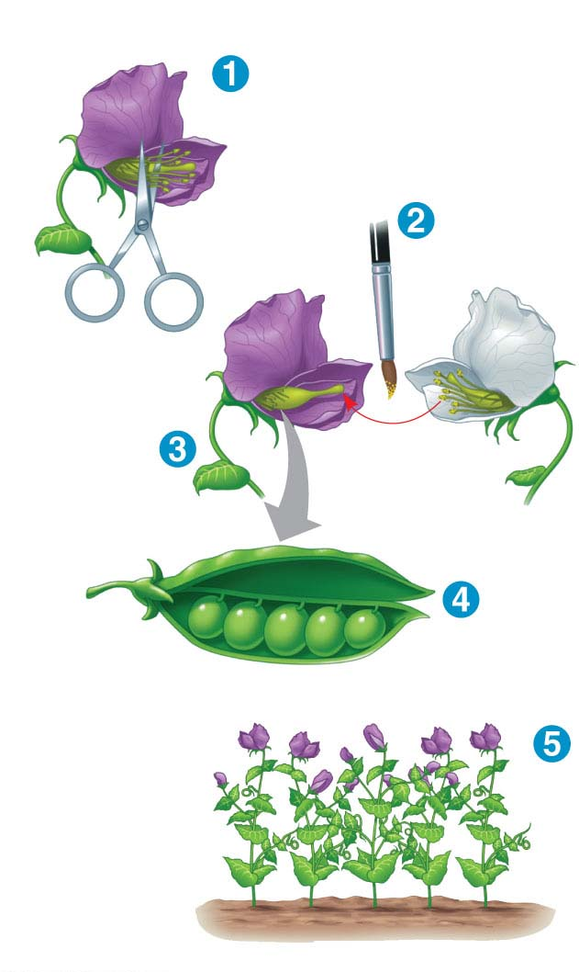
Figure 11.2
Technique
Parental
generation
(P)
Stamens
Carpel
Results
First filial
generation
offspring
(F₁)
© 2016 Pearson Education, Inc.
Notes:
Figure 11.2 Research method: crossing pea plants

Slide 5
Mendel chose to track only characters that occurred in two distinct alternative forms
He also used varieties that were true-breeding (plants that produce offspring of the same variety when they self-pollinate)
© 2016 Pearson Education, Inc.
Notes:
5

Slide 6
The Law of Segregation
When Mendel crossed contrasting, true-breeding white- and purple-flowered pea plants, all of the F₁ hybrids were purple
When Mendel crossed the F₁ hybrids, many of the F₂ plants had purple flowers, but some had white
Mendel discovered a ratio of about three to one, purple to white flowers, in the F₂ generation
© 2016 Pearson Education, Inc.
Notes:
6

Slide 7
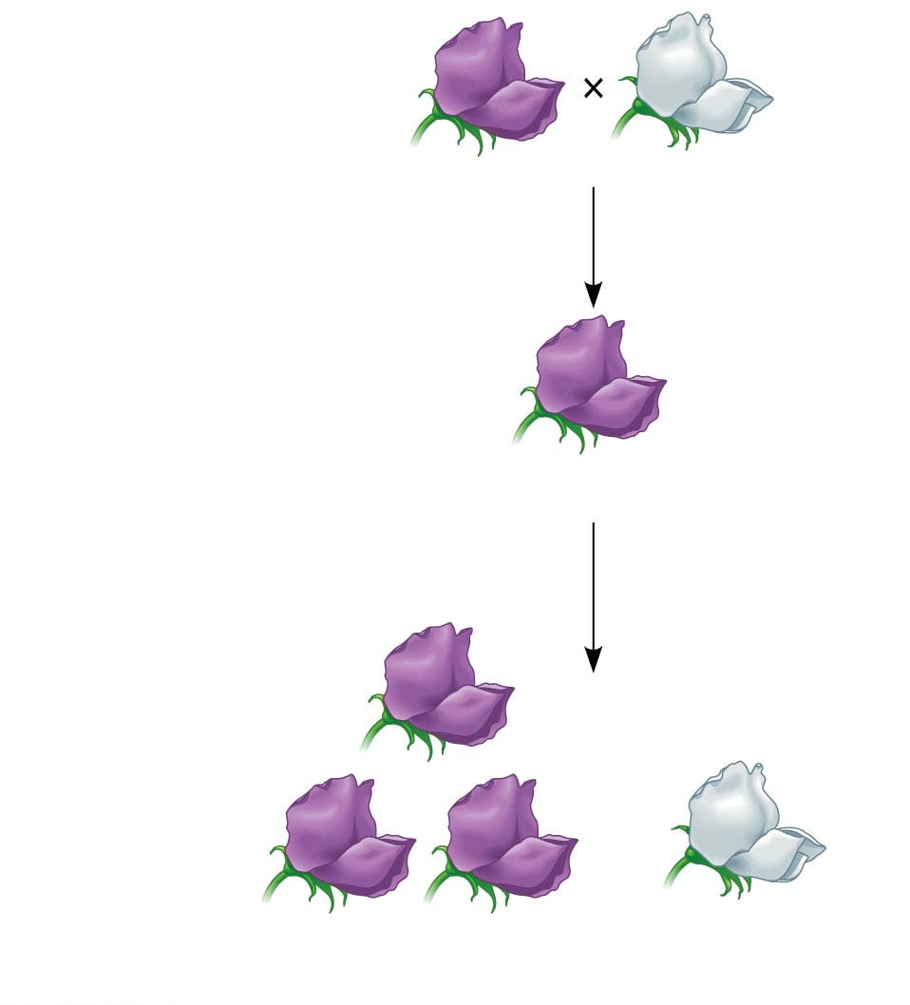
Figure 11.3-s3
Experiment
P Generation
(true-breeding
parents)
Purple
flowers
White
flowers
F₁ Generation
(hybrids)
All plants had purple flowers
Self- or cross-pollination
Results
F₂ Generation
705 purple-flowered
plants
224 white-flowered
plants
© 2016 Pearson Education, Inc.
Notes:
Figure 11.3-s3 Inquiry: When F₁ hybrid pea plants self- or cross-pollinate, which traits appear in the F₂ generation? (step 3)

Slide 8
Mendel reasoned that in the F₁ plants, the heritable factor for white flowers was hidden or masked in the presence of the purple-flower factor
He called the purple flower color a dominant trait and the white flower color a recessive trait
The factor for white flowers was not diluted or destroyed because it reappeared in the F₂ generation
© 2016 Pearson Education, Inc.
Notes:
8

Slide 9
Mendel observed the same pattern of inheritance in six other pea plant characters, each represented by two traits
What Mendel called a “heritable factor” is what we now call a gene
© 2016 Pearson Education, Inc.
Notes:
9

Slide 10
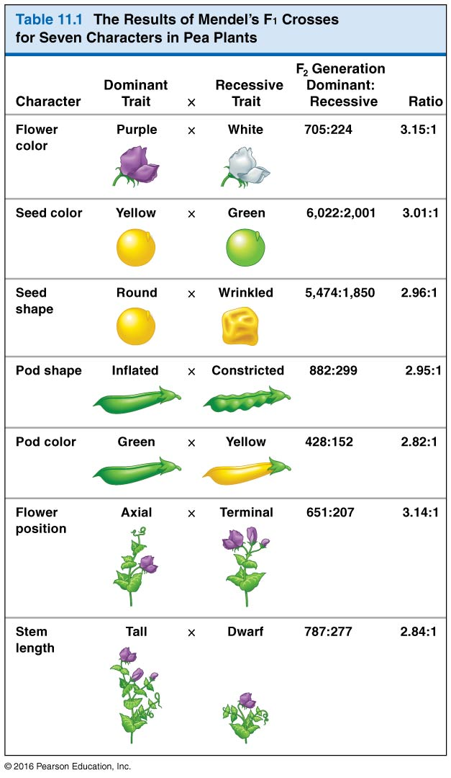
Table 11.1
© 2016 Pearson Education, Inc.
Notes:
Table 11.1 The results of Mendel’s F₁ crosses for seven characters in pea plants

Slide 11
Mendel’s Model
Mendel developed a model to explain the 3:1 inheritance pattern he observed in F₂ offspring
Four related concepts make up this model
© 2016 Pearson Education, Inc.
Notes:
11

Slide 12
First, alternative versions of genes account for variations in inherited characters
For example, the gene for flower color in pea plants exists in two versions, one for purple flowers and the other for white flowers
These alternative versions of a gene are now called alleles
Each gene resides at a specific locus on a specific chromosome
© 2016 Pearson Education, Inc.
Notes:
12

Slide 13
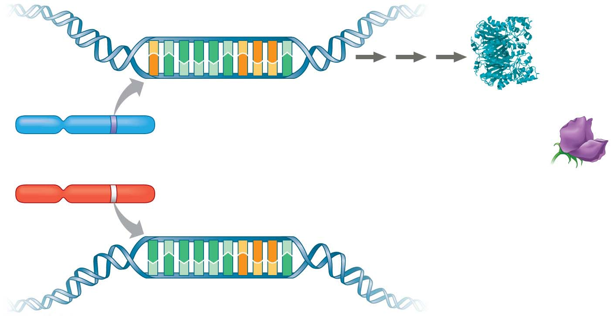
Figure 11.4
DNA with nucleotide
sequence CTAAATCGGT
Enzyme
C
T
A
A
A
T
C
G
G
T
Allele for
purple flowers
G
A
T
T
T
A
G
C
C
A
Pair of
homologous
chromosomes
Locus for flower-
color gene
Allele for
white flowers
A
T
A
A
A
T
C
G
G
T
T
A
T
T
T
A
G
C
C
A
No enzyme
DNA with nucleotide
sequence AT AAATCGGT
© 2016 Pearson Education, Inc.
Notes:
Figure 11.4 Alleles, alternative versions of a gene

Slide 14
Second, for each character, an organism inherits two alleles, one from each parent
Mendel made this deduction without knowing about the existence of chromosomes
Two alleles at a particular locus may be identical, as in the true-breeding plants of Mendel’s P generation
Alternatively, the two alleles at a locus may differ, as in the F₁ hybrids
© 2016 Pearson Education, Inc.
Notes:
14

Slide 15
Third, if the two alleles at a locus differ, then one (the dominant allele) determines the organism’s appearance, and the other (the recessive allele) has no noticeable effect on appearance
In the flower-color example, the F₁ plants had purple flowers because the allele for that trait is dominant
© 2016 Pearson Education, Inc.
Notes:
15

Slide 16
Fourth (the law of segregation), the two alleles for a heritable character separate (segregate) during gamete formation and end up in different gametes
Thus, an egg or a sperm gets only one of the two alleles that are present in the organism
This segregation of alleles corresponds to the distribution of homologous chromosomes to different gametes in meiosis
© 2016 Pearson Education, Inc.
Notes:
16

Slide 17
Mendel’s segregation model accounts for the 3:1 ratio he observed in the F₂ generation of his crosses
Possible combinations of sperm and egg can be shown using a Punnett square to predict the results of a genetic cross between individuals of known genetic makeup
A capital letter represents a dominant allele, and a lowercase letter represents a recessive allele
For example, P is the purple-flower allele and p is the white-flower allele
© 2016 Pearson Education, Inc.
Notes:
17

Slide 18
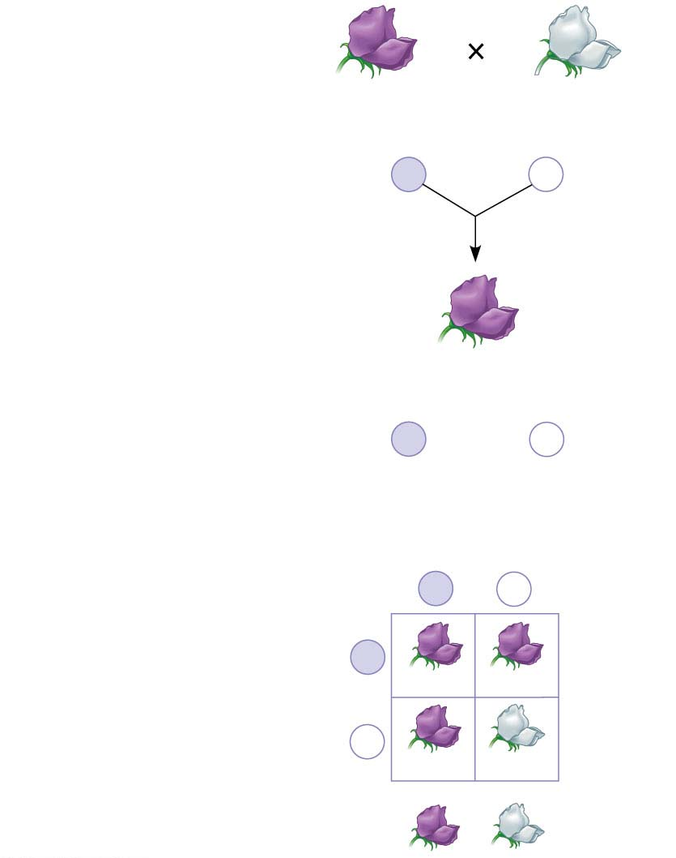
Figure 11.5-s3
P Generation
Appearance:
Genetic makeup:
Purple flowers
White flowers
PP
pp
Gametes:
P
p
F₁ Generation
Appearance:
Genetic makeup:
Purple flowers
Pp
Gametes:
1
2
P
1
2
p
Sperm from
F₁ (Pp) plant
F₂ Generation
P
p
P
Eggs from
F₁ (Pp) plant
PP
Pp
p
Pp
pp
3
: 1
© 2016 Pearson Education, Inc.
Notes:
Figure 11.5-s3 Mendel’s law of segregation (step 3)

Slide 19
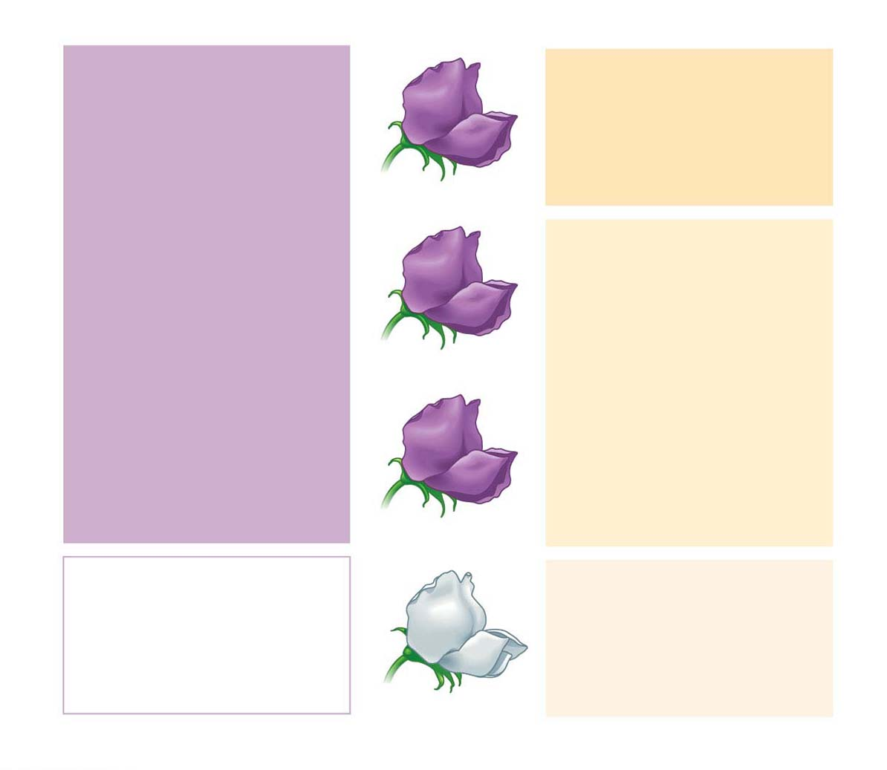
Figure 11.6
Phenotype
Genotype
Purple
PP
(homozygous)
1
3
Purple
Pp
(heterozygous)
2
Purple
Pp
(heterozygous)
1
White
pp
(homozygous)
1
Ratio 3:1
Ratio 1:2:1
© 2016 Pearson Education, Inc.
Notes:
Figure 11.6 Phenotype versus genotype

Slide 20
The Testcross
How can we tell the genotype of an individual with the dominant phenotype?
Such an individual could be either homozygous dominant or heterozygous
The answer is to carry out a testcross: breeding the mystery individual with a homozygous recessive individual
If any offspring display the recessive phenotype, the mystery parent must be heterozygous
© 2016 Pearson Education, Inc.
Notes:
20

Slide 21
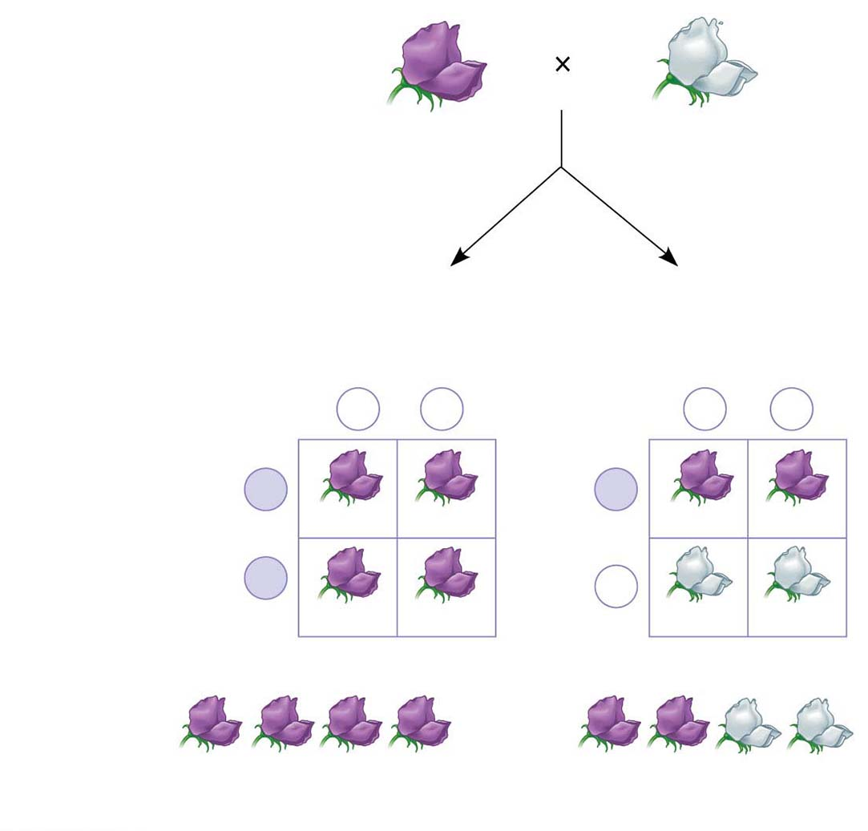
Figure 11.7
Technique
Dominant phenotype,
unknown genotype:
PP or Pp?
Recessive phenotype,
known genotype:
pp
Predictions
If purple-flowered
parent is PP:
or
If purple-flowered
parent is Pp:
Sperm
Sperm
p
p
p
p
P
P
Eggs
Pp
Pp
Eggs
Pp
Pp
P
p
Pp
Pp
pp
pp
Results
or
All offspring purple
1
2
offspring purple and
offspring white
1
2
© 2016 Pearson Education, Inc.
Notes:
Figure 11.7 Research method: the testcross

Slide 22
The Law of Independent Assortment
Mendel derived the law of segregation by following a single character
The F₁ offspring produced in this cross were monohybrids, individuals that are heterozygous for one character
A cross between such heterozygotes is called a monohybrid cross
© 2016 Pearson Education, Inc.
Notes:
22

Slide 23
Mendel identified his second law of inheritance by following two characters at the same time
Crossing two true-breeding parents differing in two characters produces dihybrids in the F₁ generation, heterozygous for both characters
A dihybrid cross, a cross between F₁ dihybrids, can determine whether two characters are transmitted to offspring as a package or independently
© 2016 Pearson Education, Inc.
Notes:
23

Slide 24
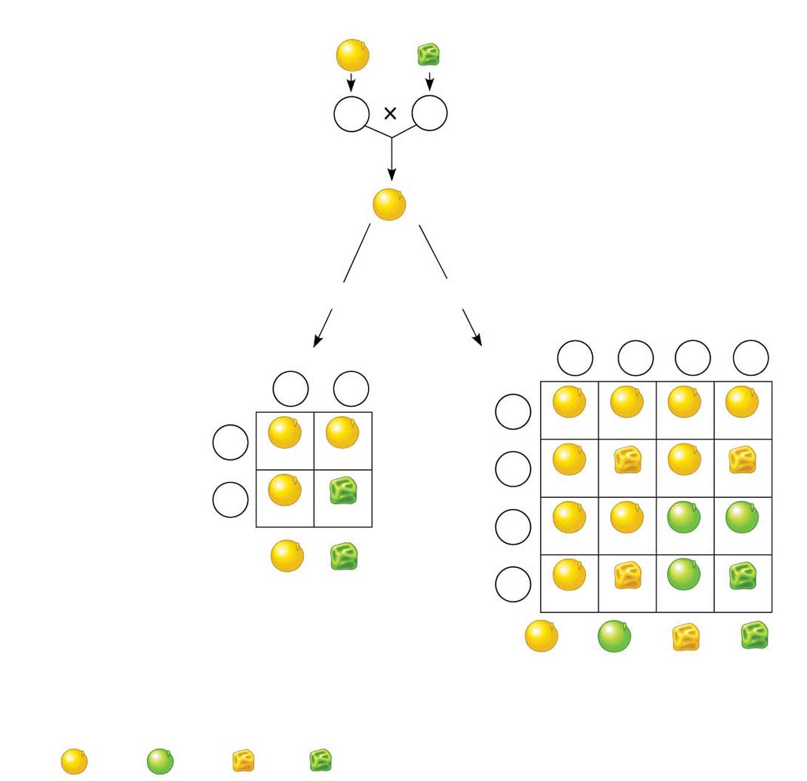
Figure 11.8
Experiment
P Generation
YYRR
yyrr
Gametes
YR
yr
F1 Generation
YyRr
Predictions
Hypothesis of
dependent assortment
Hypothesis of
independent assortment
Predicted
offspring of
F₂ generation
or
Sperm
Sperm
1
4
YR
1
4
Yr
1
4
yR
1
4
yr
1
2
YR
1
2
yr
1
4
YR
YYRR
YYRr
YyRR
YyRr
1
2
YR
Eggs
YYRR
YyRr
1
Yr
Eggs
4
YYRr
YYrr
YyRr
Yyrr
1
2
yr
YyRr
yyrr
1
yR
4
YyRR
YyRr
yyRR
yyRr
3
4
1
4
Phenotypic ratio 3:1
1
4
yr
yyRr
yyrr
YyRr
Yyrr
9
16
3
16
3
16
1
16
Phenotypic ratio 9:3:3:1
Results
315
108
101
32
Phenotypic ratio approximately 9:3:3:1
© 2016 Pearson Education, Inc.
Notes:
Figure 11.8 Inquiry: Do the alleles for one character segregate into gametes dependently or independently of the alleles for a different character?

Slide 25
The results of Mendel’s dihybrid experiments are the basis for the law of independent assortment
It states that each pair of alleles segregates independently of any other pair during gamete formation
This law applies to genes on chromosomes that are not homologous, or those far apart on the same chromosome
Genes located near each other on the same chromosome tend to be inherited together
© 2016 Pearson Education, Inc.
Notes:
25

Slide 26
Concept 11.2: Probability laws govern Mendelian inheritance
Mendel’s laws of segregation and independent assortment reflect the rules of probability
The outcome of one coin toss has no impact on the outcome of the next toss
In the same way, the alleles of one gene segregate into gametes independently of another gene’s alleles
© 2016 Pearson Education, Inc.
Notes:
26

Slide 27
The Multiplication and Addition Rules Applied to Monohybrid Crosses
The multiplication rule states that the probability that two or more independent events will occur together is the product of their individual probabilities
This can be applied to an F₁ monohybrid cross
Segregation in a heterozygous plant is like flipping a coin: Each gamete has a ½ chance of carrying the dominant allele and a ½ chance of carrying the recessive allele
© 2016 Pearson Education, Inc.
Notes:
27

Slide 28
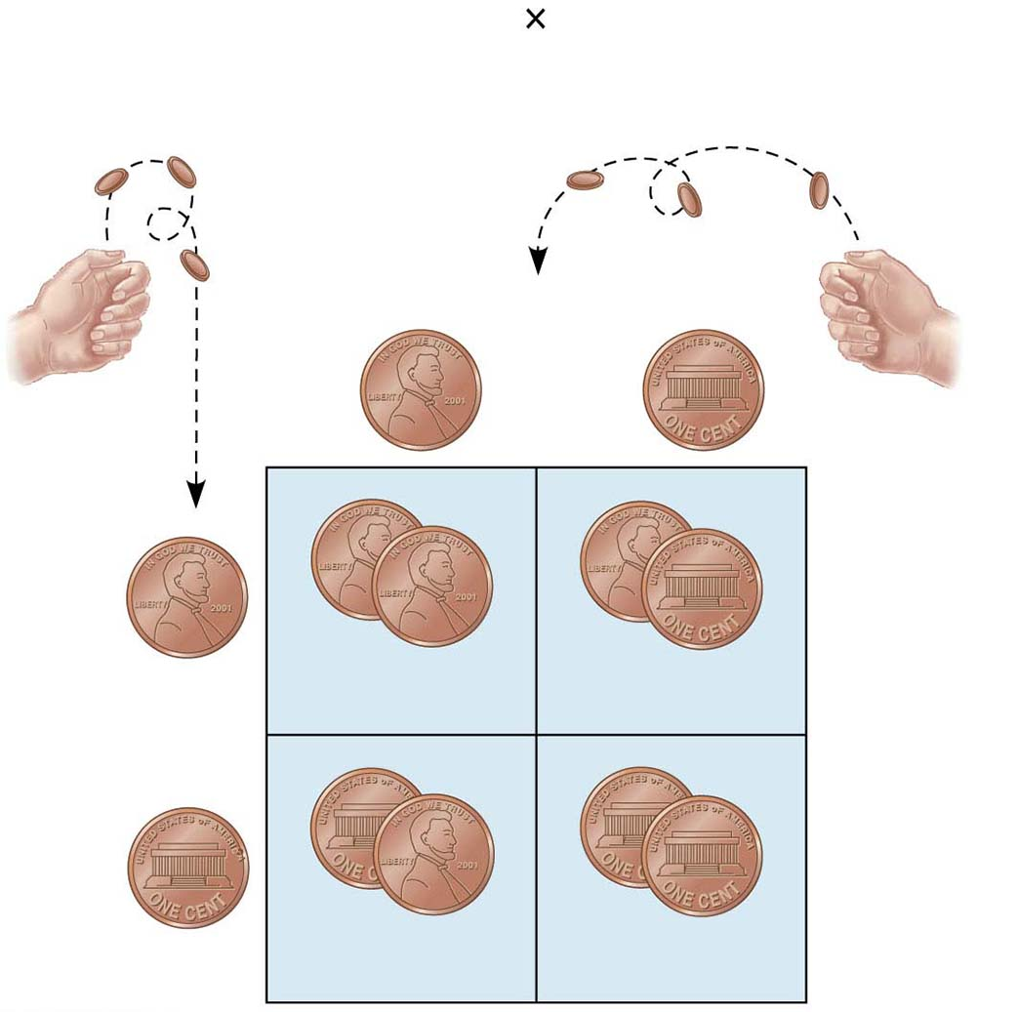
Figure 11.9
Rr
Rr
Segregation of
alleles into eggs
Segregation of
alleles into sperm
Sperm
1
R
1
r
2
2
R
R
1
R
R
r
2
1
4
1
4
Eggs
r
r
1
r
R
r
2
1
4
1
4
© 2016 Pearson Education, Inc.
Notes:
Figure 11.9 Segregation of alleles and fertilization as chance events

Slide 29
The addition rule states that the probability that any one of two or more mutually exclusive events will occur is calculated by adding together their individual probabilities
It can be used to figure out the probability that an F₂ plant from a monohybrid cross will be heterozygous rather than homozygous
© 2016 Pearson Education, Inc.
Notes:
29

Slide 30
Solving Complex Genetics Problems with the Rules of Probability
We can apply the rules of probability to predict the outcome of crosses involving multiple characters
A dihybrid or other multicharacter cross is equivalent to two or more independent monohybrid crosses occurring simultaneously
In calculating the chances for various genotypes, each character is considered separately, and then the individual probabilities are multiplied
© 2016 Pearson Education, Inc.
Notes:
30

Slide 31
For example, if we cross F₁ heterozygotes of genotype YyRr, we can calculate the probability of different genotypes among the F₂ generation
© 2016 Pearson Education, Inc.
Notes:
31

Slide 32
For example, for the cross PpYyRr × Ppyyrr, we can calculate the probability of offspring showing at least two recessive traits
© 2016 Pearson Education, Inc.
Notes:
32

Slide 33
Concept 11.3: Inheritance patterns are often more complex than predicted by simple Mendelian genetics
Not all heritable characters are determined as simply as the traits Mendel studied
However, the basic principles of segregation and independent assortment apply even to more complex patterns of inheritance
© 2016 Pearson Education, Inc.
Notes:
33

Slide 34
Extending Mendelian Genetics for a Single Gene
Advanced inheritance patterns…
Incomplete
Co
Sex linked
Multi Allele
Polygenic
© 2016 Pearson Education, Inc.
Notes:
34

Slide 35
Degrees of Dominance
Complete dominance occurs when phenotypes of the heterozygote and dominant homozygote are identical
In incomplete dominance, the phenotype of F₁ hybrids is somewhere between the phenotypes of the two parental varieties
In codominance, two dominant alleles affect the phenotype in separate, distinguishable ways
© 2016 Pearson Education, Inc.
Notes:
35

Slide 36
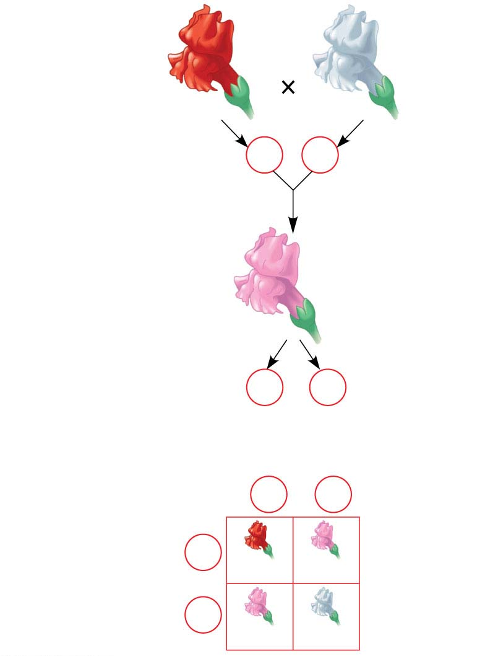
Figure 11.10-s3
P Generation
Red
C^{R}C^{R}
White
C^{W} C^{W}
Gametes
C^{R}
C^{W}
Pink
C^{R} C^{W}
F₁ Generation
Gametes
1
2
C^{R}
1
2
C^{W}
Sperm
F₂ Generation
1
2
C^{R}
1
2
C^{W}
1
2
C^{R}
Eggs
C^{R}C^{R}
C^{R}C^{w}
1
2
C^{W}
C^{R}C^{w}
C^{w}C^{w}
© 2016 Pearson Education, Inc.
Notes:
Figure 11.10-s3 Incomplete dominance in snapdragon color (step 3)

Slide 37
The Relationship Between Dominance and Phenotype
Alleles are simply variations in a gene’s nucleotide sequence
When a dominant allele coexists with a recessive allele in a heterozygote, they do not actually interact at all
For any character, dominant/recessive relationships of alleles depend on the level at which we examine the phenotype
© 2016 Pearson Education, Inc.
Notes:
37

Slide 38
Tay-Sachs disease is fatal; a dysfunctional enzyme causes an accumulation of lipids in the brain
At the organismal level, the allele is recessive
At the biochemical level, the phenotype (i.e., the enzyme activity level) is incompletely dominant
At the molecular level, the alleles are codominant
© 2016 Pearson Education, Inc.
Notes:
38

Slide 39
Frequency of Dominant Alleles
Dominant alleles are not necessarily more common in populations than recessive alleles
For example, one baby out of 400 in the United States is born with extra fingers or toes, a dominant trait called polydactyly
© 2016 Pearson Education, Inc.
Notes:
39

Slide 40
Multiple Alleles
Most genes exist in populations in more than two allelic forms
For example, the four phenotypes of the ABO blood group in humans are determined by three alleles of the gene: I^{A}, I^{B}, and i.
The enzyme (I) adds specific carbohydrates to the surface of blood cells
The enzyme encoded by I^{A} adds the A carbohydrate, and the enzyme encoded by I^{B} adds the B carbohydrate; the enzyme encoded by the i allele adds neither
© 2016 Pearson Education, Inc.
Notes:
40

Slide 41
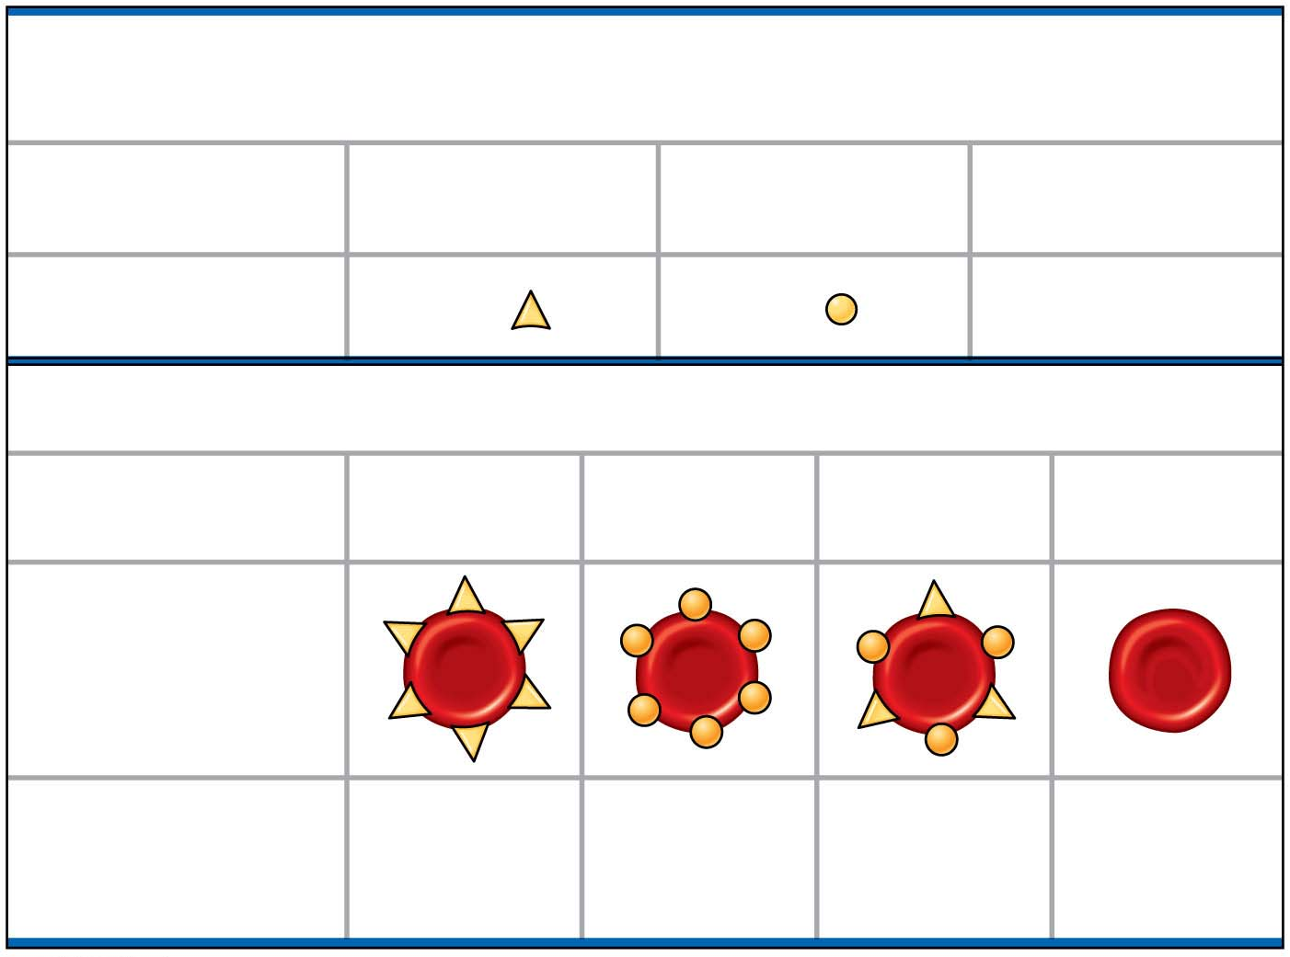
Figure 11.11
(a) The three alleles for the ABO blood groups and their carbohydrates
Allele
I^{A}
I^{B}
i
Carbohydrate
A
B
none
(b) Blood group genotypes and phenotypes
Genotype
I^{A} I^{A}
or
I^{A} i
I^{B} I^{B}
or
I^{B} i
I^{A} I^{B}
ii
Red blood cell
appearance
Phenotype
(blood group)
A
B
AB
O
© 2016 Pearson Education, Inc.
Notes:
Figure 11.11 Multiple alleles for the ABO blood groups

Slide 42
Extending Mendelian Genetics for Two or More Genes
Some traits may be determined by two or more genes
The gene products may interact
Alternatively, multiple genes could independently affect a single trait
© 2016 Pearson Education, Inc.
Notes:
42

Slide 43
Polygenic Inheritance
Quantitative characters are those that vary in the population along a continuum
Quantitative variation usually indicates polygenic inheritance, an additive effect of two or more genes on a single phenotype
Skin color in humans is an example of polygenic inheritance
© 2016 Pearson Education, Inc.
Notes:
43

Slide 44
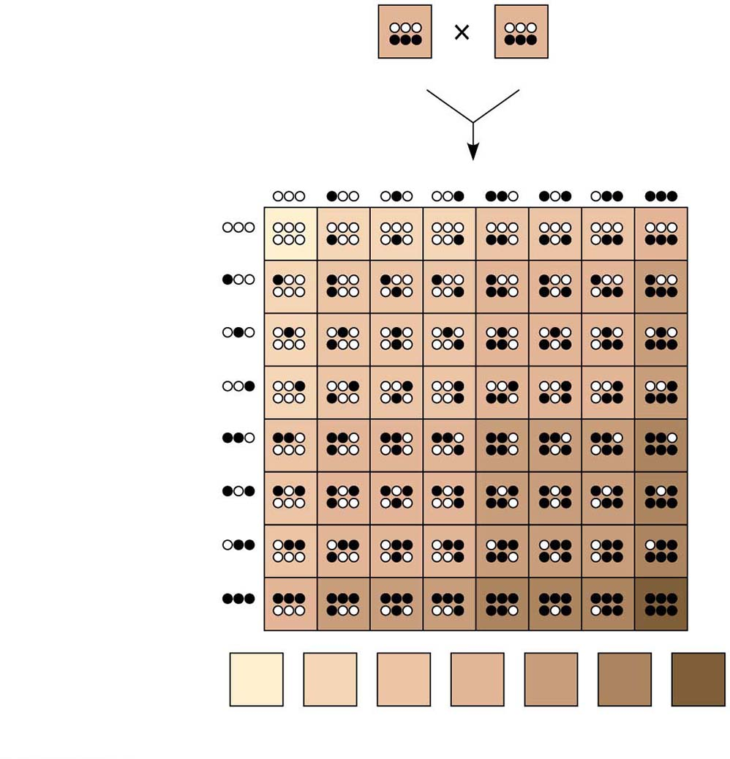
Figure 11.13
AaBbCc AaBbCc
Sperm
1
8
1
8
1
8
1
8
1
8
1
8
1
8
1
8
1
8
1
8
1
8
1
8
Eggs
1
8
1
8
1
8
1
8
Phenotypes:
Number of
dark-skin alleles:
1
64
6
64
15
64
20
64
15
64
6
64
1
64
0
1
2
3
4
5
6
© 2016 Pearson Education, Inc.
Notes:
Figure 11.13 A simplified model for polygenic inheritance of skin color

Slide 45
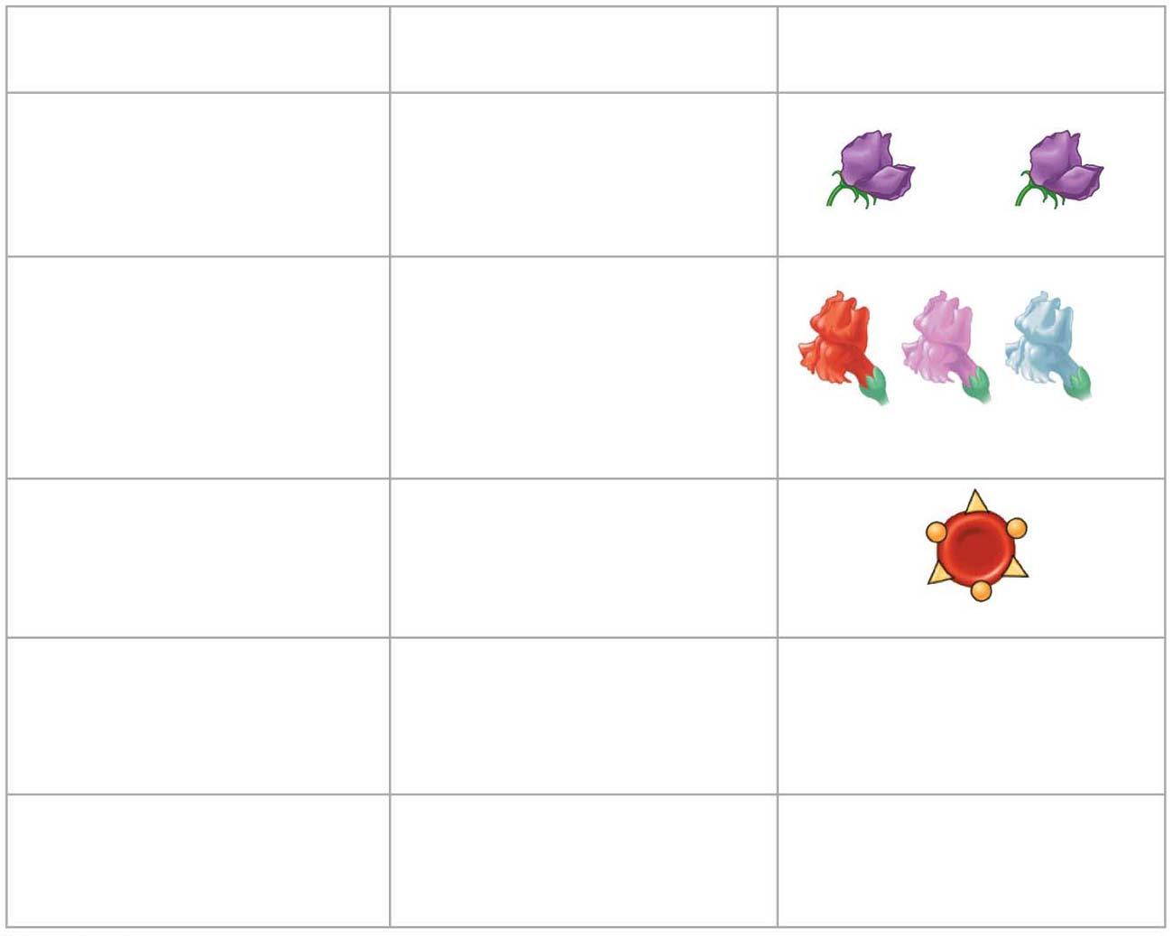
Figure 11.UN05
Relationship among
alleles of a single gene
Description
Example
Complete dominance
of one allele
Heterozygous phenotype
same as that of homo-
zygous dominant
PP
Pp
Incomplete dominance
of either allele
Heterozygous phenotype
intermediate between
the two homozygous
phenotypes
C^{R} C^{R}
C^{R} C^{W}
C^{W} C^{W}
Codominance
Both phenotypes
expressed in
heterozygotes
I^{A}I^{B}
Multiple alleles
In the population,
some genes have more
than two alleles
ABO blood group alleles
I^{A}, I^{B}, i
© 2016 Pearson Education, Inc.
Notes:
Figure 11.UN05 Summary of key concepts: single-gene Mendelian extensions

Slide 46
Nature and Nurture: The Environmental Impact on Phenotype
Another departure from Mendelian genetics arises when the phenotype for a character depends on environment as well as genotype
The norm of reaction is the phenotypic range of a genotype influenced by the environment
© 2016 Pearson Education, Inc.
Notes:
46

Slide 47
The phenotypic range is generally broadest for polygenic characters
Such characters are called multifactorial because genetic and environmental factors collectively influence phenotype
© 2016 Pearson Education, Inc.
Notes:
47

Slide 48
A Mendelian View of Heredity and Variation
An organism’s phenotype includes its physical appearance, internal anatomy, physiology, and behavior
An organism’s phenotype reflects its overall genotype and unique environmental history
© 2016 Pearson Education, Inc.
Notes:
48

Slide 49
Concept 11.4: Many human traits follow Mendelian patterns of inheritance
Humans are not good subjects for genetic research
Generation time is too long
Parents produce relatively few offspring
Breeding experiments are unacceptable
However, basic Mendelian genetics endures as the foundation of human genetics
© 2016 Pearson Education, Inc.
Notes:
49

Slide 50
Pedigree Analysis
A pedigree is a family tree that describes the interrelationships of parents and children across generations
Inheritance patterns of particular traits can be traced and described using pedigrees
© 2016 Pearson Education, Inc.
Notes:
50

Slide 51
Pedigrees can also be used to make predictions about future offspring
We can use the multiplication and addition rules to predict the probability of specific phenotypes
© 2016 Pearson Education, Inc.
Notes:
51

Slide 52
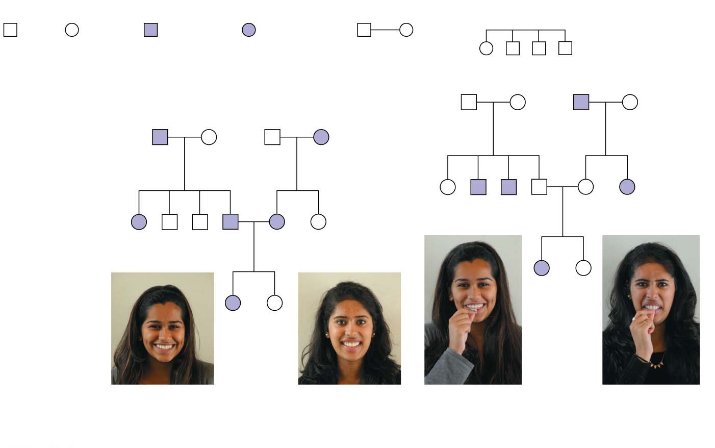
Figure 11.14
Key
Male
Female
Male with
the trait
Female with
the trait
Mating
Offspring, in
birth order
(first-born on left)
Tt
Tt
tt
Tt
1st generation
(grandparents)
Ww
ww
ww
Ww
2nd generation
(parents, aunts,
and uncles)
TT
or
tt
tt
Tt
Tt
tt
Tt
Ww
ww
ww
Ww
Ww
ww
3rd generation
(two sisters)
tt
TT
or
WW
ww
Tt
or
Ww
Widow’s peak
No widow’s peak Cannot taste PTC
Can taste PTC
(a) Is a widow’s peak a dominant or recessive trait?
(b) Is the inability to taste a chemical called PTC a dominant or recessive trait?
© 2016 Pearson Education, Inc.
Notes:
Figure 11.14 Pedigree analysis

Slide 53
Recessively Inherited Disorders
Many genetic disorders are inherited in a recessive manner
These range from relatively mild to life-threatening
© 2016 Pearson Education, Inc.
Notes:
53

Slide 54
The Behavior of Recessive Alleles
Recessively inherited disorders show up only in individuals homozygous for the allele
Carriers are heterozygous individuals who carry the recessive allele but are phenotypically normal
Most people who have recessive disorders are born to parents who are carriers of the disorder
© 2016 Pearson Education, Inc.
Notes:
54

Slide 55
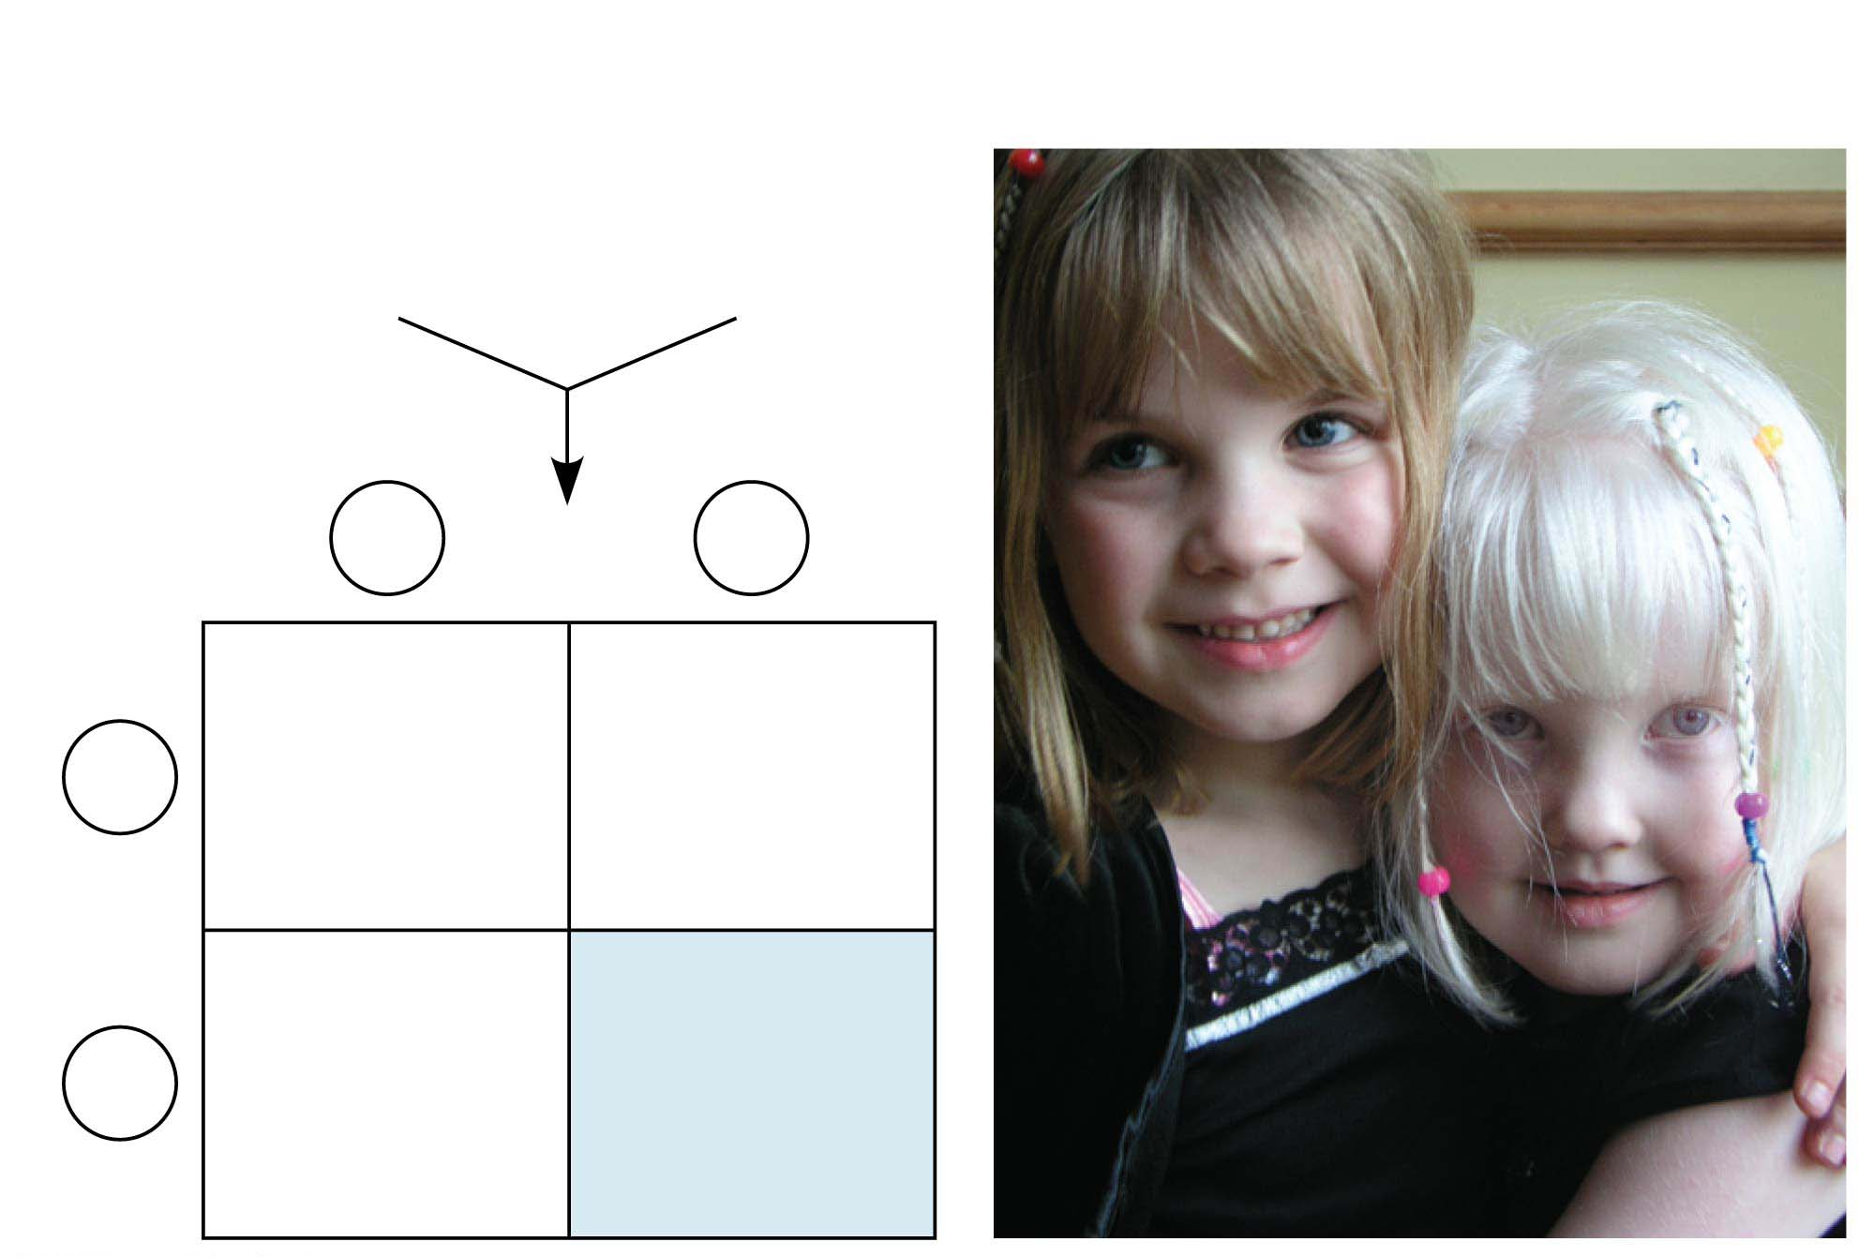
Figure 11.15
Parents
Normal
phenotype
Aa
Normal
phenotype
Aa
⋅
Sperm
A
a
Eggs
Aa
Carrier with
normal
phenotype
AA
Normal
phenotype
A
Aa
Carrier with
normal
phenotype
aa
Albinism
phenotype
a
© 2016 Pearson Education, Inc.
Notes:
Figure 11.15 Albinism: a recessive trait

Slide 56
If a recessive allele that causes a disease is rare, then the chance of two carriers meeting and mating is low
Consanguineous (between close relatives) matings increase the chance of mating between two carriers of the same rare allele
Most societies and cultures have laws or taboos against marriages between close relatives
© 2016 Pearson Education, Inc.
Notes:
56

Slide 57
Cystic Fibrosis
Cystic fibrosis is the most common lethal genetic disease in the United States, striking one out of every 2,500 people of European descent
The cystic fibrosis allele results in defective or absent chloride transport channels in plasma membranes leading to a buildup of chloride ions outside the cell
Symptoms include mucus buildup in some internal organs and abnormal absorption of nutrients in the small intestine
© 2016 Pearson Education, Inc.
Notes:
57

Slide 58
Sickle-Cell Disease: A Genetic Disorder with Evolutionary Implications
Sickle-cell disease affects one out of 400 African-Americans
The disease is caused by the substitution of a single amino acid in the hemoglobin protein in red blood cells
In homozygous individuals, all hemoglobin is abnormal (sickle-cell)
Symptoms include physical weakness, pain, organ damage, and even stroke and paralysis
© 2016 Pearson Education, Inc.
Notes:
58

Slide 59
Heterozygotes (said to have sickle-cell trait) are usually healthy but may suffer some symptoms
About one out of ten African-Americans has sickle-cell trait, an unusually high frequency of an allele with detrimental effects in homozygotes
Heterozygotes are less susceptible to the malaria parasite, so there is an advantage to being heterozygous
© 2016 Pearson Education, Inc.
Notes:
59

Slide 60
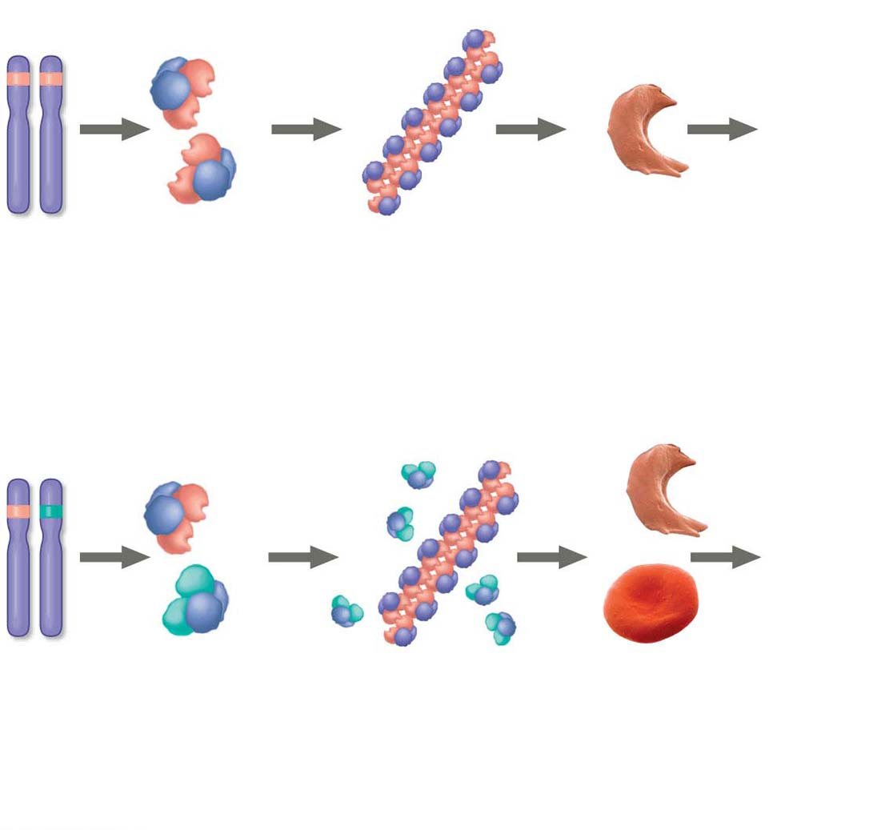
Figure 11.16
Sickle-cell alleles
Low
O₂
Sickle-
cell
disease
Sickle-cell
hemoglobin
proteins
Part of a fiber of
sickle-cell hemo-
globin proteins
Fibers cause sickled
red blood cells
(a) Homozygote with sickle-cell disease
Sickle-cell allele
Normal allele
Very
low
O₂
Sickle-
cell
trait
Sickle-cell
and normal
hemoglobin
proteins
Part of a sickle-cell
fiber and normal
hemoglobin proteins
Sickled
and normal
red blood cells
(b) Heterozygote with sickle-cell trait
© 2016 Pearson Education, Inc.
Notes:
Figure 11.16 Sickle-cell disease and sickle-cell trait

Slide 61
Dominantly Inherited Disorders
Some human disorders are caused by dominant alleles
Dominant alleles that cause a lethal disease are rare and arise by mutation
Achondroplasia is a form of dwarfism caused by a rare dominant allele
© 2016 Pearson Education, Inc.
Notes:
61

Slide 62
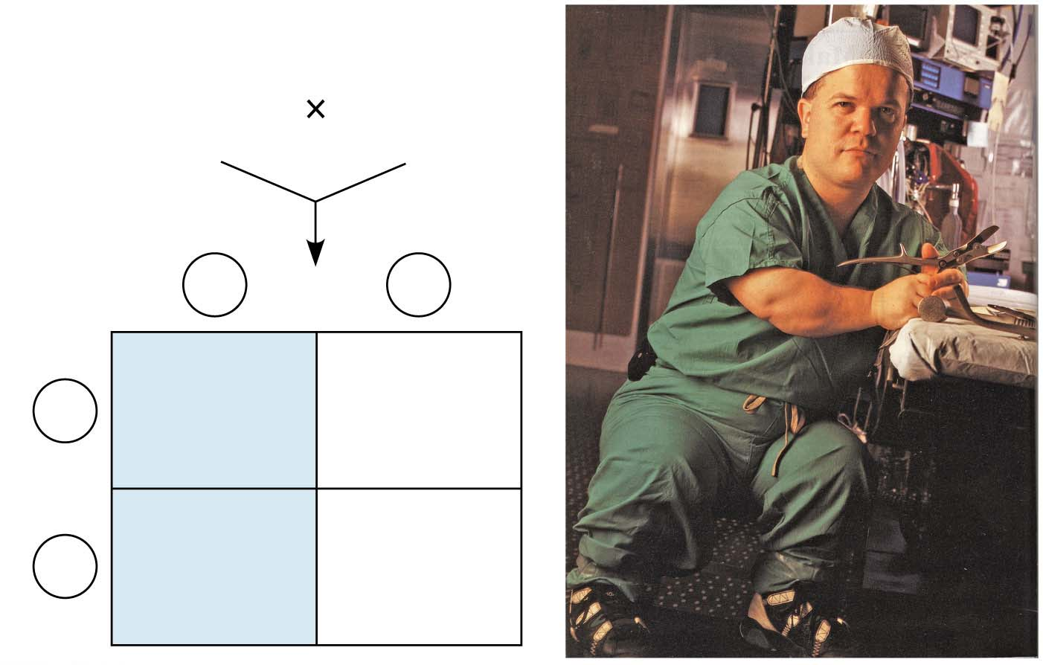
Figure 11.17
Parents
Dwarf
phenotype
Dd
Normal
phenotype
dd
Sperm
D
d
Eggs
Dd
Dwarf
phenotype
dd
Normal
phenotype
d
Dd
Dwarf
phenotype
dd
Normal
phenotype
d
© 2016 Pearson Education, Inc.
Notes:
Figure 11.17 Achondroplasia: a dominant trait

Slide 63
The timing of onset of a disease significantly affects its inheritance
Huntington’s disease is a degenerative disease of the nervous system
The disease has no obvious phenotypic effects until the individual is about 35 to 45 years of age
Once the deterioration of the nervous system begins the condition is irreversible and fatal
© 2016 Pearson Education, Inc.
Notes:
63

Slide 64
Multifactorial Disorders
Many diseases, such as heart disease, diabetes, alcoholism, mental illnesses, and cancer, have both genetic and environmental components
Lifestyle has a tremendous effect on phenotype for cardiovascular health and other multifactorial characters
© 2016 Pearson Education, Inc.
Notes:
64

Slide 65
Genetic Counseling Based on Mendelian Genetics
Genetic counselors can provide information to prospective parents concerned about a family history for a specific disease
Each child represents an independent event in the sense that its genotype is unaffected by the genotypes of older siblings
© 2016 Pearson Education, Inc.
Notes:
65

